Slide 1





Slide 2

Bandwagon
Advertisers make it seem that EVERYONE is buying this product, so you feel that you should buy it too.
For example, if a game said, “The best and most exciting game is sweeping the nation. ALL of your friends and neighbors are playing.”
This statement is intended to make you fee left out if you are not playing it.
Old Navy

Slide 3
Avant-Garde
This technique is the OPPOSITE of Bandwagon.
Advertisers make it seem that the product is so new that you will be the first one on the block to have it.
The idea is that only super-cool people like you will even know about the product.
Iggy’s grill
commercial

Slide 4
Testimonials
  Advertisers use celebrities and regular people to endorse products.
  For example, a famous actor urges consumers to buy a product.
  Pay close attention: sometimes the celebrity does not actually say that he or she uses the product.
Aveno Ad

Slide 5
Facts and Figures
  Statistics, percentages, and numbers are used to convince you that this product is better or more effective than another product.
  However, be aware of what the numbers are actually saying.
  What does “30 % more effective than the leading brand” really mean?
Toyota commercial

Slide 6
Transfer
This technique may be hard to spot.
To recognize it, you need to pay attention to the background of the ad or to the story of the commercial.
The transfer technique wants you to associate the good feelings created in the ad with the product.
For example, a commercial that shows a happy family gathered around a bowl of soup may want you to associate a feeling of comfort and security with their product.
Rolex commercial

Slide 7
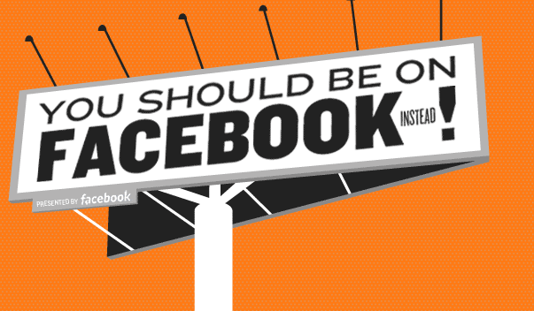
Bandwagon

Slide 8
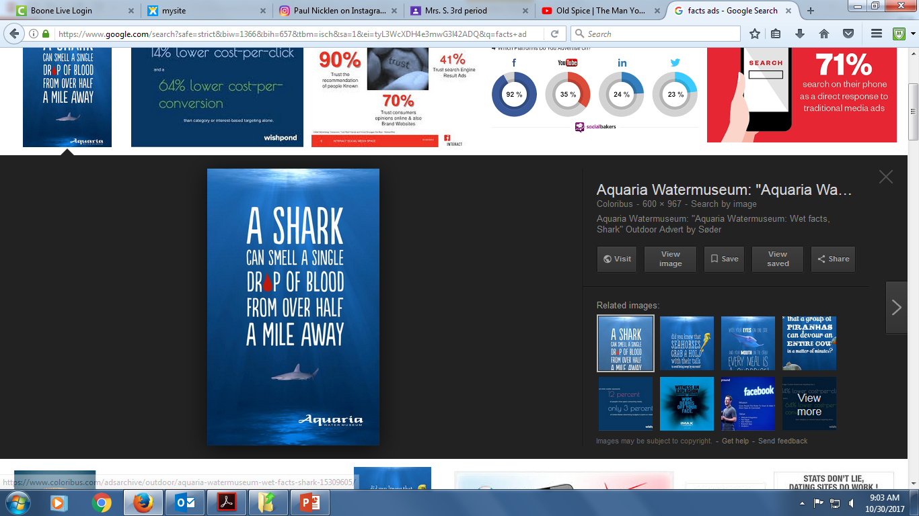
Facts and Figures

Slide 9

Testimonials

Slide 10
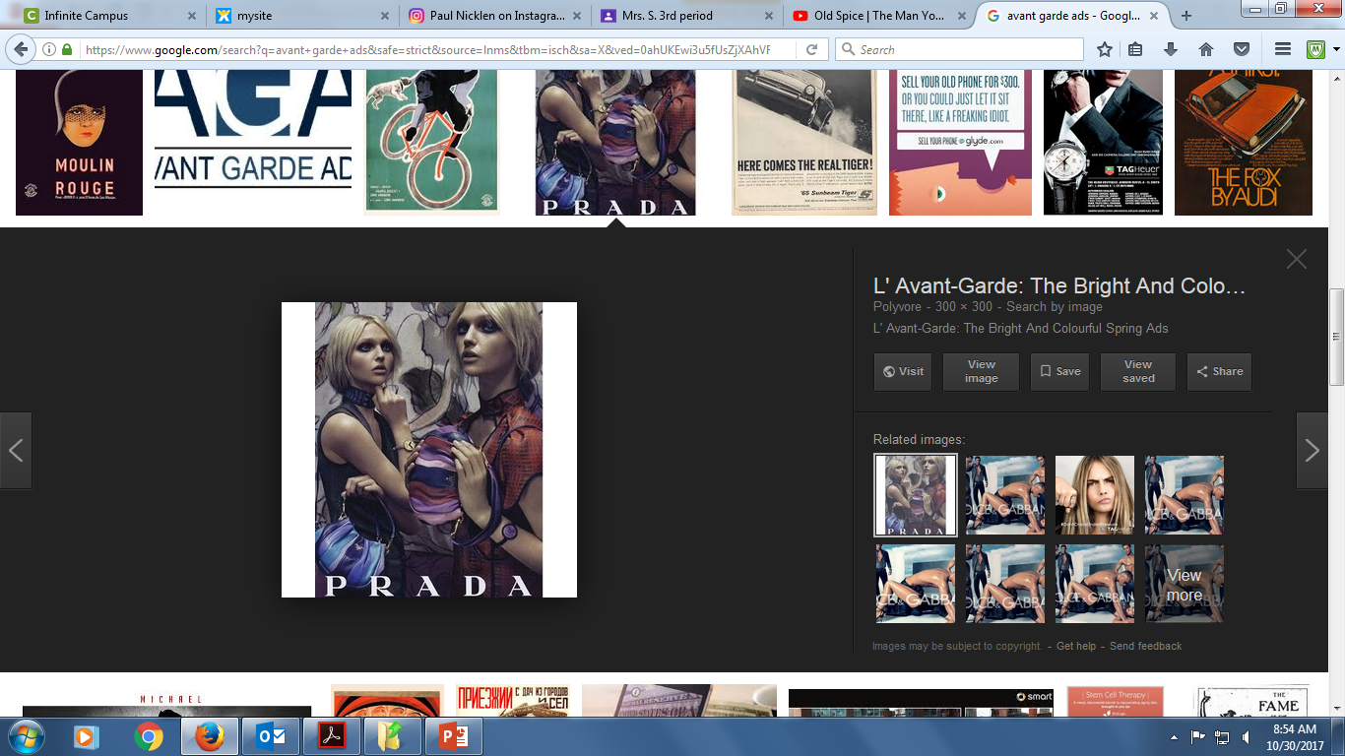
Avant-Garde

Slide 11
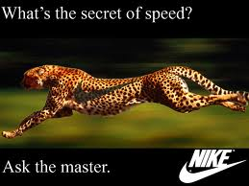
Transfer

Slide 12
Bonus:
Old Spice - transfer
Prius - Bandwagon

