Slide 1
Understanding Health &Wellness
Chapter 1

Slide 2
Essential Questions: In your Journal
Wednesday:
  What are some everyday decisions that teens face that can affect their health?
  What are some ways that people can take charge of their health?
Thursday:
  How do health-related choices you make today impact your future?
  What does it mean to be physically healthy?
Friday:
  What are some characteristics of a person who has good mental health?
  How does your attitude affect your Health?
Monday:
  What are some behaviors that put health at risk?
  Why is it important to know what behaviors put your health at risk?
  What are some situations in which you would speak up to help a friend avoid a risk behavior?
Tuesday:
  What does it mean to be Health Literate?
  What are some things you do each day to promote good health?

Slide 3
Group Assignment:
Write down TEN words/ideas that relate the following terms:
  Physical Health
  Social Health
  Mental/Emotional Health

Slide 4

Your Health Triangle
Health: the combination of physical, mental/emotional, and social-well being.
Health Class: Gives you knowledge and skills you need to take charge of your health for a lifetime.
KEY: Balance – if you concentrate too little on one area, the triangle can become unbalanced.
When your health triangle is balanced, you have a high degree of wellness- an overall state of well-being or total health

Slide 5
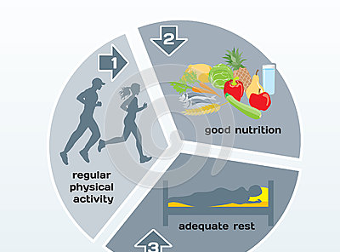
Physical Health
How well does your body function?
Do you have enough energy to perform your daily activities, deal with everyday stresses, and avoid injury?

Slide 6
What does it take to keep a healthy body?
eight to ten hours of sleep each night
Eat nutritious meals and drink eight cups of water each day
Engage in 30-60 minutes of physical activity every day
Avoid the use of tobacco, alcohol, and other drugs
Bathe daily, and floss and brush your teeth every day

Slide 7
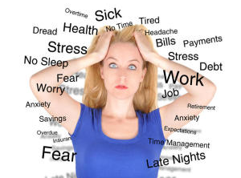
Mental and Emotional Health
Your feelings and your thoughts
A reflection of how you feel about yourself, how you meet the demands of your daily life, and how you cope with the problems that occur in your life.

Slide 8

People who are mentally and emotionally healthy:
Enjoy challenges that help them grow
Accept responsibility for their actions
Have a sense of control over their lives
Can express their emotions in appropriate ways
Usually can deal with life’s stresses and frustrations
Generally have a positive outlook
Make thoughtful and responsible decisions
Spiritual health: a deep-seated sense of meaning and purpose in life. Having a feeling of purpose and a sense of values.

Slide 9

Social Health
How well do you get along with other?
Your social network includes your family, friends, teachers, and other members of your community.
You don’t need lots of friends to have good social health – just a few solid friends!
Healthy relationships include:
Seeking and lending support when needed
Communicating clearly and listening to others
Showing respect and care for yourself and others

Slide 10
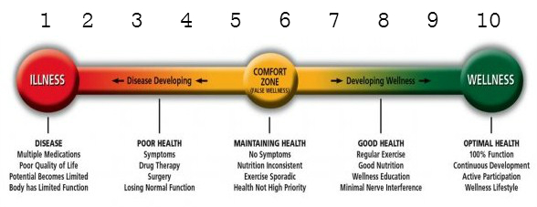
The Health Continuum
Your Health and Wellness are ALWAYS changing
What are some actions or events that could positively or negatively change a person’s health?

Slide 11
What affects your health?
Lesson 2

Slide 12
What affects your Health?
 | Define | How does this affect your health?
Heredity
Environment
Attitude
Behavior
Media
Technology

Slide 13
What affects your Health?
 | Define | How does this affect your health?
Heredity | All the traits that were biologically passed on to you from your parents | Diseases and health conditions can be passed down from your parents & grandparents. Important to ask questions so that you can take preventative measures. Example: Diabetes, cancer, etc.

Slide 14
P
Environment | The sum of your surroundings, including the physical places that you live and the people who make up your world. culture
Physical Environment | Neighborhood & school safety Air and water quality Availability of parks, recreational facilities, and libraries Access to medical care | What factors in your physical environment can you control?
Social Environment | All the people who surround you, including your family and your peers. | How can your family and peers affect your health?
Cultural Environment | The collective beliefs, customs, and behaviors of a group (ethnic group, community, nation) Includes your language, foods you eat, spiritual beliefs, and traditions you practice | How can your culture affect your health?

Slide 15
Factors
Attitude | The way you view situations. Optimistic people usually have better health than pessimists! | How can you attitude affect your health?
Behavior | The one factor you have CONTROL over – your actions! | How can your behavior affect your health in a positive and negative way?
Media & Technology | Media- various methods for communicating information Technology- content it is delivered: radio, television, internet, printed materials. | How can the media affect your health? Make sure you check your source! .gov or .edu Look for HONcode

Slide 16
Lesson 3
Health Risks & Your Behavior

Slide 17
Risk Behaviors: actions that can potentially threaten your health or the health of others
Risk Behaviors
Tobacco Use
Unhealthy dietary behaviors
Inadequate physical activity
Alcohol and other drug use
Sexual behaviors that may result in HIV infection, other sexually transmitted diseases, and unintended pregnancies
Behaviors that contribute to unintentional injuries and violence
Not using safety belts

Slide 18
Cumulative Risks: Risks that add up over time; related risks that increase in effect with each added risk.
Drinking & Driving
Smoking over time
Speeding
Texting and driving
Tanning

Slide 19
Group Activity: Create a PSA
A PSA (Public Service Announcement is a short, informative announcement that shares important information with the public. PSAs are often aired on television and radio. Many PSAs covey information about health behaviors.
Work in small groups to write a 30-60 commercial PSA that promotes a behavior that reduces a health risk, such as wearing a seatbelt or avoiding tobacco.
  What is your thesis (point you are going to make in your speech)?
  How will you grab the readers attention?
  What facts will you include in your speech?
  What solutions or actions will you mention to reduce this health risk?
  How will you end your speech?
Record your PSA using an electronic device and upload your video to youtube – share the video with CoachAngelaBrunner@gmail.com
Label with last name_period_year SO Brunner_5th_17
We will share them with the class! *Best video receives a prize!!!!!!!!!!!!!!!!!

Slide 20
Getting Started
4. Grab your audience's attention. You might use visual effects, an emotional response, humor, or surprise to catch your target audience. Be careful, however, of using scare tactics. Attention getters are needed, but they must be carefully selected. For example, when filming a PSA about controlling anger, a glass-framed picture of a family can be shattered on camera. This was dramatic, but not melodramatic. Staging a scene between two angry people to convey the same idea is more difficult to do effectively.
5. Create a script and keep your script to a few simple statements. A 30-second PSA will typically require about 5 to 7 concise assertions. Highlight the major and minor points that you want to make. Be sure the information presented in the PSA is based on up-to-date, accurate research, findings and/or data.
6. Storyboard your script.
7. Film your footage and edit your PSA.
8. Find your audience and get their reaction. How do they respond and is it in the way you expected? Your goal is to call your audience to action. Are they inspired?
1. Choose your topic. Pick a subject that is important to you, as well as one you can visualize. Keep your focus narrow and to the point. More than one idea confuses your audience, so have one main idea per PSA.
2. Time for some research - you need to know your stuff! Try to get the most current and up to date facts on your topic. Statistics and references can add to a PSA. You want to be convincing and accurate.
3. Consider your audience. Are you targeting parents, teens, teachers or some other social group? Consider your target audience's needs, preferences, as well as the things that might turn them off. They are the ones you want to rally to action. The action suggested by the PSA can be almost anything. It can be spelled out or implied in your PSA, just make sure that message is clear.

Slide 21
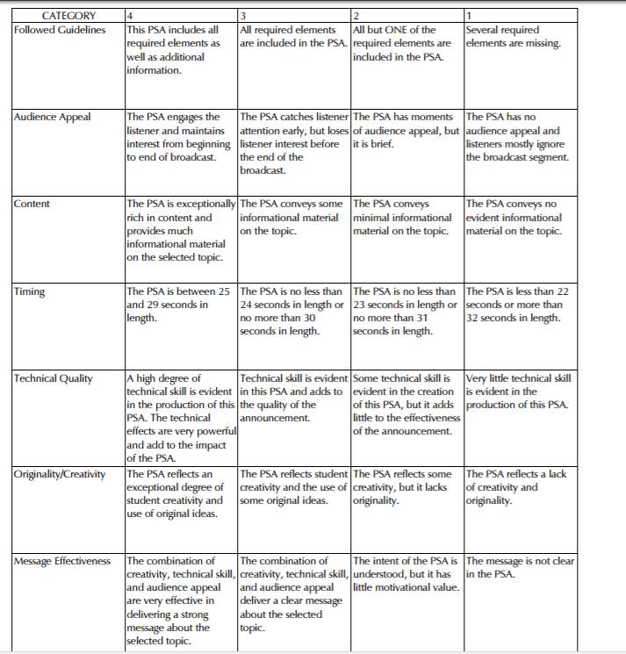
PTSA RUBRIC

Slide 22
Drinking While Driving Suicide Prevention
Anger Management Alcohol Adopt-A-Pet
Smoking Exercising Child Abuse
Drugs Nutrition Fighting
Stress management Stay in School
Steroids Seat Belt Law
Road Rage Car safety Child Abuse
Littering Sportsmanship
Guns Shop Lifting
Domestic Abuse School Violence
Peer Pressure Gambling Teasing
Distracted Driving
Helmet Safety Racism
Sex Trafficking Warning Alcoholics Anonymous
Be a Mentor Gangs
Fire Safety Mental Health Theft
Child Abuse
Crossing Streets Fake I.D. Vandalism
Volunteering Speed Limit
Addiction Selling to minors
Graffiti Forgery
Stranger Alert Hate Crimes Home Alone Tips
Verbal Abuse Adoption Homeless
Rioting Water Conservation Carpooling
Energy Conservation Handicap Help
Rave party warnings Noise pollution Passenger Safety
New Parent Help Censorship Animal Abuse
Parental Advisory Talk to your parents Talk to your Kids
Dangers on the Internet

Slide 23
How to avoid or reduce risks
Protective factors are people or values that will help you become successful.
  Positive Role Models- peers, or others that a young person looks up to.
  Positive Values- are beliefs and standards of conduct that you find important.
  Prevention: taking steps to keep something from happening (regular medical and dental check ups)
  Abstinence: a deliberate decision to avoid high-risk behaviors, including sexual activity and the use of alcohol, tobacco, and other drugs.

Slide 24
Lifestyle Factors
Personal habits or behaviors related to the way a person lives
  Getting eight hours of sleep each night
  Starting each day with a healthy breakfast
  Eating a variety of nutritious foods each day
  Being physically active for 30 to 60 minutes most days of the week
  Maintaining a healthy weight
  Abstaining from smoking or using other tobacco products
  Abstaining from the use of alcohol or other drugs

Slide 25
Lifestyle Survey
Assignment: Create a Survey of the Important lifestyle factors and survey 4 different advisement classes (Freshman, Sophomores, Juniors, and Seniors)
Step 1: Create 9 different multiple choice questions (one for each lifestyle factor)
Step 2: create an anonymous survey (ask for gender and grade only) using google forms.
Step 3: Each student in the group is responsible for having 15 different people take the survey. You must get a sample from all GRADES
Step 4: Graph your results on a poster board
DO NOT WRITE NAME
Gender:
Grade:
1. How many hours of sleep do you get:
A. 4-6
B. 6-7
C. 8-10
D. 10-12
2. Do you eat a nutritious breakfast?
A. Never- I don’t eat breakfast
B. No - I only eat processed food (poptarts)
C. Sometimes
D. Always

Slide 26
The Importance of Health Education
In 2012, the US spent an average of $8,915 per person on health care, reaching a total of $2.8 trillion
US health spending reached $3.2 trillion in 2015, or $9,990 per capita, and accounted for 17.8% of gross domestic product (GDP).
Federal spending increased by $75.4 billion, or 8.9%. Federal subsidies for ACA marketplace premiums and cost sharing accounted for $17.3 billion, while an additional $38.5 billion was spent on Medicaid.
The growth rate on household spending nearly doubled from 2.6% in 2014 to 4.7% in 2015. Households' contribution to employer-sponsored private health insurance premiums represented $16.1 billion of the $40.2 billion increase, due in part to increased enrollment.
Spending on prescription drugs increased by $26.7 billion, or 9.0%. Spending on new brand-name drugs was the primary driver in the growth.
Much of that expense could be avoided if people made healthier decisions about the way they live, adopted health-promoting habits, and took responsibility for maintaining their wellness.
Educating the public is key to creating a healthier nation
Health Education includes: providing accurate health information and teaching health skills to help people make healthy decisions.
Read more: http://www.chcf.org/publications/2014/07/health-care-costs-101#ixzz3id8w935Z

Slide 27

Healthy People
I
Every decade, the Healthy People initiative develops a new set of science-based, 10-year national objectives with the goal of improving the health of all Americans.
A health disparity is a health difference that is closely linked with social, economic, or environmental disadvantage.
In December 2010, the Department of Health and Human Services launched Healthy People 2020, which has four overarching goals:
Attain high-quality, longer lives free of preventable disease, disability, injury, and premature death;
Achieve health equity, eliminate disparities, and improve the health of all groups;
Create social and physical environments that promote good health for all; and
Promote quality of life, healthy development, and healthy behaviors across all life stages.
http://www.cdc.gov/nchs/healthy_people/hp2020/hp2020_topic_areas.htm
HEALTHY PEOPLE is a nationwide health promotion and disease prevention plan designed to serve as a guide for improving the health of all people in the U.S.

Slide 28
Becoming Health Literate
  To become an informed individual who can make sound health decision, one must:
  Know where to find health information
  Decide if the information is correct
  Assess the risks and benefits of treatment
  Figure out how much medicine to take
  Understand test results
  A health-literate person knows how to find and use reliable health information
  Health Literacy describes an individual’s capacity to obtain, interpret, and understand basic health information and services and use such information and services in ways to promote his or her health and wellness.

Slide 29
Qualities of a Health-Literate Person:
A critical thinker and problem-solver:
A responsible, productive citizen: someone who acts in a way that promotes the health of the community; shows respect for themselves and others
A self-directed learner: someone who searches for health information to make health-related decisions- can determine if health information is reliable, accurate, or current.
An effective communicator: person who is able to express health knowledge in a variety of ways

Slide 30
Go ahead and research!
http://www.healthypeople.gov/2020/topicsobjectives2020/default
Step 1: Chose a topic from the Healthy People 2020 that interests you (use link above for google to get to link)
Step 2: Provide the following information on your topic
Goal
Overview
Name 2 or 3 objectives
Why are they important?
What is important to understand about your topic?
What are the emerging issues, if any?
Step 3: Find a current article from a different reliable source and share 2-3 sentences, expressing the main idea!

