Slide 1
Password enabled security system and Motion Detection
Presented BY-
Swapnil Roy(510714008)
Sarthak shekhar roy paul(510714010)
Pratim Dashmahapatra(510714010)

Slide 2
Why this project?
To increase the security network of mainly residential areas where occurrences of theft and other intruder incidents are common.
Manual security service is not upto the mark.
Technologies like biometric detection and face recognition are not viable due to economic difficulties and circuit complexities.
To establish a secure and simple security system.
To integrate both password generation mechanism and sensor detection together.

Slide 3
Outline and highlights
This is a password protected system which is used to detect the person entering the confined area in question.
This is followed by ultrasonic and PIR motion sensing for automated lights.
The ultrasonic sensor is used to detect the initial presence of the intruder.
It is instrumental in the opening of the door.
The motion sensors help to detect the motion of the person inside the room.
The opening of the door is signaled by the green LED.
The motion sensors are represented by other LEDS.
The red LED represents wrong password ; hence intruder.

Slide 4
Equipments Used
Arduino uno R3 board based on microcontroller AT mega328 chip.
Hc-SR04 ultrasonic sensors using SONAR to determine distance of objects.
PIR Motion Sensor Board using infrared radiation sensing.
LEDS and Breadboards.

Slide 5
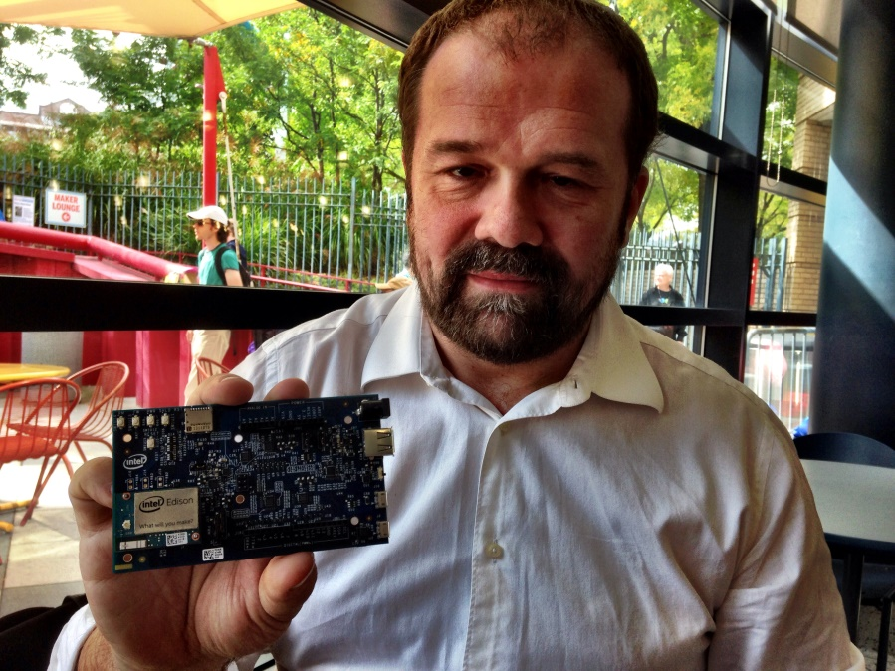
Arduino
Overview:
Arduino- i) Open source computer hardware and software company.
ii) Manufactures microcontroller based kits for digital devices and interactive
objects.
iii) Provides an inexpensive and easy way to create devices that interact with their
environment using sensors and actuators.
Chief designer Massimo Banzi

Slide 6
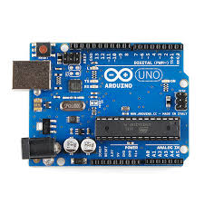
Arduino Uno R3 Board
Most widely used variant of the Arduino.
Features:
i) Atmega 328P microcontroller manufactured by AtMel corporation.
ii) Input voltage - 7-12V
iii) 14 Digital I/O Pins (6 PWM outputs)
iv) 6 Analog Inputs
v) 32k Flash Memory
vi) 16Mhz Clock Speed
Additional Components:
i) USB connection
ii) Power Jack
iii) ICSP Header
iv) Reset Button

Slide 7
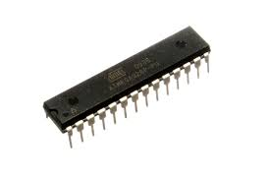

ATmega 328P Microcontroller
Brain of the Arduino Board
Belongs to family of AVR microcontrollers.
Manufactured by the Atmel corporation in 1996.
Uses on-chip flash memory for program storage.
Features:
Flash memory - 32 Kbytes
Pin Count - 32
Max. Operating Freq. - 20 MHz

Slide 8
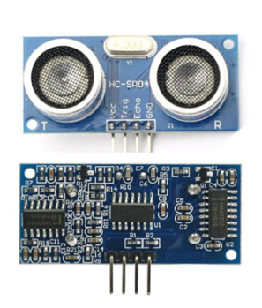
HC-SR04 Module
Uses sonar to determine distance to an object.
Operation is not affected by sunlight or black material.
Consists of ultrasonic transmitter and receiver module.
Features:-
i) Power Supply : +5V DC
ii) Effectual Angle : <15°
iii) Ranging Distance : 2cm – 400 cm
iv) Measuring Angle : 30 degree
Pins:-
VCC : +5V DC
Trig : Trigger (INPUT)
Echo : Echo (OUTPUT)
GND : Ground

Slide 9
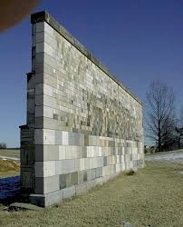
HC-SR04 Module
Working Principle:-
Emitted Wave
Reflected Wave
Ultrasonic Sensor
Obstacle

Slide 10
Algorithm
The sequence-
Right
Wrong
Enter password
the
Green Light
Red light
Green light is on , as door opens . Entrance due to ultrasonic sensors and other lights due to PIR motion sensors
Intruder alarm is on
Exit, all lights switched off

Slide 11
The Mechanism
In this project, we establish a serial communication between MATLAB and Arduino. At the entry point of the room or the door, we establish the Password Authentication process using MATLAB. If it is correct, then the Green LED lights up in our circuit which signifies that the door has opened. His presence in the room is detected by an ultrasonic sensor at the entrance and lights present near the door light up. As he/she moves further into the room, his motion is detected by PIR motion sensors and the lights are switched ON one by one as he/she strides through. Then when he/she leaves the room, the lights are switched off at once. This is how the mechanism takes place.

Slide 12
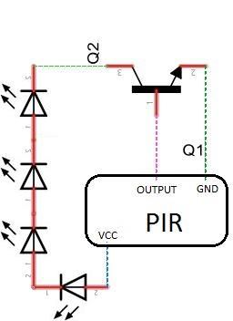
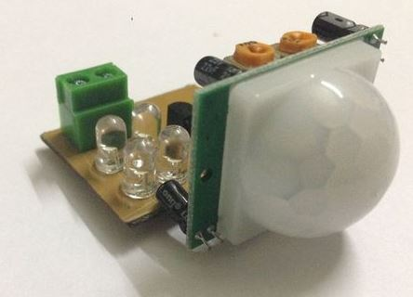
PIR related Diagrams
PIR Motion Detector Circuit
A PIR Motion Sensor

Slide 13
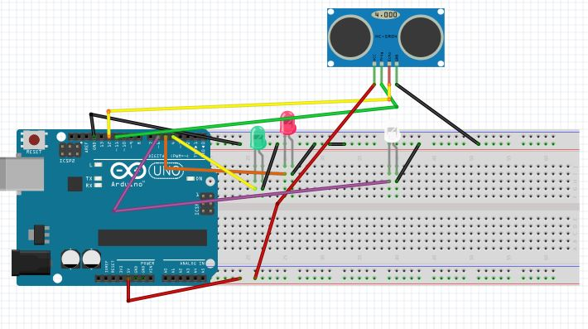
Arduino Circuit Diagram

Slide 14
MATLAB Code
answer=12345; % this is where we'll store the user's Password
arduino =serial('COM5','BaudRate',9600); % create serial communication object on port
COM5 (Where Arduino is connected)
fopen (arduino); % initiate arduino communication
while answer
fprintf (arduino, '%s', answer); % send answer variable content to arduino
answer=input('Enter value 12345 (12345=ON, 0=EXIT PROGRAM): '); % ask user to
enter value for variable answer
end
fclose (arduino); % end communication with Arduino

Slide 15
Arduino Code
Int matlabData;
#define trig Pin 11
#edefine echoPin 12
int ultrasono (int duration, int distance);
long distance,duration;
int led = 4; int led1 = 5; int led2 = 6;
void setup() {
pinMode (trigPin, OUTPUT);
pinMode (echoPin, INPUT);
pinMode (led, OUTPUT);
pinMode (led1, OUTPUT);
pinMode (led2, OUTPUT);
Serial.begin (9600); }
void loop() {

Slide 16
while(Serial.available()> 0)
{ matlabData=Serial. read(); // read data
if(matlabData==1)
{ digitalWrite(led , HIGH); // turn green light on
distance=ultrasono(duration, distance);
if(distance <= 5)
digitalWrite(led2, HIGH);
else
digitalWrite(led2, LOW); }
else if(matlabData==2)
{ digitalWrite(led1, HIGH); // turn red light on
digitalWrite(led,LOW); } // turn green led off
} }

Slide 17
int ultrasono(long duration, long distance)
{ digitalWrite(trigPin, LOW);
delayMicroseconds(2);
digitalWrite(trigPin, HIGH);
delayMicroseconds(10);
digitalWrite(trigPin, LOW);
duration = pulseIn(echoPin, HIGH);
distance = (duration/2) / 29.1;
return distance; }

Slide 18
Limitations and Scope
The PIR sensors were not that effective in detection due to use of less expensive sensors.
Sometimes the distance at which an object is detected around an ultrasonic sensor varies practically from it’s theoretical value. As a result, errors in calculation takes place.
There is a delay in serial communication between MATLAB and Arduino coding.
Easing on the economic factor, more expensive sensors would yield better results.
An allowance regarding distance and sensor detection should be made.
Without using MATLAB, OpenCV, Java or Python based password authentication techniques can be used.

Slide 19
BIBLIOGRAPHY
http://www.instructables.com/id/Make-An-Simple-Motion-Sensor-Light-PIR/?ALLSTEPS
http://allaboutee.com/2011/07/04/how-to-send-data-from-matlab-to-your-arduino
http://in.mathworks.com
http://www.arduino.cc

Slide 20
Acknowledgement
This work was inspired and supported in part by Prof. Santanu Das, Professor and Head of the Department, Department of Electronics and Telecommunication Engineering, Indian Institute of Engineering Science and Technology, Shibpur. Sincere thanks to all the lab assistants for helping us use the lab facilities for our project.
THANK YOU

