Slide 1
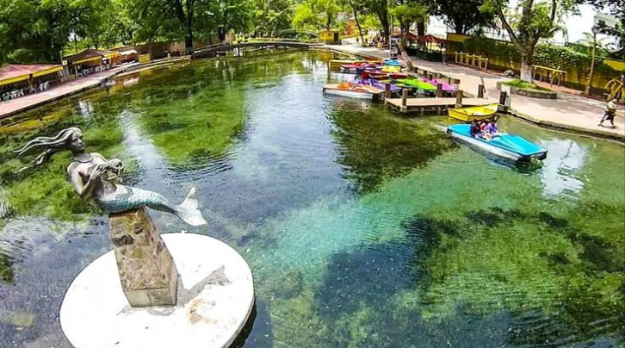
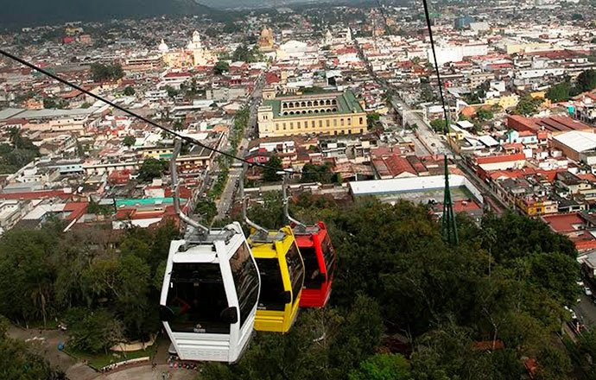
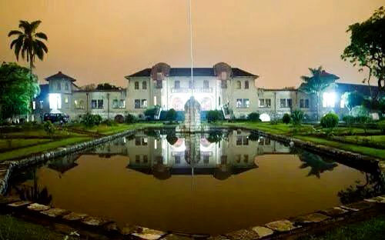
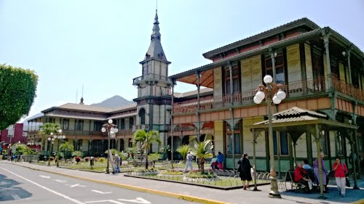
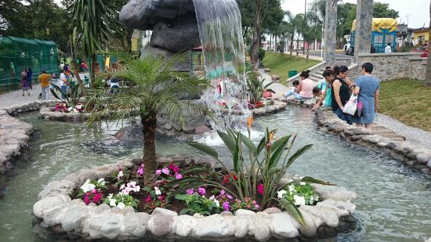
HOTELES EN ORIZABA
Holiday Inn Orizaba (Hotel Sede) | https://www.ihg.com/holidayinn/hotels/us/es/orizaba/veroz | 01 800 000 04 04
Mision Orizaba ex Casa Real | http://www.hotelesmision.com.mx/e_veracruz_orizaba.php | 01 272 106 9294 Whatsapp 2721549648
Casa de la iaia | http://casadelaiaia.com/portal/es/evening-hotel/street-view/ | 01 (272) 726 4862 / 726 3747 Whatsapp 272 190 9572
Tres79 Hotel Boutique | http://www.tres79hotelboutique.com/ | 01 (272) 725 2379
Haus | http://www.hoteleshaus.com/ | 01 (272) 72 410 00
Ha | http://www.hotelesha.com.mx/index.php/es/ | 01 (272) 72 5 36 99 ó 01 (272) 72 5 34 1
L'Orbe | https://www.hotellorbe.com/ | 01 (272) 72 5 50 33
HAUS Express | https://www.hoteles.com/ho670456/hoteles-haus-express-orizaba-mexico/ | 01 272 724 4000
Orizaba Inn | http://www.hotelorizabainn.com.mx/ | 01(272)-72-50626
Hotel Trueba | http://www.hoteltrueba.com/ | 01 800 7018314 Whatsapp 2721031464
Hotel Alameda |  | 01 (272) 72 5 71 43 Whatsapp 044 272 135 00 56

Slide 2
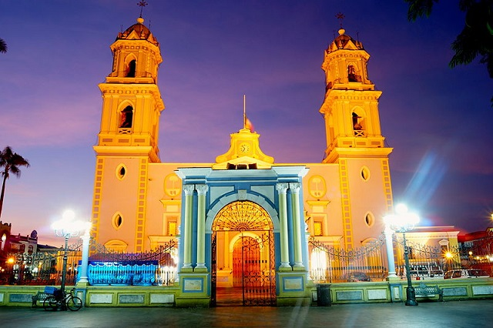
HOTELES EN CORDOBA
Villas Layfer | http://www.hoteleslayfer.com/ | 01 271 716 0950
Layfer Express | http://www.hoteleslayfer.com/ | 01 271 405 1500
Layfer | http://www.hoteleslayfer.com/ | 01 271 714 0505
Suites Layfer | http://www.hoteleslayfer.com/ | 01 271 717 3200
Villa Florida Hotel & Suites | http://villaflorida.com.mx/cordoba/ | 01 800 10 VILLA 01(271) 716.33.33
El Pueblito | https://www.hotelpueblitofortin.com/ | 01 271 713 1088
Comfort Inn Córdoba | http://www.comfortinncordoba.com/ | 01 271 718 0777
Palacio | http://www.hotelpalaciocordoba.com.mx/ | 01 271 712 2188
HB Cordoba | http://www.hotelbello.com/hbcordoba/ | 01 271 714 2800
Posada Loma | https://www.posadaloma.com/ | 01 271 713 0658
Posada Pastora | http://www.hotelpastora.com/ | 01 271 712 8882

