Slide 1
A Brief Survey of DSM5, ICD-10-11 and PDM: Diagnostic and Treatment Issues
Robert M. Gordon, Ph.D. ABPP in Clinical Psychology and Psychoanalysis

Slide 2
Outline
Learn what is a diagnosis and why diagnose.
Examine Ethical Concerns.
Discover the issues with the DSM 5.
Learn why the ICD-10 and ICD-11 are what really matter.
Find out how the PDM informs about
treatment more than any other taxonomy.
6. Participate in a voluntary exercise on diagnostic formulation.

Slide 3
The term “Diagnosis” is derived from Greek- meaning a distinguishing, to perceive, to know thoroughly.

Slide 4

What is Missing?

Slide 5
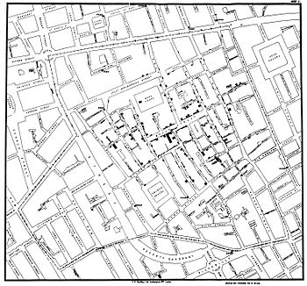
In 1854, after a major outbreak of cholera struck London, John Snow, a physician linked the outbreak to contaminated water from this hand pump on Broadwick Street. He removed the handle and stopped the epidemic

Slide 6
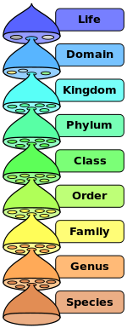
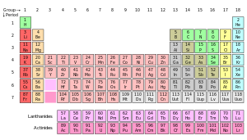
Which Taxonomic Organization for Mental and Behavioral Science?
Like a Biological Organization?
Like a Periodic Table?

Slide 7
Start with a good diagnostic formulation
“Once I have a good feel for the person, the work is going well, I stop thinking diagnostically and simply immerse myself in the unique relationship that unfolds between me and the client…one can throw away the book and savor individual uniqueness.”
Nancy McWilliams (2011) Psychoanalytic Diagnosis: Understanding Personality Structure in the Clinical Process, Second Edition.

Slide 8
Main Reasons for Diagnosing
1. Its usefulness for treatment planning. “Understanding character styles help the therapist be more careful with boundaries with a histrionic patient, more pursuant of the flat affect with the obsessional person, and more tolerant of silence with a schizoid client.”
2. Its implications for prognosis. “Realistic goals protect patients from the demoralization and therapist from burnout.”

Slide 9
Why Diagnose?
3. Its value in enabling the therapist to convey empathy.
Once one knows that a depressed patient also has a
borderline rather neurotic level personality structure, the
therapist will not be surprised if during the second year of
treatment she makes a suicide gesture.
Or once a borderline client starts to have hope of real change,
that the borderline client often panics and flirts
with suicide in an effort to protect himself from
traumatic disappointment.

Slide 10
Why Diagnose?
Its role treatment, ex: in reducing the probability that certain easily frighten people will flee from treatment. It is helpful for the therapist to communicate to hypomanic or counter-dependent patients an understanding of how hard it may be for them to stay in therapy.

Slide 11
Why Diagnose?
5. Its value in risk management. Often therapists mistakenly use a presenting symptom as the only diagnosis and missed the borderline level of personality or psychopathic personality and got into trouble.
6. It’s value in process and outcome research.

Slide 12
Risk Factors in Litigious Patients
Borderline Personality Organization
Psychopathic traits
History of acting out

Slide 13
Ethical Implications of a Diagnosis
“A diagnosis has clinical, personal and social significance.
In the clinical context, a correct diagnosis provides a basis for effective treatment. An incorrect diagnosis may delay or impede effective treatment or even exacerbate a situation by inviting inappropriate treatment.
A diagnosis has personal significance insofar as it can become central to how a person experiences him- or herself, an incorrect diagnosis can be crippling.
A diagnosis has profound social implications. Social judgments are made in response to a diagnosis, and diagnoses can play an important role in awarding entitlements and determining placements.”

Slide 14


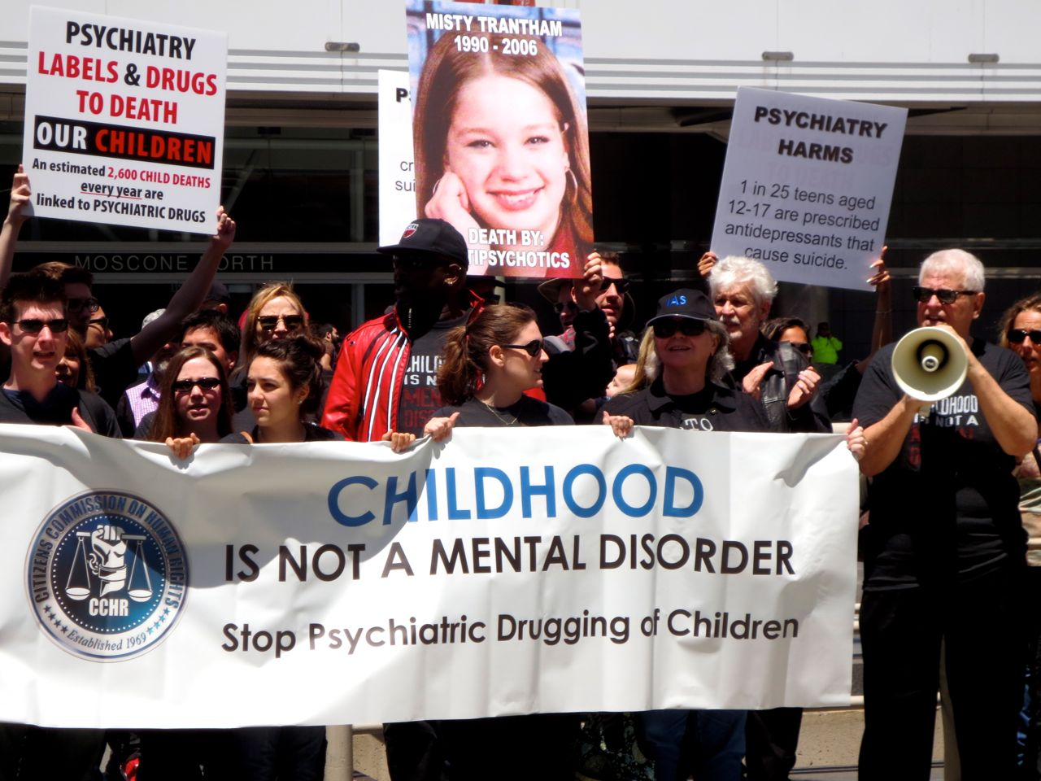
Attacks on DSM5

Slide 15
Published on May 18, 2013
DSM-5 Moves from Multi-axial system to a similar ICD 10 System
No More GAF

Slide 16
DSM-5 Coding and Reporting Procedures
Multiple diagnoses allowed.
Principal diagnosis is listed first, the rest listed in order of attention. If the reason for the visit is due to a medical condition, then that medical condition is listed first.
Specifiers (ex: Bipolar II Disorder 296.89, F31.81,
most recent episode Hypomanic, with rapid cycling, severe.)
4. Provisional Diagnosis is used until more data becomes available.

Slide 17
Main DSM 5 Categories
Neurodevelopmental Disorders
Schizophrenia Spectrum and Other Psychotic Disorders
Bipolar and Related Disorders
Depressive Disorders
Anxiety Disorders
Obsessive-Compulsive and Related Disorders
Trauma and Stressor Related Disorders
Dissociative Disorders
Somatic Symptom Disorders
Feeding and Eating Disorders
Elimination Disorders
Sleep-Wake Disorders
Sexual Dysfunctions
Gender Dysphoria
Disruptive, Impulse Control, and Conduct Disorders
Substance Use and Addictive Disorders
Neurocognitive Disorders
Personality Disorders
Paraphilic Disorders
Other Disorders

Slide 18
Some Coding Differences
Now two options:
other specified disorder (allows the clinician to specify the reason that the criteria for a specific disorder are not met)
and unspecified disorder (option to forgo specification).

Slide 19
Neurodevelopmental Disorders
Intellectual Disability (Intellectual Developmental Disorder)
Diagnostic criteria for intellectual disability (intellectual developmental disorder) emphasize the need for an assessment of both cognitive capacity (IQ) and adaptive functioning.
Severity is determined by adaptive functioning rather than IQ score. Moreover, a federal statue in the United States (Public Law 111-256, Rosa’s Law) replaces the term “mental retardation” with intellectual disability.
The term intellectual developmental disorder was placed in parentheses to reflect the ICD-11 (to be released in 2015).

Slide 20
Intellectual Disability
(Intellectual Developmental Disorder)
DSM-IV criteria had required an IQ score of 70 as the cutoff for diagnosis; the new criteria recommend IQ testing and describe “deficits in adaptive functioning that result in failure to meet developmental and sociocultural standards for personal independence and social responsibility.”
The new criteria also include Specifiers for mild, moderate, severe, and profound intellectual disability.

Slide 21
Autism Spectrum Disorder (ASD)
Consolidation of DSM-IV criteria for autism, Asperger’s, childhood disintegrative disorder, and pervasive developmental disorder-not otherwise specific (PDD-NOS)—into one diagnostic category called autism spectrum disorder (ASD).
The new criteria describe two principal symptoms: “deficits in social communication and social interaction” and “restrictive and repetitive behavior patterns”

Slide 22
Autism spectrum disorder
Persistent communication and social interaction deficits in multiple situations; restricted, repeditive behavior and interests, originally manifested in the early developmental period and causing significant impairment
Specify if: With or without accompanying intellectual impairment, With or without accompanying language impairment, Associated with a known medical or genetic condition or environmental factor, Associated with another neurodevelopmental, mental, or behavioral disorder with catatonia.

Slide 23
Communication Disorders
The DSM-5 communication disorders include:
language disorder
speech sound disorder
childhood-onset fluency disorder (a new name for stuttering)
social (pragmatic) communication disorder, a new condition for persistent difficulties in the social uses of verbal and nonverbal communication.

Slide 24
Attention-Deficit/Hyperactivity Disorder
The same 18 symptoms are used as in DSM-IV
the onset criterion has been changed from “symptoms that caused impairment were present before age 7 years” to “several inattentive or hyperactive-impulsive symptoms were present prior to age 12”;
a comorbid diagnosis with autism spectrum disorder is now allowed;
a symptom threshold change has been made for adults with the cutoff for ADHD of five symptoms, instead of six required for younger persons

Slide 25
AD/HD
"Persistent pattern of inattention and/or hyperactivity-impulsivity that interferes with functioning or development" begining in childhood, and present across more than one setting
Specify whether:
314.01 Combined presentation
314.00 Predominantly inattentive presentation
314.01 Predominantly hyperactive/impulsive presentation
Specify if: In partial remission Specify current severity: Mild, Moderate Severe
314.01 Other specified AD/HD- Symptoms are present and cause significant impairment in important functional areas, but do not meet the full criteria, and where the reason for failing the criteria is specified.
314.01 Unspecified attention-deficit/Hyperactivity disorder
Same as 314.01 above but with no reason specified or insufficient information is available to provide one

Slide 26
Specific Learning Disorder
Specific learning disorder combines the DSM-IV diagnoses of reading disorder, mathematics disorder, disorder of written expression, and learning disorder not otherwise specified. Because learning deficits in the areas of reading, written expression, and mathematics commonly occur together, coded specifiers for the deficit types in each area are included.

Slide 27
Schizophrenia Spectrum and Other Psychotic Disorders
Schizophrenia
Elimination of the special attribution of bizarre delusions and Schneiderian first-rank auditory hallucinations (e.g., two or more voices conversing).
The second change is the addition of a requirement in Criterion A that the individual must have at least one of these three symptoms: delusions, hallucinations, and disorganized speech. At least one of these core “positive symptoms” is necessary for a reliable diagnosis of schizophrenia

Slide 28
Schizophrenia subtypes
The DSM-IV subtypes of schizophrenia (i.e., paranoid, disorganized, catatonic, undifferentiated, and residual types) are eliminated due to their limited diagnostic stability, low reliability, and poor validity.
Instead, a dimensional approach to rating severity for the core symptoms of schizophrenia.

Slide 29
Schizoaffective Disorder
The primary change to schizoaffective disorder is the requirement that a major mood episode be present for a majority of the disorder’s total duration after Criterion A has been met.
It makes schizoaffective disorder a longitudinal instead of a cross-sectional diagnosis—more comparable to schizophrenia, bipolar disorder, and major depressive disorder, which are bridged by this condition.

Slide 30
Delusional Disorder
Criterion A for delusional disorder no longer has the requirement that the delusions must be nonbizarre. A specifier for bizarre type delusions provides continuity with DSM-IV. The demarcation of delusional disorder from psychotic variants of obsessive-compulsive disorder and body dysmorphic disorder is explicitly noted with a new exclusion criterion, which states that the symptoms must not be better explained by conditions such as obsessive-compulsive or body dysmorphic disorder with absent insight/delusional beliefs.

Slide 31
Delusional disorder
Specify whether:
Erotomanic type
Grandiose type
Jealous type
Persecutory type
Somatic type
Mixed type
Unspecified type
Specify if: With bizarre content
Specify if: First episode, currently in acute episode First episode, currently in partial remission First episode, currently in full remission Multiple episodes, currently in acut episode Multiple episodes, currently in partial remission Multiple episodes, currently in full remission Unspecified, Specify current severity:

Slide 32
Catatonia
In DSM-5, catatonia may be diagnosed as a specifier for depressive, bipolar, and psychotic disorders

Slide 33
Bipolar and Related Disorders
Bipolar Disorders
Criterion A for manic and hypomanic episodes now includes an emphasis on changes in activity and energy as well as mood. The DSM-IV diagnosis of bipolar I disorder, mixed episode, requiring that the individual simultaneously meet full criteria for both mania and major depressive episode, has been removed. Instead, a new specifier, “with mixed features,” has been added.
Added is a specifier for anxious distress.

Slide 34
Depressive disorders
The bereavement exclusion in DSM-IV was removed from depressive disorders in DSM-5.
New disruptive mood dysregulation disorder (DMDD) for children up to age 18 years
Premenstrual dysphoric disorder moved from an appendix for further study, and became a disorder.

Slide 35
Depressive Disorders
Disruptive Mood Dysregulation Disorder- to address concerns about potential overdiagnosis and overtreatment of bipolar disorder in children, a new diagnosis, disruptive mood dysregulation disorder, is included for children up to age 18 years who exhibit persistent irritability and frequent episodes of extreme behavioral dyscontrol.
What was referred to as Dysthymia in DSM-IV now falls under the category of Persistent Depressive Disorder, which includes both chronic major depressive disorder and the previous dysthymic disorder.

Slide 36
Bereavement
In DSM-IV, there was an exclusion criterion for a major depressive episode that was applied to depressive symptoms lasting less than 2 months following the death of a loved one (i.e., the bereavement exclusion). This exclusion is omitted in DSM-5. 1, to remove the implication that bereavement typically lasts only 2 months when both physicians and grief counselors recognize that the duration is more commonly 1–2 years. 2, bereavement is recognized as a severe psychosocial stressor that can precipitate a major depressive episode in a vulnerable individual, and an increased risk for persistent complex bereavement disorder, which is now in Conditions for Further Study in DSM-5 Section III. 3, bereavement-related major depression is most likely to occur in individuals with past personal and family histories of major depressive episodes. It is genetically influenced and is associated with similar personality characteristics, patterns of comorbidity, and risks of chronicity and/or recurrence as non–bereavement-related major depressive episodes

Slide 37
Anxiety Disorders
The DSM-5 chapter on anxiety disorder no longer includes obsessive-compulsive disorder (which is included with the obsessive-compulsive and related disorders) or posttraumatic stress disorder and acute stress disorder (which is included with the trauma- and stressor-related disorders). However, the sequential order of these chapters in DSM-5 reflects the close relationships among them.

Slide 38
Anxiety disorders
For phobias and anxiety disorders, DSM-5 removes the requirement that the subject (formerly, over 18 years old) "must recognize that their fear and anxiety are excessive or unreasonable". Also, the duration of at least 6 months now applies to everyone (not only to children).
Panic attack became a specifier.
Panic disorder and agoraphobia became two separate disorders in DSM-5.
Specific types of phobias became specifiers but are otherwise unchanged.
The generalized specifier for social anxiety disorder (formerly, social phobia) changed in favor of a performance only (i.e., public speaking or performance) specifier.
Separation anxiety disorder and selective mutism are now classified as anxiety disorders (rather than disorders of early onset).

Slide 39
PTSD
The 3 clusters of DSM-IV symptoms will be divided into 4 clusters in DSM-5: intrusion symptoms, avoidance symptoms, arousal/reactivity symptoms and negative mood and cognitions.
Criterion A2 (requiring fear, helplessness or horror happen right after the trauma) will be removed.
The diagnosis is proposed to move from the class of anxiety disorders into a new class of "trauma and stressor-related disorders."
PTSD assessment measures, such as the CAPS and the PCL, are being revised by the National Center for PTSD to be made available upon the release of DSM-5.

Slide 40
Somatic Symptom and Related Disorders
The DSM-5 classification reduces the number of these disorders and subcategories. Diagnoses of somatization disorder, hypochondriasis, pain disorder, and undifferentiated somatoform disorder have been removed.

Slide 41
Parental Alienation Syndrome
Parent-child relational problem "may include negative attributions of the other's intentions, hostility toward or scapegoating of the other, and unwarranted feelings of estrangement."
Child psychological abuse "non-accidental verbal or symbolic acts by a child's parent or caregiver that result, or have reasonable potential to result, in significant psychological harm to the child.”

Slide 42
Thomas R. Insel, MD- National Institute of Mental Health director wrote on April 29, 2013:
“While DSM has been described as a “Bible” for the field, it is, at best, a dictionary, creating a set of labels and defining each. The strength of each of the editions of DSM has been “reliability” – each edition has ensured that clinicians use the same terms in the same ways.
The weakness is its lack of validity. ... Patients with mental disorders deserve better.”

Slide 43
DSM-5 has major reliability problems
Only 5 diagnoses achieved kappa levels of agreement between 0.60-0.79.
The nine DSM-5 disorders in the kappa range of 0.40-0.59 previously would have been considered just plain poor, but DSM-5 puffs these up as "good.”
Then DSM-5 calls “acceptable” 6 disorders that achieved unacceptable reliabilities with kappas of 0.20-0.39.
Major Depressive Disorder and Generalized Anxiety Disorder were among those that achieved the unacceptable kappas in 0.20-0.39 range.

Slide 44
A diagnostic framework that attempts to characterize the whole person--the depth as well as the surface of emotional, cognitive, and social functioning; from healthy to disturbed in a mixed categorical -dimensional system

Slide 45
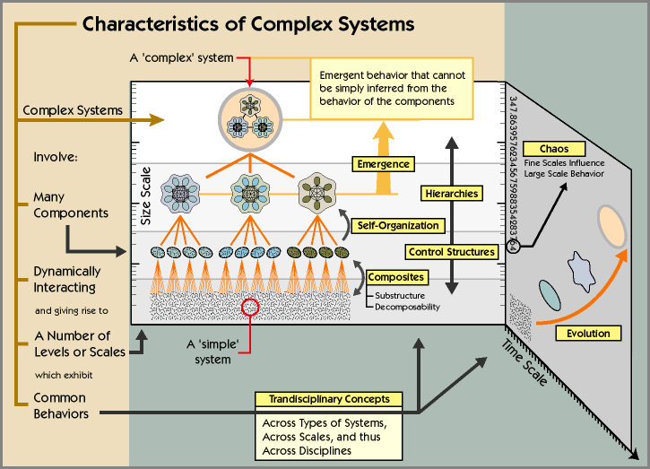
Psychodynamic Theory as a Complex Adaptive System-temperament, affects, cognitions, development, traumas, defenses, fantasies, attachments all interacting at various levels of consciousness.

Slide 46
PDM’s Current Taxonomy

Slide 47
The Psychodynamic Diagnostic Manual
Over-all level of personality organization
(Healthy, Neurotic or Borderline)
Personality patterns and disorders
(Temperament, conflicts, affects, cognitions and defensives)
Specific capacities of mental functioning
(learning, relationships, self regard, affective experience, internal representations, differentiation and integration, psychological mindedness, a sense of morality)
The subjective experience of symptoms

Slide 48
P103. Psychopathic (Antisocial) Personality Disorder
P103.1 Passive/Parasitic
P103.2 Aggressive
Contributing constitutional-maturational patterns: aggressiveness, high threshold for emotional stimulation
Central tension/preoccupation: Manipulating/being manipulated
Central affects: Rage, envy
Characteristic pathogenic belief about self: I can make anything happen
Characteristic pathogenic belief about others: Everyone is selfish, manipulative, dishonest
Central ways of defending: Reaching for omnipotent control
Notes:
48

Slide 49
Aggressive Subtype
Explosive
Actively predatory
Often violent
Notes:
49

Slide 50
Passive/Parasitic Subtype
More dependent
Less aggressive, usually non-violent
Manipulator
Con artist
Notes:
50

Slide 51
Psychodiagnostic Chart (PDC)
An Integration of the Psychodynamic Diagnostic Manual (PDM), ICD and DSM
Robert M. Gordon and Robert F. Bornstein
(both on the Initial PDM2 Work Committee with Vittorio Lingiardi, Nancy McWilliams and Francesco Gazzillo)

Slide 52
Psychodiagnostic Chart

Slide 53
Personality Organization Related to Psychotherapy Issues
Koelen, et al (2012) identified 18 studies that suggest that higher initial levels of personality organization are moderately to strongly associated with better treatment outcome.
And some studies suggest that personality organization may interact with the type of intervention (i.e., interpretive versus supportive) in predicting treatment outcome.
Koelen JA, Luyten P, Eurelings-Bontekoe LH, Diguer L, Vermote R, Lowyck B, Bühring ME. (2012). The impact of level of personality organization on treatment response: a systematic review. Psychiatry, 75(4), 355-374

Slide 54
MMPI-2 Hysteria-Hy, Schizophrenia-Sc, and Ego Strength-Es Scales within the Psychotic, Borderline, and Neurotic Categories of the Personality Structure Scale
Psychotic (ratings 1-3, n = 13), Borderline (4-6, n = 52), and Neurotic (7-10, n = 33).
Psychotic: Sc >> Hy>> Es; Borderline: (Sc ~ Hy) >> Es; Neurotic: (Sc ~ Hy) > Es all in the average to moderate range.
Notes:
N=98 In hypothesis B.1., we predicted the Sc scale mean should be significantly larger than both the Hy and Es scale means for the psychotic level. Pairwise comparisons supported that prediction: Sc was significantly larger than Es (M = 85.77, SD = 19.55 vs. 34.31, SD = 6.78, p = .001) and significantly larger than Hy (M = 85.77, SD = 19.55 vs. 72.69, SD = 18.46, p = .017).
In hypothesis B.2.for the borderline level, we predict that both the Sc scale mean and the Hy scale mean should not be significantly different (borderline as a mix of psychotic and neurotic features), but they both should be significantly larger than the Es scale mean. That prediction was supported: Sc and Hy were not significantly different, but Sc was significantly larger than Es (M = 62.21, SD = 12.31, vs. 43.58, SD = 10.25, p = .001) and Hy was also significantly larger than Es (64.21, SD = 12.31 vs. 43.58, SD = 10.25, p = .001).
Finally, for the neurotic level, we predicted in hypothesis B.3. that the Es, Sc and Hy scales should all be in the normal-moderate range. There were significant mean differences between Es (M = 49.55, SD = 10.16) in comparison to both Hy (M = 59.85, SD = 12.15) and Sc,(M = 56.18, SD = 9.28). Hy and Sc were in the moderate range, and Ego strength moved up to the average range showing support for the prediction (see Figure 1 for the MMPI-2 scale means within each level).
We next examined the pattern of means for each of the Hy, Sc, and Es scales separately across each of the three scale categories. A series of One-Way ANOVAs was used to test the hypothesized outcomes. For hypothesis C.1., we predicted significant mean differences for Hy across the psychotic, borderline, and neurotic scale categories, with the largest scale mean for psychotic followed by borderline and lastly the neurotic category (See Table 4 for the means and standard deviations). The ANOVA indicated that there were significant differences among the three scale categories on the Hy scale, F (2, 95) = 3.96, p < = .022, 2= .08. Scheffe post hoc tests indicated that patients rated as psychotic scored significantly higher on the Hy scales in comparison to patients rated as neurotic (M = 72.69 vs. M = 59.85, p = .023). Although in the predicted direction, there was no significance mean difference between patients rated as psychotic and those rated as borderline (M = 72.69 vs. 64.21, p = .154) nor was there significant mean differences between patients rated as borderline and those rated as neurotic (M = 64.21 vs. 59.85, p = .379).
For hypothesis C.2., we predicted significant mean differences for Sc across the psychotic, borderline, and neurotic scale categories, with the largest scale mean for psychotic followed by borderline and lastly the neurotic category (see Table 4 for the means and standard deviations). The ANOVA indicated that there were significant differences among the three scale categories on the Sc scale, F (2, 95) = 26.15, p <.001, 2= .36. Scheffe post hoc tests indicated that patients rated as psychotic scored significantly higher on the Sc scale in comparison to those rated as borderline (M = 85.77 vs. 62.21, p = .001) and neurotic (M = 85.77 vs. 56.18, p = .001). There was no significant mean difference between patients rated as borderline versus neurotic (M = 62.21 vs. 56.18, p = .104).
We predicted for hypothesis C.3., significant mean differences for Es across the psychotic, borderline, and neurotic scale categories, with the largest scale mean for neurotic, followed by borderline and lastly the psychotic category (see Table 4 for the means and standard deviations). This final ANOVA also found significant mean differences among the three scale categories on the Es scale, F (2, 95) = 11.506, p. = 001,2= .20. Scheffe post hoc tests indicated that patients rated as neurotic scored significantly higher on the Es scale in comparison to those rated as borderline (M = 49.55 vs. 43.58, p = .028), and psychotic (M = 49.55 vs. M = 34.31, p = .001). There was also a significance mean difference between patients rated as borderline and those rated as psychotic (M = 43.58 vs. 34.31, p = .012).

Slide 55
1. Level of Personality Structure
Please rate each capacity from 1 to 10; ratings range from Most Disturbed (1) to Most Healthy (10).
1. Identity: ability to view self in complex, stable, and accurate ways
2. Object Relations: ability to maintain intimate, stable, and satisfying relationships
3. Affect Tolerance: ability to experience the full range of age-expected affects
4. Affect Regulation: ability to regulate impulses and affects with flexibility in using defenses or coping strategies
5. Superego Integration: ability to use a consistent and mature moral sensibility
6. Reality Testing: ability to appreciate conventional notions of what is realistic
7. Ego Resilience: ability to respond to stress resourcefully and to recover from painful events without undue difficulty

Slide 56
1. Level of Personality Structure- Rating
Healthy Personality- characterized by 9-10 scores, life problems never get out of hand and enough flexibility to accommodate to challenging realities.
Neurotic Level- characterized by mainly 6-8 scores, rigidity and limited range of defenses and coping mechanisms, basically a good sense of identity, healthy intimacies, good reality testing, fair resiliency, fair affect tolerance and regulation, favors repression.
Borderline Level- characterized by mainly 3-5 scores, recurrent relational problems, difficulty with affect tolerance and regulation, poor impulse control, poor sense of identity, poor resiliency, favors primitive defenses such as denial, splitting and projective identification.
Psychotic Level- characterized by mainly 1-2 scores, delusional thinking, sometimes hallucinations, poor reality testing and mood regulation, extreme difficulty functioning in work and relationships.
Overall Personality Structure
Based on the 7 ratings above, rate person’s overall personality structure from 1 (Psychotic) to 10 (Healthy)

Slide 57
2. Personality Patterns or Disorders- Scoring
Review the P axis in the PDM for the personality patterns most descriptive of your client (use the PDP).
Begin by checking off as many descriptors that apply. Then decide on the most dominant personality patterns or disorders, and the level of severity (1-10).

Slide 58
PDM Categories:
Schizoid
Paranoid
Psychopathic (antisocial); Subtypes - passive/parasitic or aggressive
Narcissistic; Subtypes - arrogant/entitled or depressed/depleted;
Sadistic (and intermediate manifestation, sadomasochistic)
Masochistic (self-defeating); Subtypes - moral masochistic or relational masochistic
Depressive; Subtypes - introjective or anaclitic; Converse manifestation - hypomanic
Somatizing
Dependent (and passive-aggressive versions of dependent); Converse manifestation - counterdependent
Phobic (avoidant); Converse manifestation - counterphobic
Anxious
Obsessive-compulsive; Subtypes - obsessive or compulsive
Hysterical (histrionic); Subtypes - inhibited or demonstrative/ flamboyant
Dissociative
Mixed/other
Rate: Dominate Personality Disorder or Maladaptive Traits & Overall Severity of Impairment

Slide 59
3. Mental Functioning
1. Capacity for Attention, Memory, Learning, and Intelligence
2. Capacity for Relationships and Intimacy (including depth, range, and consistency)
3. Quality of Internal Experience (level of confidence and self-regard)
4. Affective Comprehension, Expression, and Communication
5. Level of Defensive or Coping Patterns
1-2: Psychotic level (e.g., delusional projection, psychotic denial, psychotic distortion)
3-5: Borderline level (e.g., splitting, projective identification, idealization/devaluation, denial, acting out)
6-8: Neurotic level (e.g., repression, reaction formation, rationalization, displacement, undoing)
9-10: Healthy level (e.g., anticipation, sublimation, altruism, and humor)
6. Capacity to Form Internal Representations (sense of self and others are realistic and guiding)
7. Capacity for Differentiation and Integration (self, others, time, internal experiences and
external reality are all well distinguished)
8. Self-Observing Capacity (psychological mindedness)
9. Realistic sense of Morality

Slide 60
4. ICD, DSM or PDM SYMPTOMS
Symptoms are considered in the context of:
1. level of personality structure,
2. personality pattern or disorder
3. mental functioning.
Here you may use the symptoms that may be the focus of the chief complaint and necessary for third party reimbursement.

Slide 61
5. Cultural, Contextual, and Other Relevant Considerations
This is a qualitative section where the practitioner may write how cultural or contextual factors contribute to symptoms, better explain symptoms and/or degree of suffering.

Slide 62
Clinical Example Using the PDC
“Bana” is a 28 year old woman from Syria. Her husband was killed in the war and she has no children. Her brother was able to get her to the US this year.
1. Level of Personality Structure- is 7 (Neurotic Level). Her capacity scores are mainly in the 6-9 range. Her lowest rating is in Affect Tolerance (5) which may be due to her PTSD. She is a good candidate for PDT.
2. Personality Patterns or Disorders- mainly Hysterical/Inhibited type at the Moderate level of severity (6) with some obsessional and dependent features.
3. Mental Functioning- most of the 9 capacities are in the high range. She has a masters in education, her marriage was good, she has average self esteem, she can go from inhibited to overly excited expression of affect, her favored defenses are repression and intellectualization, she has a warm relationship with her mother and both sets of grandparents, her father was killed when she was a child, good level of differentiation and integration, very insightful and excellent moral reasoning.
4. Manifest Symptoms- ICD-10: (F43.1) Post-traumatic stress disorder
5. Cultural, Contextual Issues- recent death of husband, war trauma, loss of father, leaving much of her family and friends behind, immigration fears and guilt.

Slide 63
The International Classification of Diseases
The ICD is currently the most widely used statistical classification system for diseases in the world.
This is in fact the official diagnostic system for mental disorders in the US.
The ICD-10, was developed in 1992.
ICD-11 is planned for 2015.

Slide 64
ICD is Required by HIPPA
The deadline for the United States to begin using Clinical Modification ICD-10-Clinical Modification (CM) is currently October 1, 2014.
The deadline was previously October 1, 2011, then October 1, 2014. The transition to ICD-10 is required for everyone covered by the Health Insurance Portability Accountability Act (HIPAA).

Slide 65
ICD-10
“These descriptions and guidelines carry no theoretical implications, and they do not pretend to be comprehensive statements about the current state of knowledge of the disorders.
They are simply a set of symptoms and comments that have been agreed, by a large number of advisors and consultants in many different countries...” p.9 ICD-10 CM

Slide 66
mental and behavioural disorders
"Disorder” is used here to imply the existence of a clinically recognizable set of symptoms or behaviors associated with distress and with interference with personal functions. Social deviance or conflict alone, without personal dysfunction, should not be included in mental disorder as defined here.

Slide 67
Recording Diagnoses
Record as many diagnoses as are necessary to cover the clinical picture.
Start with the main diagnosis, and to label any others as subsidiary or additional diagnoses.
Precedence should be given the diagnosis most relevant to the purpose for which the diagnoses are being collected.
If there is any doubt about the order, then record the diagnoses in the numerical order in which they appear in the classification.

Slide 68
ICD-10 mental and behavioural disorders consists of 10 main groups:
F01-F09 Mental disorders due to known physiological conditions
F10-F19 Mental and behavioral disorders due to psychoactive substance use
F20-F29 Schizophrenia, schizotypal, delusional, and other non-mood psychotic disorders
F30-F39 Mood [affective] disorders
F40-F48 Anxiety, dissociative, stress-related, somatoform and other nonpsychotic mental disorders
F50-F59 Behavioral syndromes associated with physiological disturbances and physical factors
F60-F69 Disorders of adult personality and behavior
F70-F79 Intellectual disabilities
F80-F89 Pervasive and specific developmental disorders
F90-F98 Behavioral and emotional disorders with onset usually occurring in childhood and adolescence
F99-F99 Unspecified mental disorder

Slide 69
F20-F29 Schizophrenia, schizotypal, delusional, and other non-mood psychotic disorders
The block that covers schizophrenia, schizotypal states and delusional disorders (F20-F29) has been expanded by the introduction of new categories such as undifferentiated schizophrenia, postschizophrenic depression, and schizotypal disorder.
The classification of acute short-lived psychoses, which are commonly seen in most developing countries, is considerably expanded compared with that in the ICD-9.

Slide 70
F43.1 Post-traumatic stress disorder
This arises as a delayed and/or protracted response to a stressful event or situation (either short- or long-lasting) of an exceptionally threatening or catastrophic nature, which is likely to cause pervasive distress in almost anyone (e.g. natural or man-made disaster, combat, serious accident, witnessing the violent death of others, or being the victim of torture, terrorism, rape,or other crime). Predisposing factors such as personality traits (e.g. compulsive, asthenic) or previous history of neurotic illness may lower the threshold for the development of the
syndrome or aggravate its course, but they are neither necessary nor sufficient to explain its occurrence.
Typical symptoms include episodes of repeated reliving of the trauma in intrusive memories ("flashbacks") or dreams, occurring against the persisting background of a sense of "numbness" and emotional blunting, detachment from other people, unresponsiveness to surroundings, anhedonia, and avoidance of activities and situations reminiscent of the trauma. Commonly there is fear and avoidance of cues that remind the sufferer of the original trauma. Rarely, there may be dramatic, acute bursts of fear, panic or aggression, triggered by stimuli arousing a sudden recollection and/or re-enactment of the trauma or of the original reaction to it.

Slide 71
ICD 10 Disorders of adult personality and behavior
F60 Specific personality disorders
F60.0 Paranoid personality disorder
F60.1 Schizoid personality disorder
F60.2 Dissocial personality disorder
F60.3 Emotionally unstable personality disorder
.30 Impulsive type
.31 Borderline type
F60.4 Histrionic personality disorder
F60.5 Anankastic personality disorder (i.e. OCPD)
F60.6 Anxious [avoidant] personality disorder
F60.7 Dependent personality disorder
F60.8 Other specific personality disorders
F60.9 Personality disorder, unspecified
F61 Mixed and other personality disorders
F61.0 Mixed personality disorders
F61.1 Troublesome personality changes

Slide 72
2013 ICD-10 Personality Disorders
F60 Specific personality disorders
F60.0 Paranoid personality disorder
F60.1 Schizoid personality disorder
F60.2 Antisocial personality disorder
F60.3 Borderline personality disorder
F60.4 Histrionic personality disorder
F60.5 Obsessive-compulsive personality disorder
F60.6 Avoidant personality disorder
F60.7 Dependent personality disorder
F60.8 Other specific personality disorders
F60.81 Narcissistic personality disorder
F60.89 Other specific personality disorders
F60.9 Personality disorder, unspecified

Slide 73
ICD-11 Survey Overview
Developed for psychologists by WHO and International Union of Psychological Sciences (IUPsyS)
Parallel to survey conducted by WHO and World Psychiatric Association (WPA) of 4887 psychiatrists in 44 countries
2155 global psychologists participated
Recruited through 23 IUPsyS member national psychological associations in 23 countries
10 low and middle-income countries
Administered in 5 languages (English, Spanish, French, German, Turkish)

Slide 74
ICD-11 2015
ICD-11 will draw on research about how clinicians conceptualize mental disorders in hopes of creating a more intuitive and psychological classification system.
ICD-11 will be available for free on the Internet.
More than 70 percent of the world's psychiatrists use ICD while just 23 percent turn to the DSM. The same pattern is found among psychologists globally.

Slide 75
Purpose of Classification
% Participants

Slide 76
Number of
Categories Desired
% Participants

Slide 77
Strict Criteria vs.
Flexible Guidance
% Participants

Slide 78
ICD-10 and DSM-IV
Categories Used Most Often (Why they couldn’t get rid of Borderline)
ICD-10 | % | DSM-IV | %
Depressive Episode | 71% | Major Depressive Disorder | 60%
Generalized Anxiety Disorder | 48% | Generalized Anxiety Disorder | 59%
Social Phobia | 46% | Post-Traumatic Stress Disorder | 42%
Mixed Anxiety and Depressive Disorder | 44% | Adjustment Disorders | 41%
Recurrent Depressive Disorder | 44% | Attention-Deficit/Hyperactivity Disorder | 38%
Post-Traumatic Stress Disorder | 42% | Obsessive-Compulsive Disorder | 37%
Borderline Personality Disorder | 42% | Social Phobia | 37%
Adjustment Disorder | 42% | Borderline Personality Disorder | 34%
Specific (Isolated) Phobias | 41% | Single Major Depressive Episode | 34%
Hyperkinetic (Attention Deficit) Disorder | 34% | Panic Disorder without Agoraphobia | 32%
Obsessive-Compulsive Disorder | 34% | Bipolar I Disorder | 27%
Bipolar Affective Disorder | 28% | Alcohol-Related Disorders | 26%

Slide 79
The New Three Core Competencies in Psychiatry
Supportive Therapy (Rogerian)
Cognitive- Behavioral Therapy (CBT)
Long-Term Psychodynamic Psychotherapy

Slide 80
Integrative Psychotherapeutic Interventions
Going From Supportive, CBT and Psychodynamic
Personal Qualities of the Therapist
Maintaining the Therapeutic Frame
Reassurance
Listening
Behavioral Mastery: Self-Soothing
Cognitive Learning
Clarifications
Interpretations of mental life that affects subjective well-being and relationships

Slide 81
Personality Structure and Treatment
McWilliams points out that for many neurotic level people, the best time to make interpretations is when the patient is a state of emotional arousal, so that the patient is less likely to intellectualize the affect.
With borderline clients, who require a supportive approach, the opposite consideration applies, because when they are very upset, it is hard for them to take anything in.

Slide 82
Take Home Message
Neurotic Level Personality Disorders
focus more on using insight into past traumas that need to be worked through.
Borderline Level Personality Disorders focus more on using here and now interventions to help with reality testing, better self control and self soothing.

Slide 83
Take Home Message
Be technically eclectic mixing Supportive, CBT and Psychodynamic according to the needs of the patient (not according to your biases).
Use a psychodynamic formulation so you will know what interventions are likely be most effective, and to communicate that you understand your patient at all levels of existence (not just seeing symptoms).

Slide 84
Consider Instruments Such as the PDC
To guide your diagnostic and case formulation
To keep in your chart
To assess progress

Slide 85
Take Home Message:
Use the ICD with the PDM
Consider the over-all level of personality organization
Consider the personality patterns or disorders
Consider the mental capacities
Consider the subjective experience of the symptoms and use the ICD codes
You will find that your greater empathy will be felt by your patient, and this can greatly improve any treatment.

Slide 86
Free Copies- Search
“Psychodiagnostic Chart”
Take Home Message:
Keep using your ICD-9 codes until Oct. 1, 2014
Then Switch to using the ICD-10 for insurance
Use the PDM only if you want to understand people not just symptoms

