Slide 1


Slide 2

Rag'n'Bone Man

Slide 3
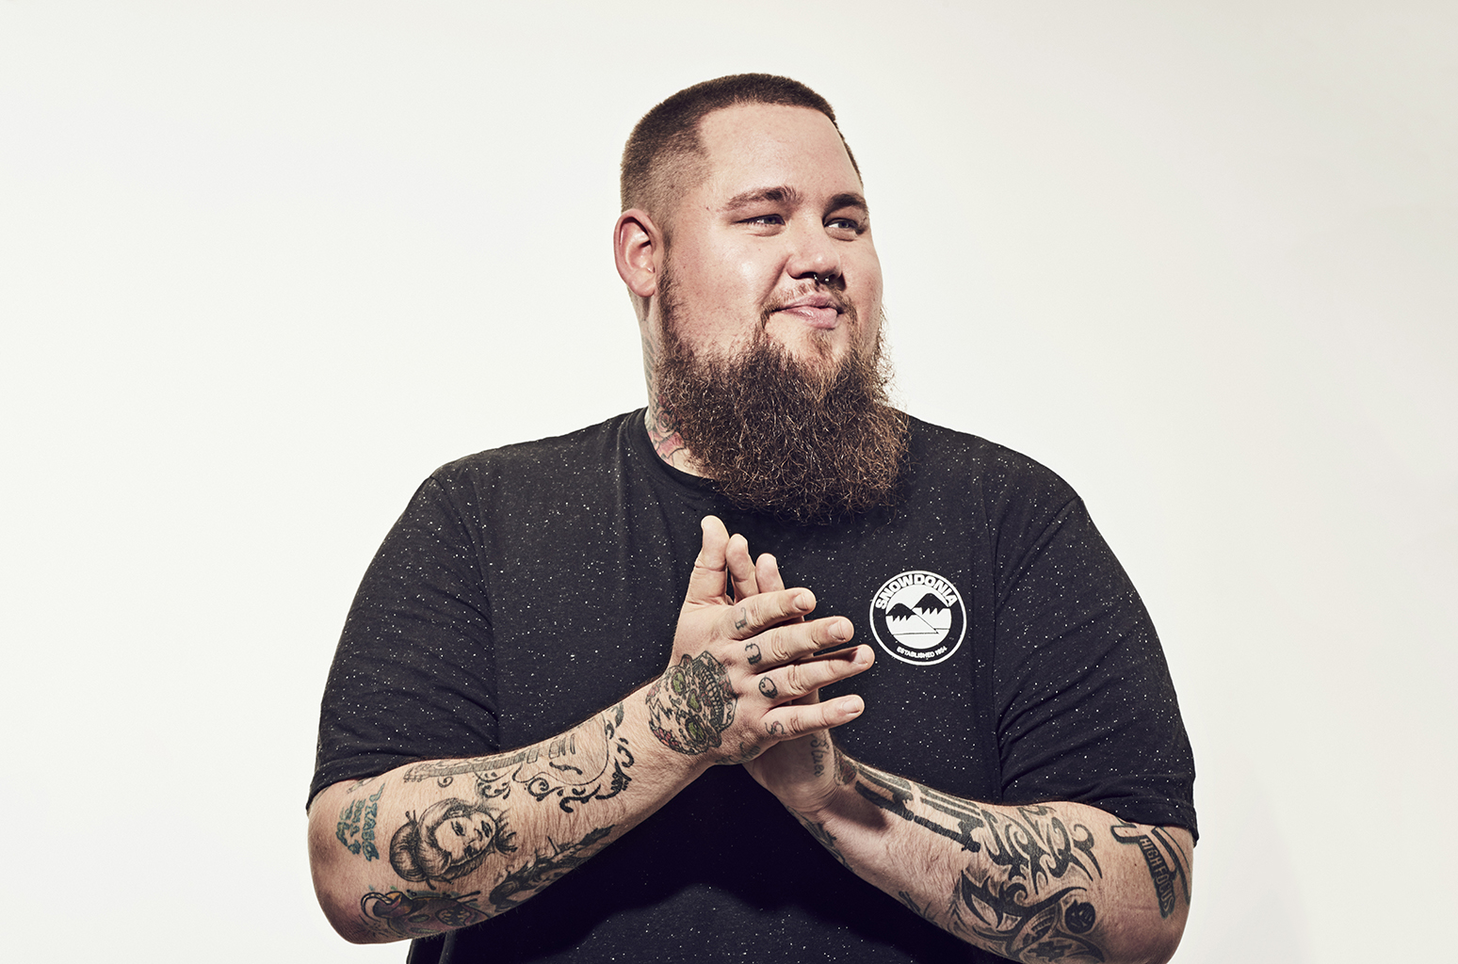
Rag'n'Bone Man
Rory Charles Graham
an English singer-songwriter
Pop, soul, blues

Slide 4

Maybe

Slide 5
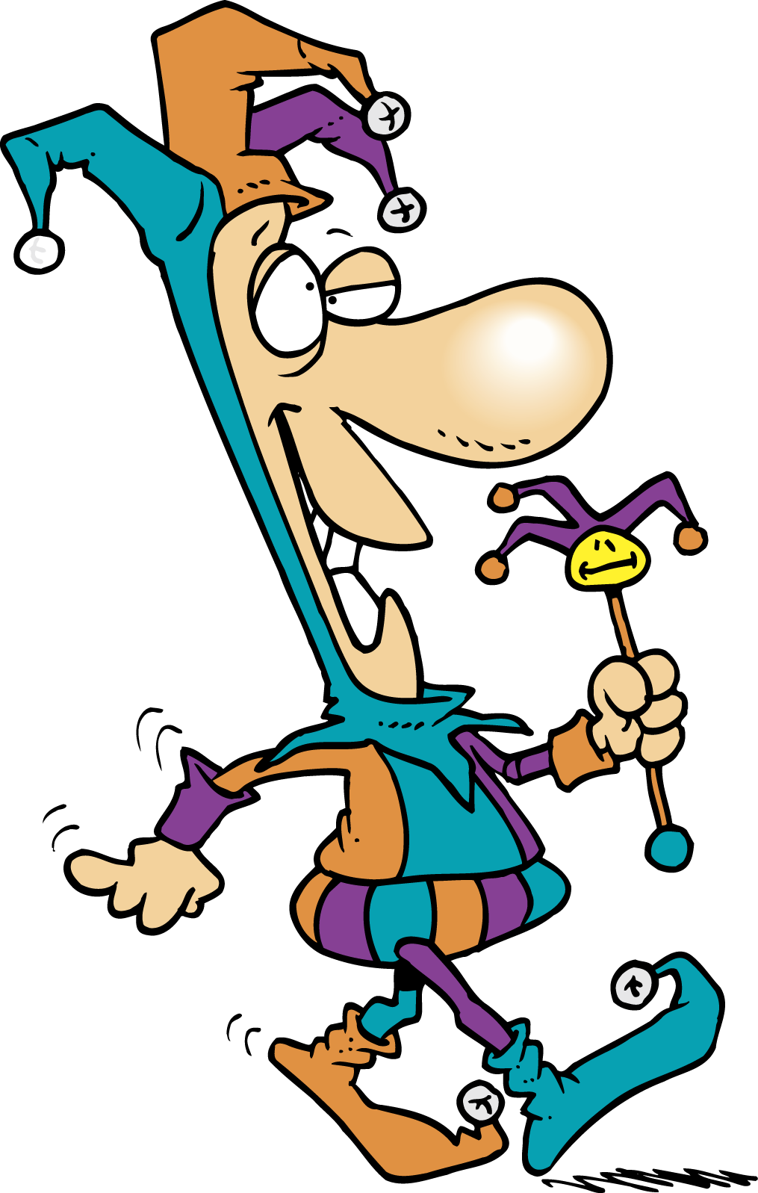
Foolish

Slide 6

Blind

Slide 7

Prove

Slide 8

After all

Slide 9

Put blame on…..

Slide 10

Take a look

Slide 11

Deceive(d)=lie (to)

Slide 12
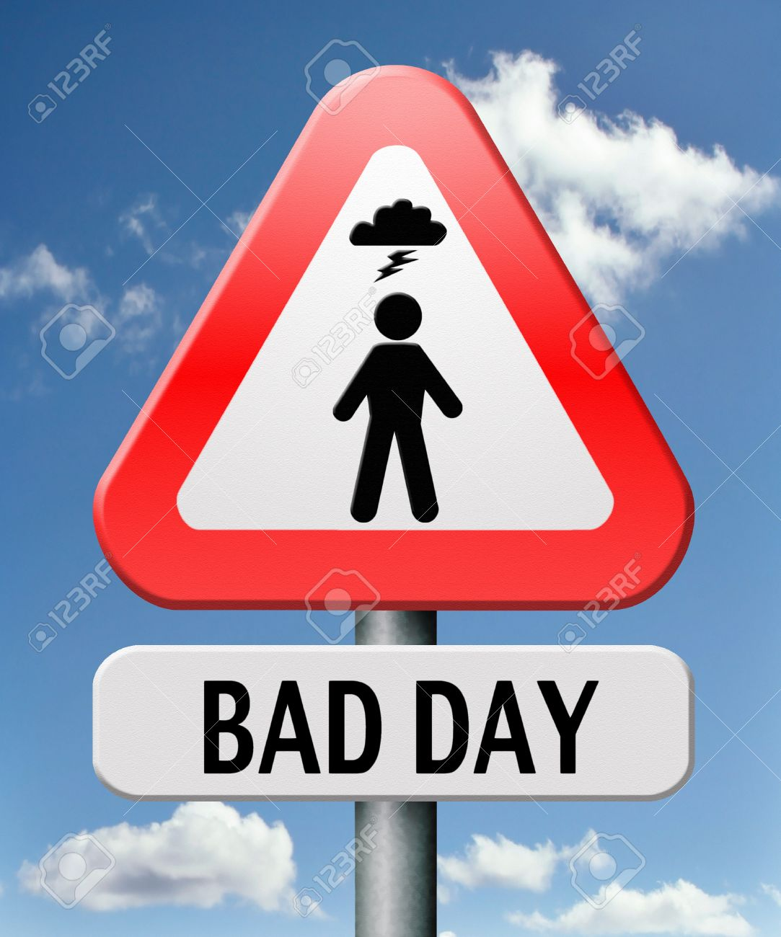
Out of luck

Slide 13
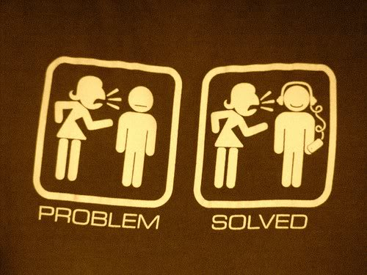
Solve

Slide 14

Opinion

Slide 15
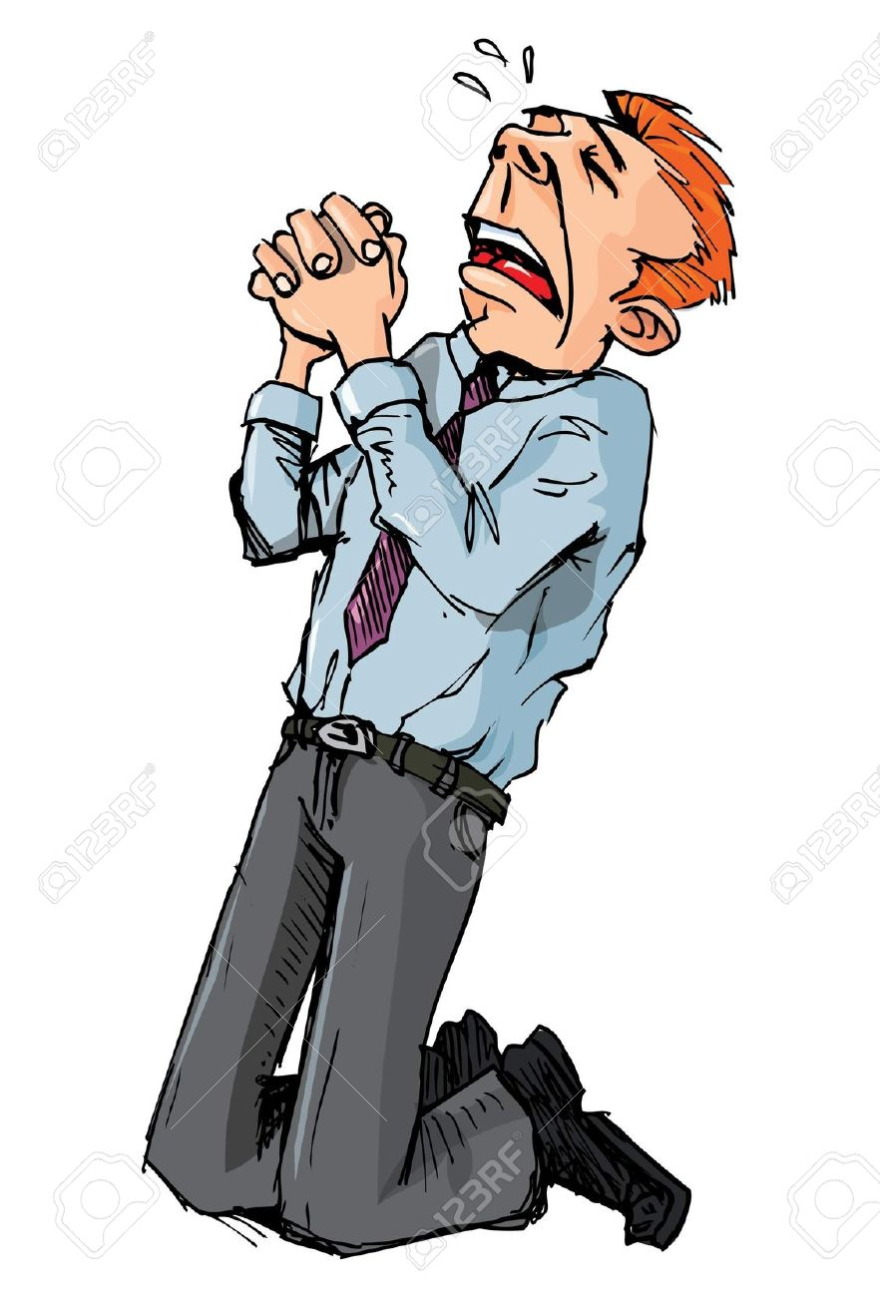
Beg for forgiveness

Slide 16
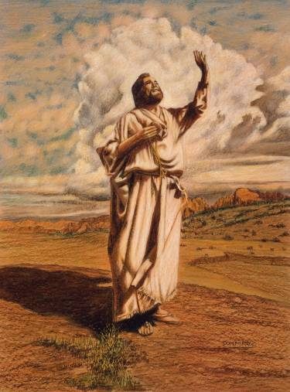
Prophet

Slide 17

Messiah

