Slide 1
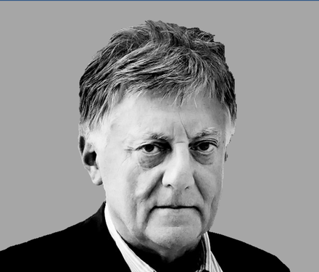
Aldo Rossi
By Valeria Galipoli

Slide 2
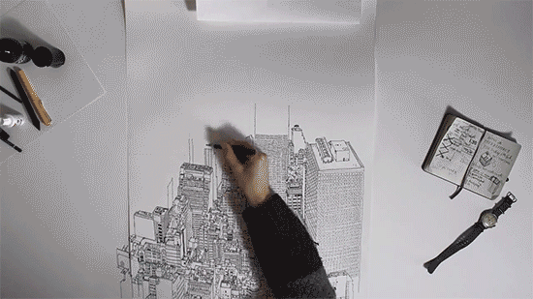
About him
Italian architect born on May 3, 1931 in Milan, Italy and died in Milan on September 4, 1997 because of a car accident.
He was internationally recognized in the areas of theory, drawing, architecture, and product design
He grew up during the years of World War II
He did his early education at Lake Como.
He started his architectural studies in 1949 in the Polytechnic University of Milan, from which he graduated in 1959.

Slide 3
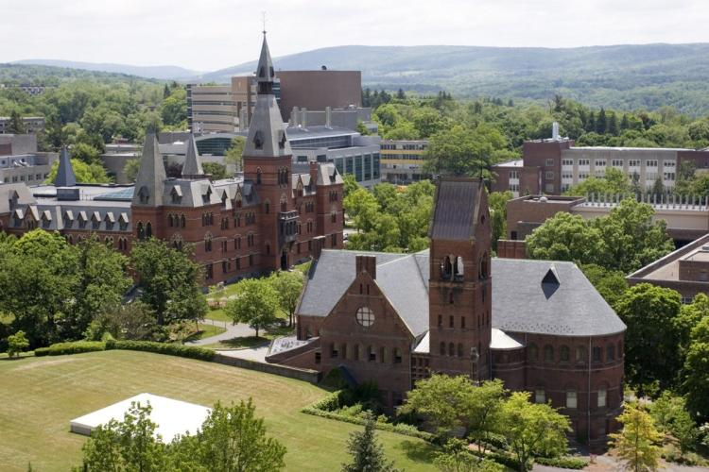
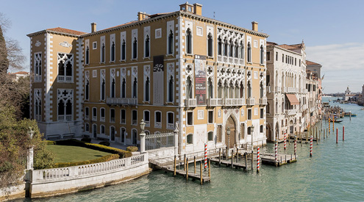
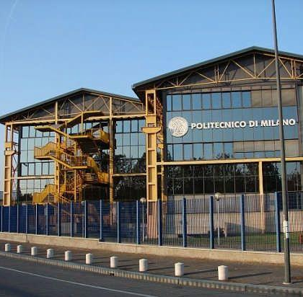
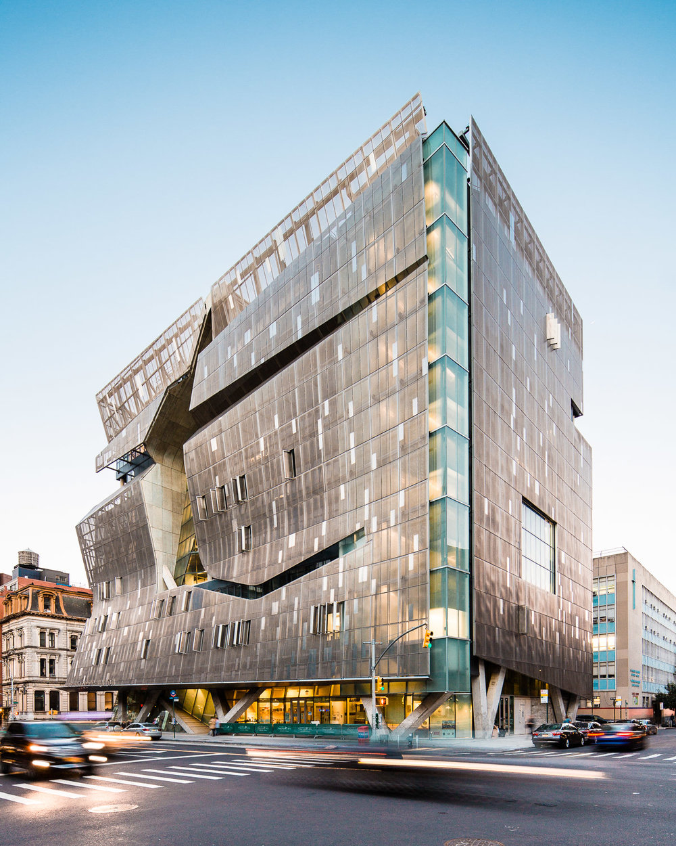
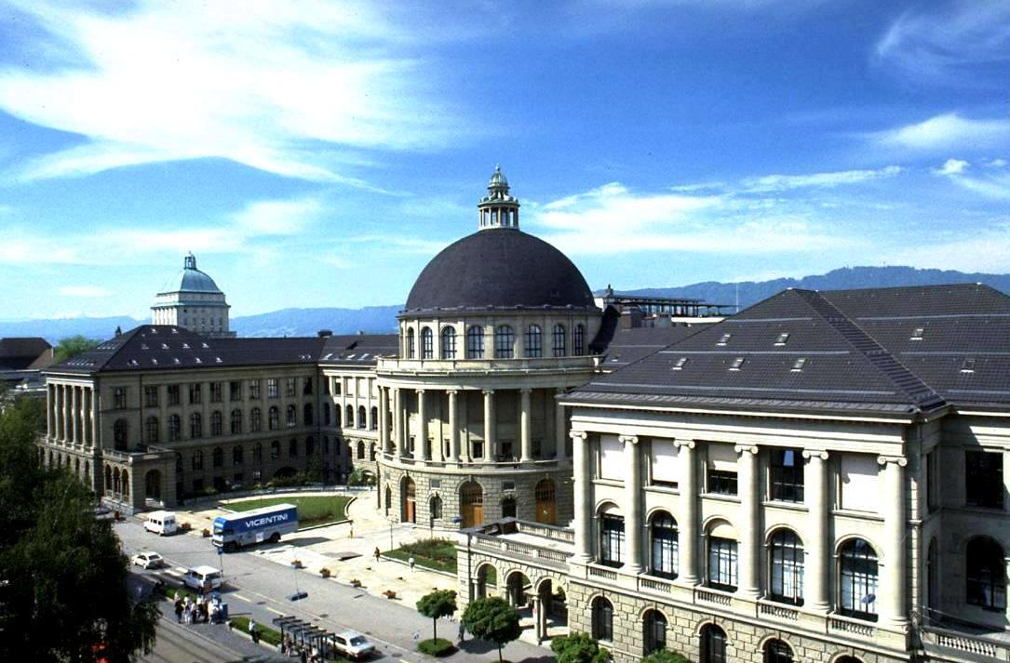
Rossi as a teacher
After graduating, he started working as a helper of professor Ludovico Quaroni in the Urbanism School of Arezzo, and professor Carlo Aymonino in the Architectural institute of the University of Venice.
Later he started to teach in the Polytechnic of Milan in 1965 and then in the polytechnic of Zurich in 1972.
He abandoned his teaching career for four years because of political reasons and he later resumed it in 1975 in the University of Venice.
Finally, he taught in the U.S in the university of Cornell, and Cooper Union.

Slide 4
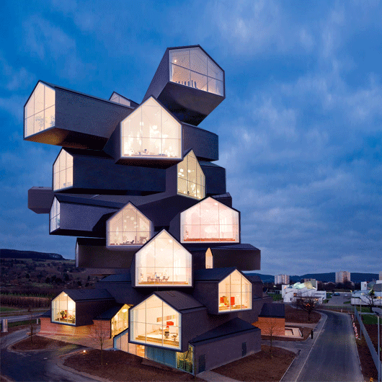
His theory
His theory and philosophy was build up by a mixture of architectural movements and influences including Adolf Loos, the surrealist painter Giorgio de Chirico and the landscapes of the Italian painters Mario Sironi and Giorgio Morandi
“Aldo Rossi starts from a personal interpretation of Boulle’s architecture, in which he finds the roots of what he calls exalted rationalism”.
His concept of autonomy of architecture was influenced by Kauffman. “Autonomy is conceived starting from the reflections he does on the city, that is seen as a spatial structure ruled by laws and elements guided by architecture itself ”.
Aldo Rossi’s architecture is part of a neo-rationalist movement called Tendenza, which intends to save the architecture and the city from the dangers of the megalopolitan consumerism.
https://www.youtube.com/watch?v=aCJvk1snNbk&t=4s

Slide 5
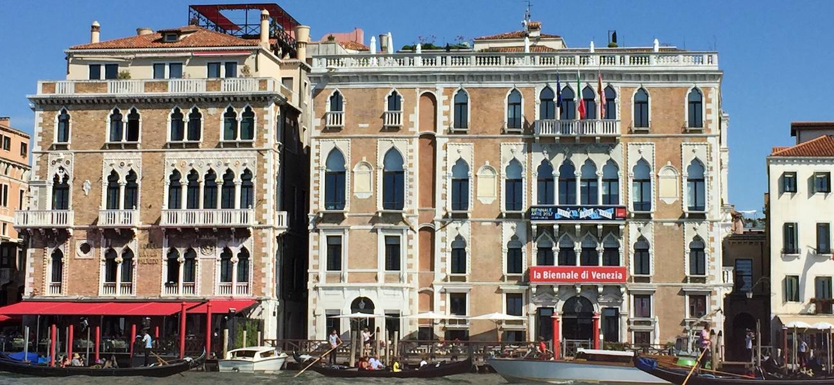
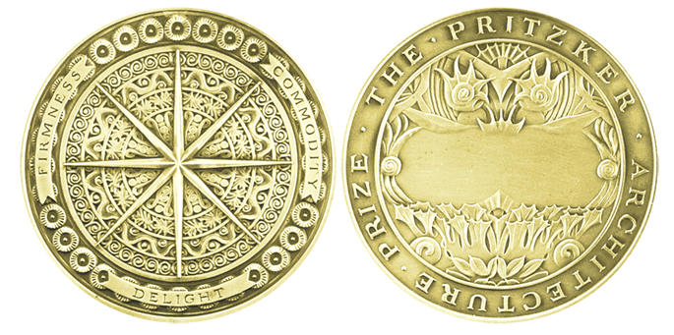

Awards
1983: He was nominated Managing Director of Architecture for the Biennale Di Venezia
1990: Was awarded the Pritzker Architecture Prize.
1992: received the Thomas Jefferson medal in architecture and the Campione D’ Italia Nel Mondo Prize.

Slide 6
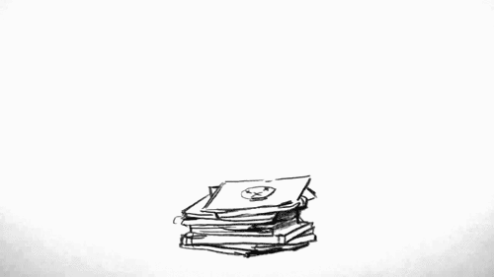
Books

Slide 7
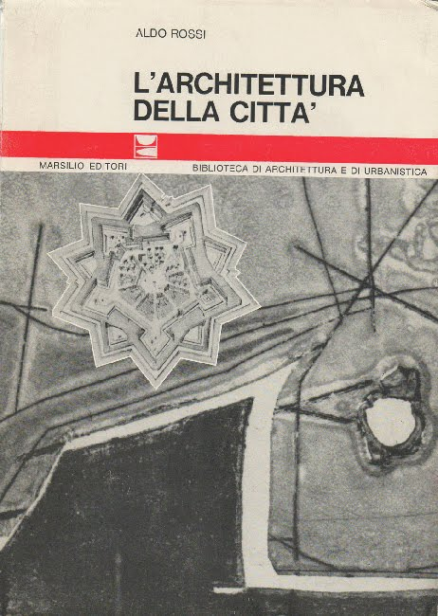
The Architecture of the City
He published his first book, “The Architecture of the City”, in 1966 in which he established his theory of the urban design. In this book Rossi promotes different thoughts of architectural structures and he portrays architecture as a positive science. Through the book we can also see he has a similar ideologies as the artists in the classical era. Additionally, he gives advices to modern architects about how to contemplate the city and he “argues that architects should be sensitive to urban context, making use of historical design precedent rather than trying to reinvent typologies.

Slide 8
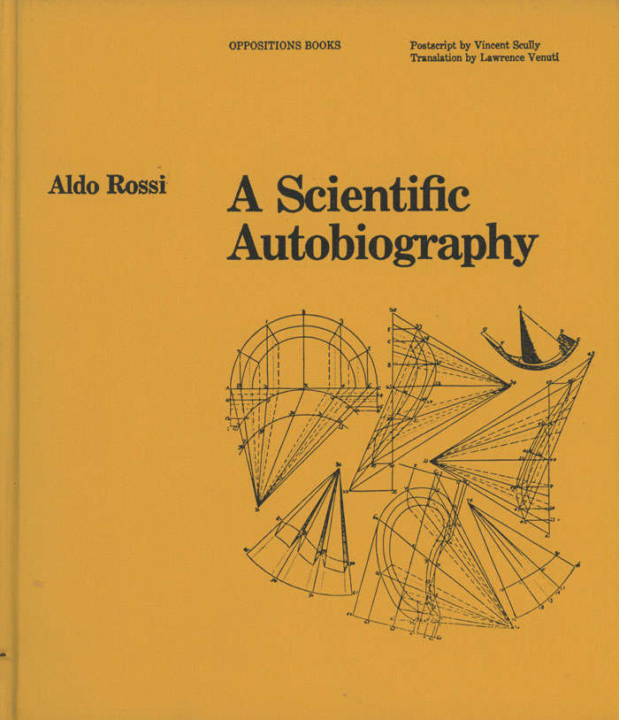
A Scientific Autobiography
Then in 1981 he published his autobiography. It was a revealing memoir with a mixture of literature, imagination and memories that contain his thoughts from his obsession with theater to his point of view in architecture.

Slide 9
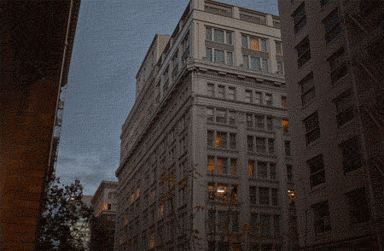
Architecture

Slide 10
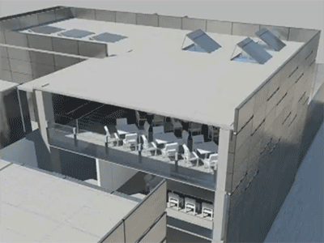
K. Michael Hays, Eliot Noyes professor of architectural theory on Aldo Rossi.
https://www.youtube.com/watch?v=zXLHxJhGcJU

Slide 11
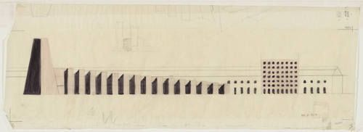
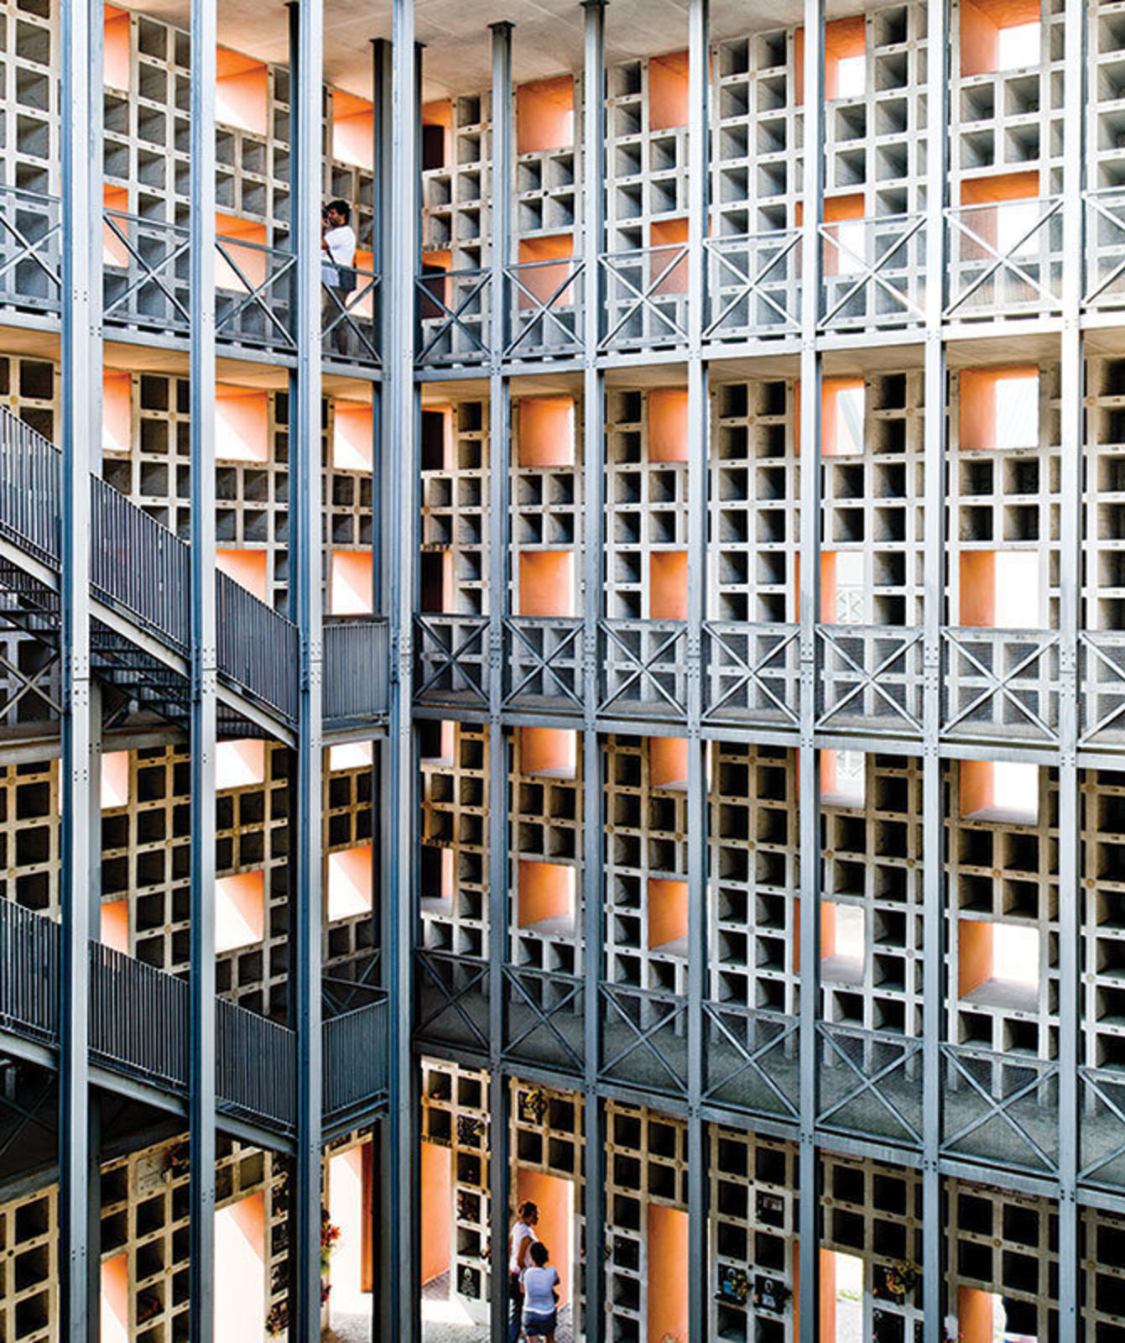
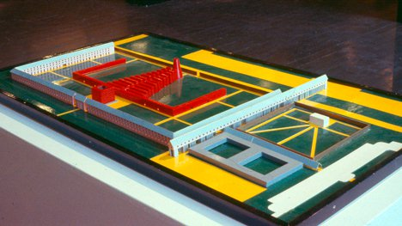
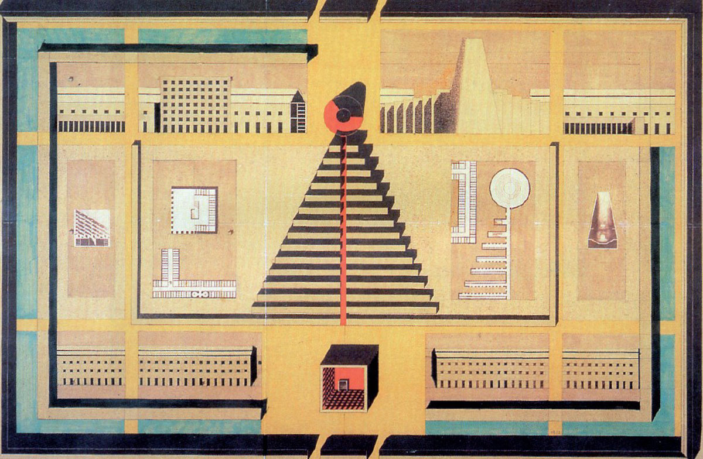
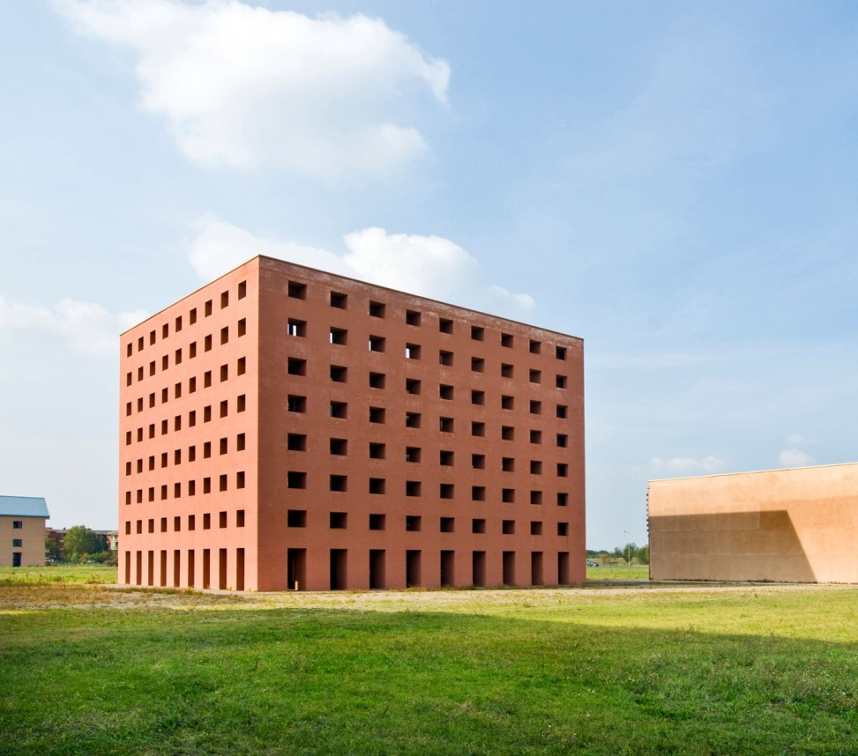
San Cataldo Cemetery
It is a complex cemetery from the neo rationalism style made in Modena, Italy in 1971.
The building was inspired by the 19th century Costa and Jewish cemeteries
It was built structure in a competition against Gianni Braghieri, which Rossi achieved to win with the cemetery.
The structure is characterized by its unadorned exteriors, uniformity in openings, and having no roof, windows, doors, or floor labs.

Slide 12
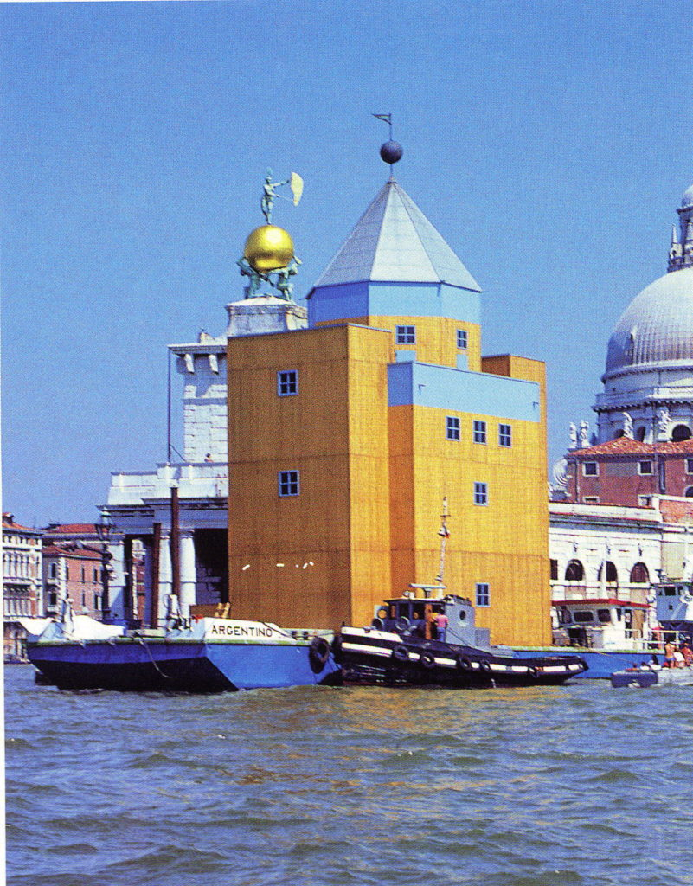
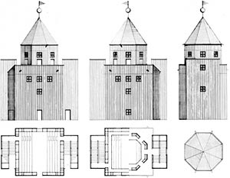
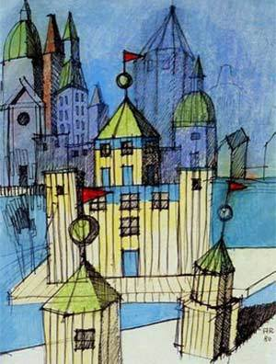
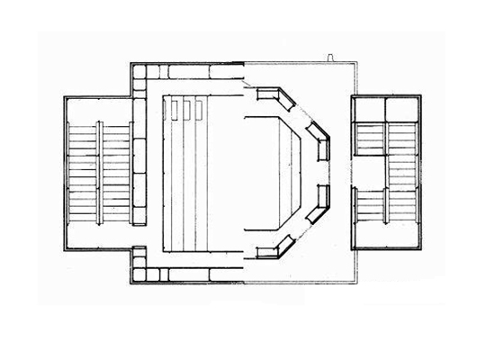
Teatro del Mondo
It is a modern temporary theater built in 1979 in Venice, Italy.
The main purpose of this building was to evoke the floating theaters as a stage for performing arts.
The theater is inspired in the Anatomic Theater of Padua and the Shakespearian Globe theater. However, unlike those two, in the Teatro Del Mondo the stage is a hall that links a door with a window and the structure of the main floor is not centralized

Slide 13
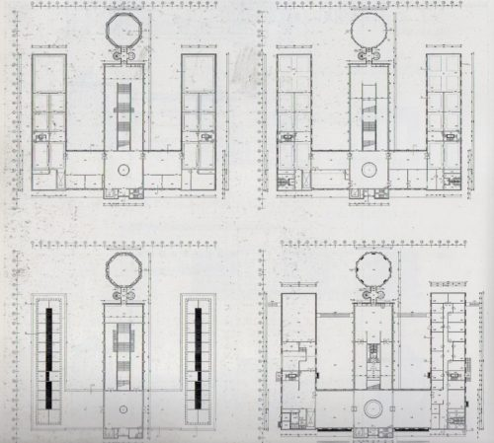
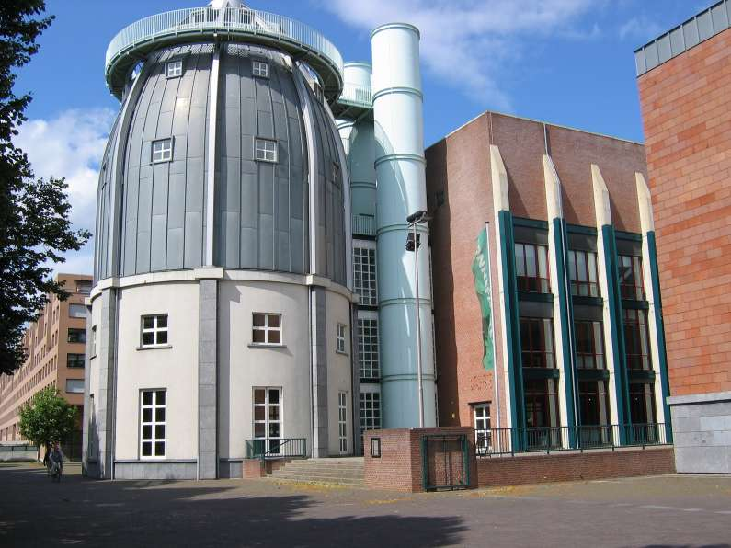
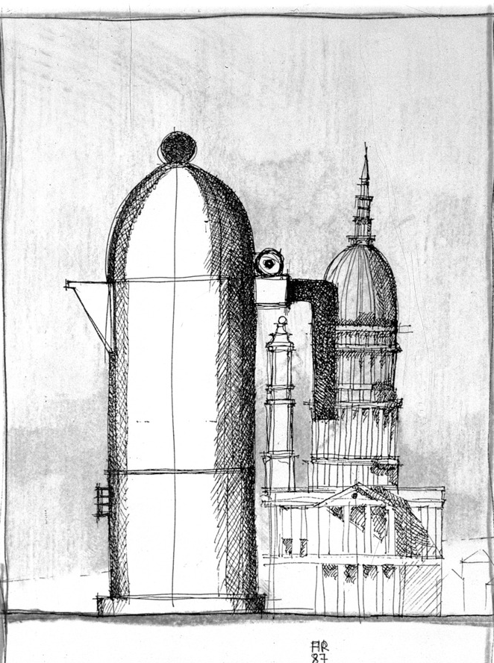
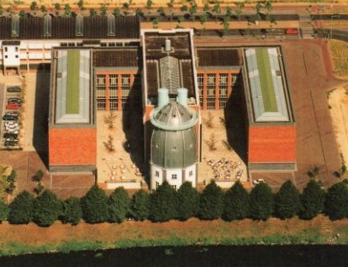
Bonnefanten Museum
It is a post modern museum located in Netherlands and built in 1992.
The structure is symmetrical and forms an E-shape
This structure shows a connection between his architecture and his artifacts of product design.
It is through this construction that Rossi shows how his architecture was based on forms.

Slide 14
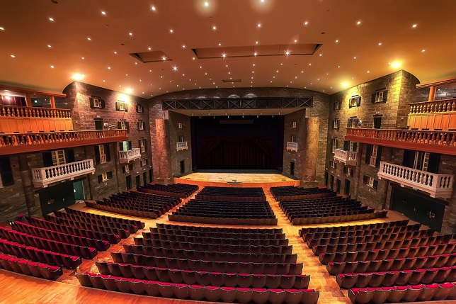
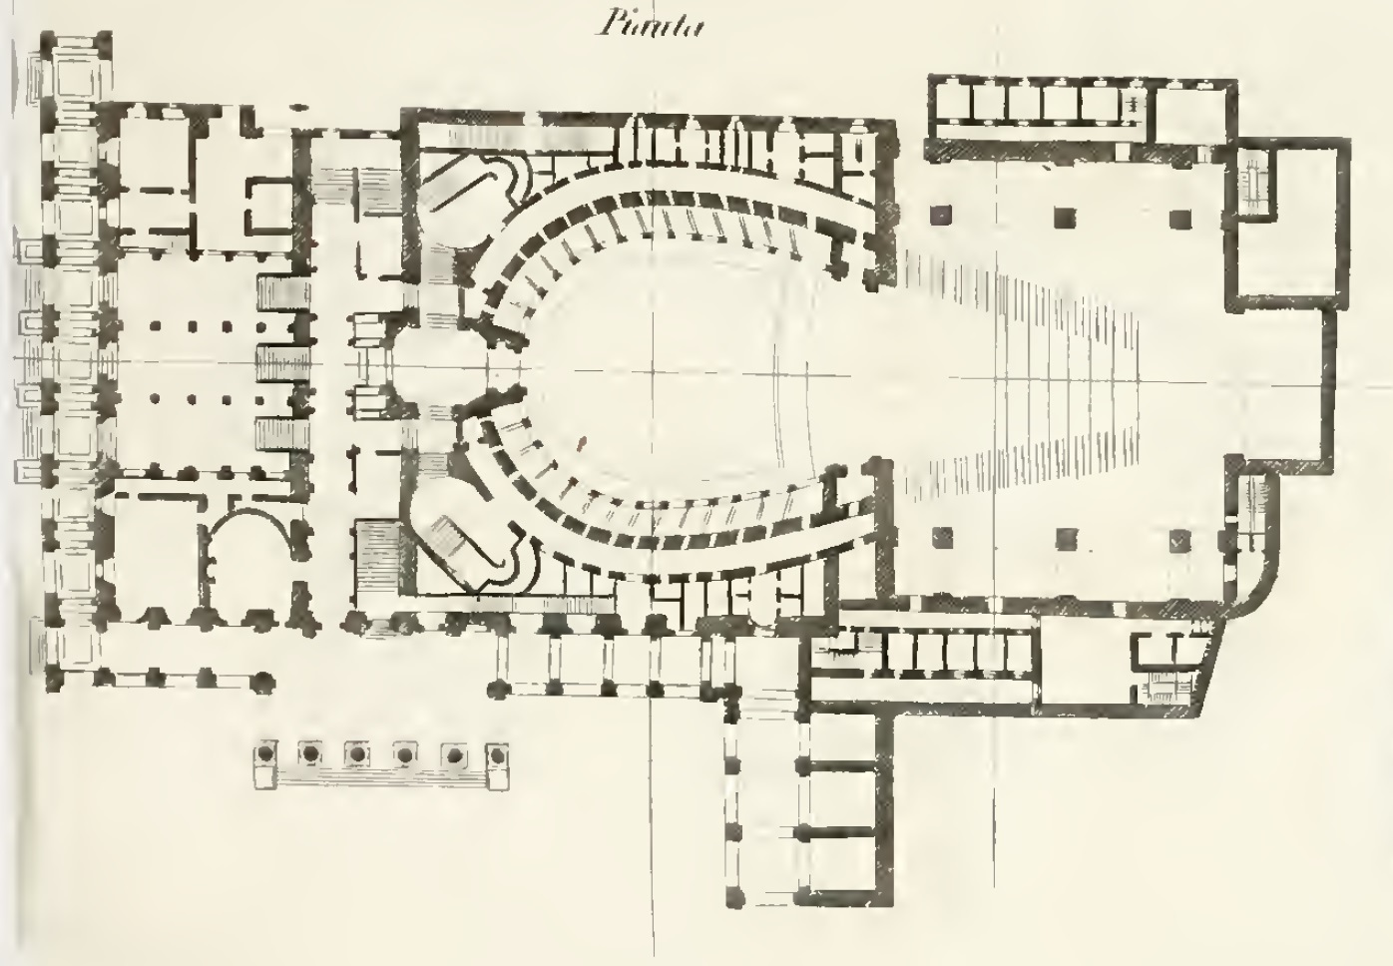
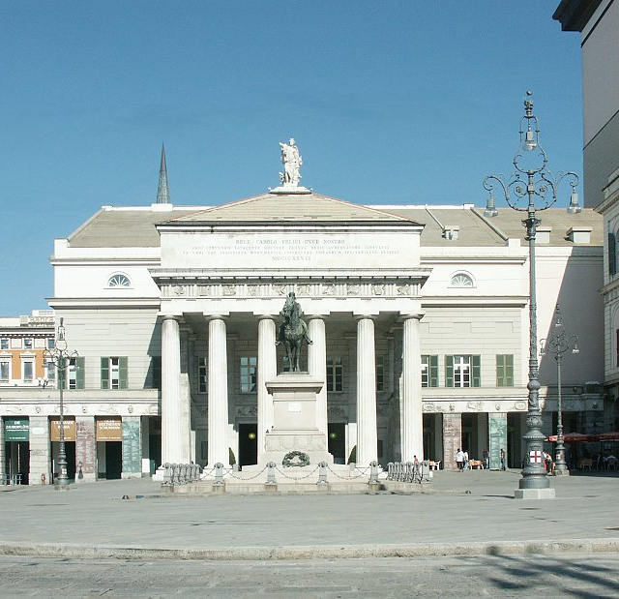
Carlo Felice Theater
Genoa’s Opera House severely suffered from the damages of WWII. In 1983 Aldo Rossi ‘ s design was selected in a competition to actualize the theater. He reconstructed the exterior and redesign the interior by keeping the old façade but adding amplitude and new technology.
Through this structure Rossi shows his preference for basic geometric forms and for the rationalist style.

Slide 15


