Slide 1
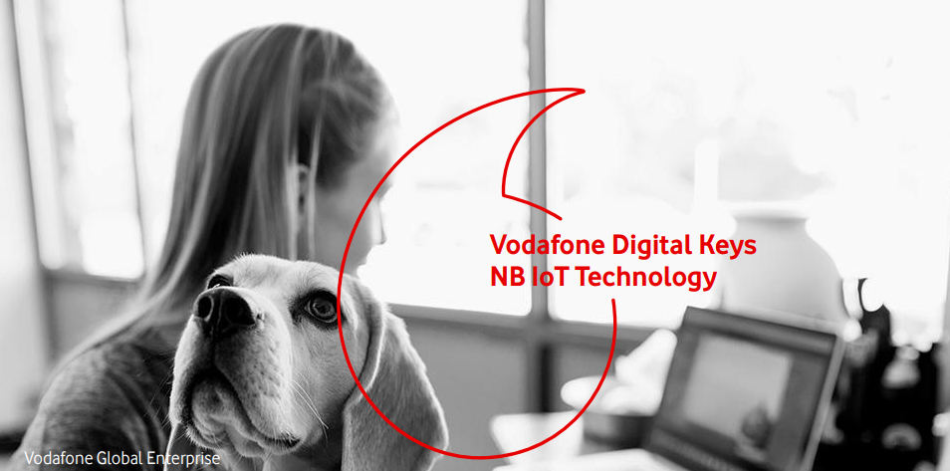
Notes:
Lock Manufacturers are still stuck in the middle ages. (Problem Slide)

Slide 2

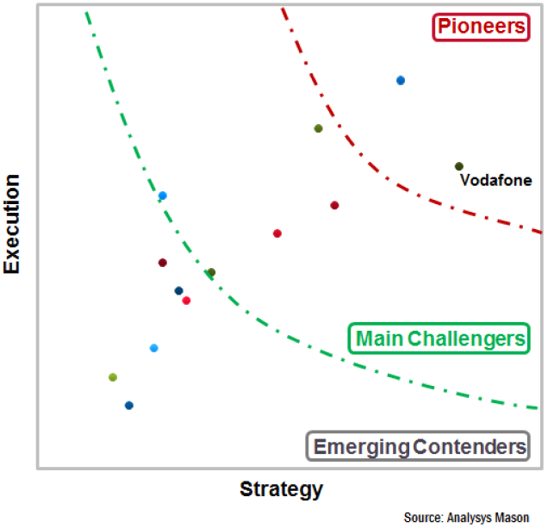
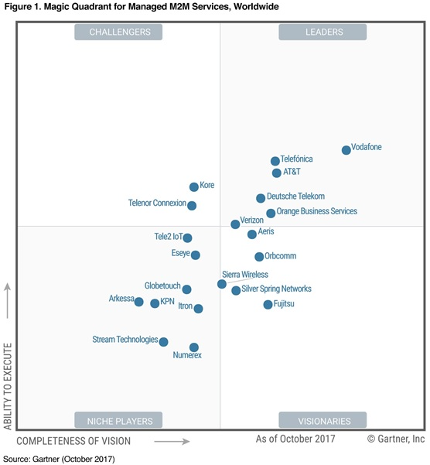
Vodafone Leadership Position

Slide 3





What is
Low Power Wide Area wireless network technology is specifically for connecting devices with low bandwidth requirements, using low power whilst providing increased penetration.
Many millions of devices will be connected via LPWA.
$
$

Slide 4
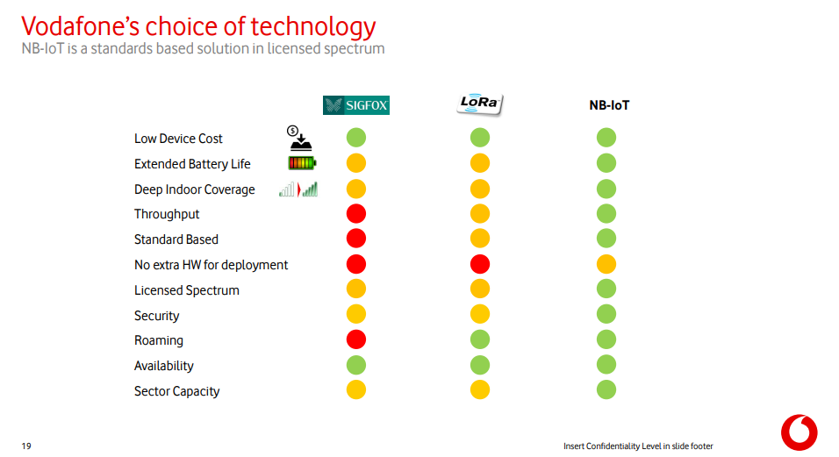

Slide 5


Existing Access Control is:
Insecure
Expensive
Inconvenient
Infrastructure heavy
Disconnected
Unintuitive

Slide 6
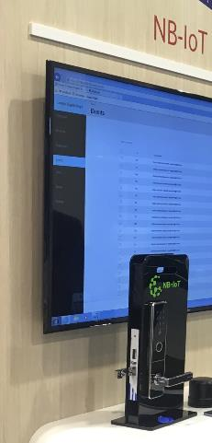
NB IoT Smart Access Control
Complete end-to-end solution - includes;
Digital Keys Management Platform
Smartphone apps
API’s
NB IoT Smart locks
Battery Powered - AA 4 years life, 30,000 activations
Metal Key Override – emergency access
Simple Installation – Plug and play reduces time compared to other solutions
Service, training, support – 2 year warranty
Choice of many opening methods – cards, NFC bracelets/rings, fobs, PIN of choice, smartphones

Slide 7

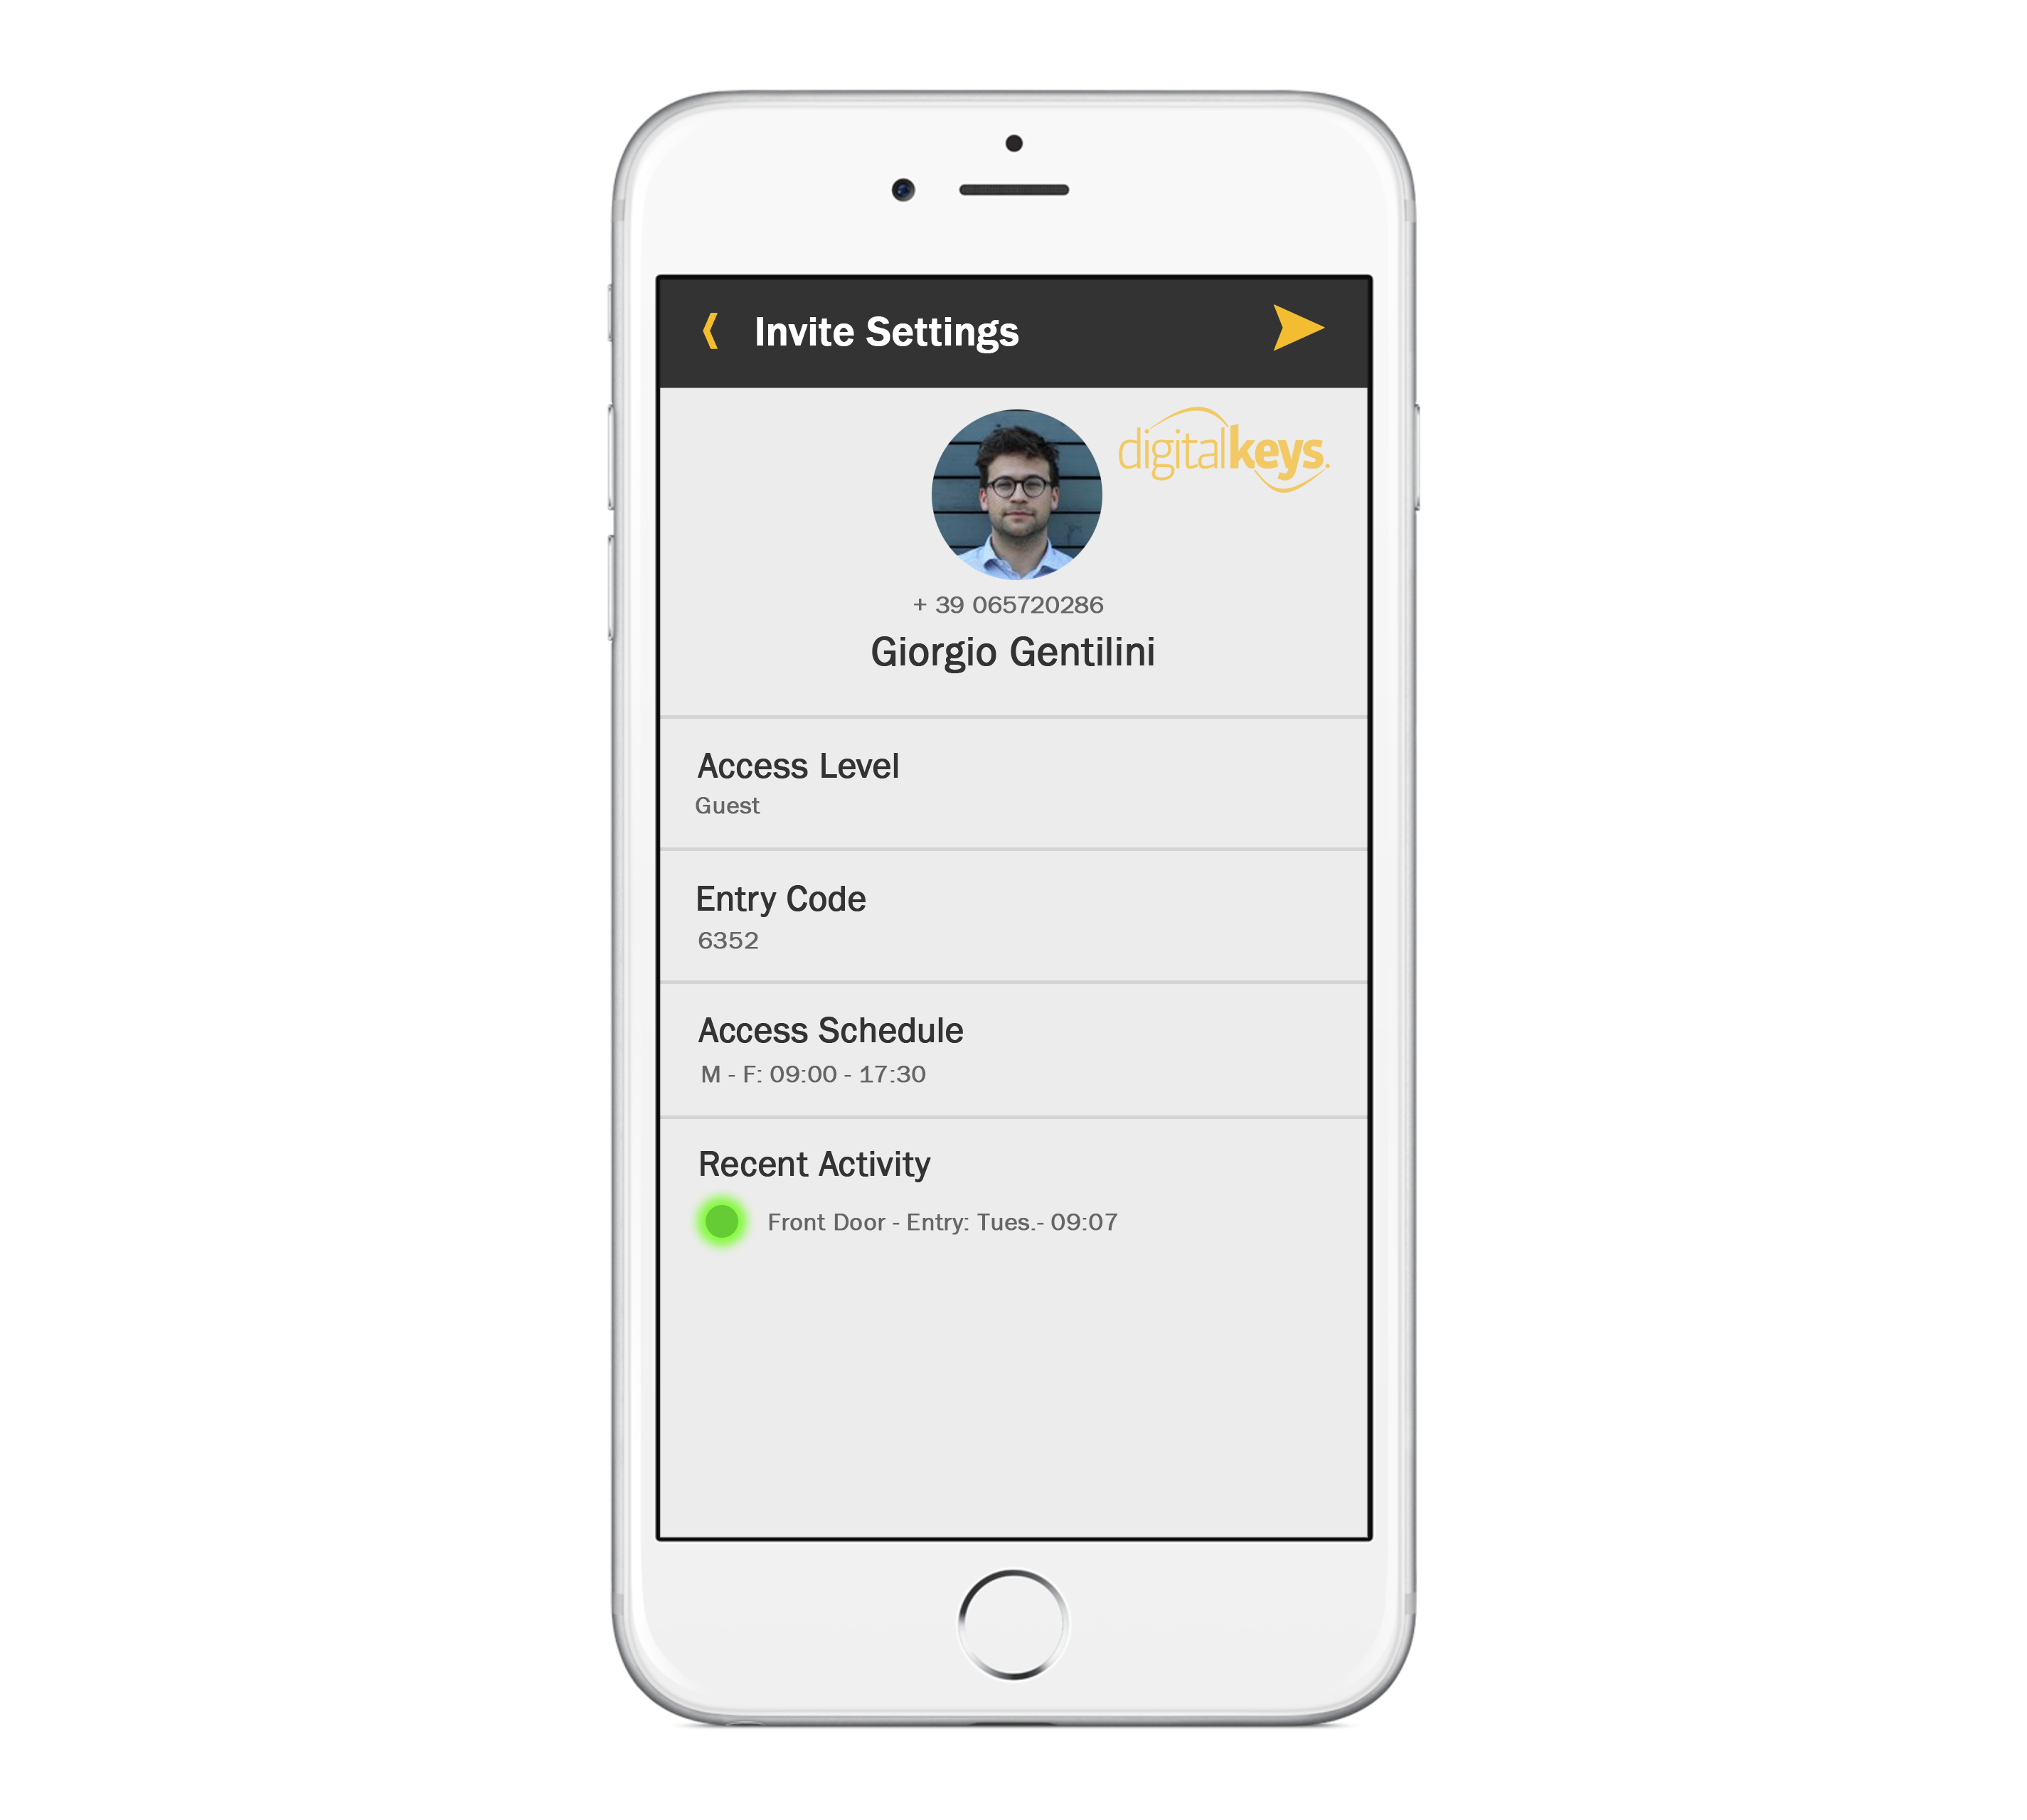
NB IoT Smart Access Control
Tracking employee hours and activities in real-time is essential for evacuation and safety reporting.
Create time-sensitive digital keys online, anywhere, for anyone, anytime.
Simple to use - linked key cards, NFC tokens.

Slide 8


Technology Comparison
 | RFID Keycard Systems | Wi-Fi/Bluetooth Systems | NB IoT systems
Time-sensitive access control
Typical set-up costs | Approximately €6000 | Wi-Fi systems approx. €300 (routers/modems etc) | €0*
Typical cost per lock | €400-€1500 | €250-€400 | €200-€300
Onsite infrastructure | Wiring, card encoder box, onsite PC/software, controller box, programmer device | Router, modem, cables, ISP, bridge, boosters, phone line | nothing
Key management software licence fee (per 100 locks annually - approx) | €1000 | €1000 | €1000
Security | Hacked; subject to man-in-middle attacks | 128 Bit encryption + congested/unstable/insecure network. Hacked;KRACK | 3072 Bit encryption + purpose built network for smart devices
Battery Life | 2 years | 3 months | 1.5 - 2 years
Online solution – incl. smart phone capabilities (e.g self check-in, 24/7 virtual check-in desk, big data, digital keys, live audit
*For off the shelf available NB IoT Smart locks. Customerised hardware designs TBD

Slide 9
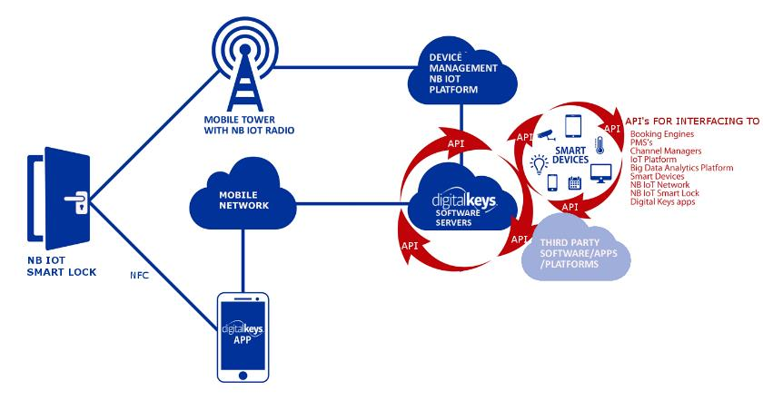
Ecosystem

Slide 10
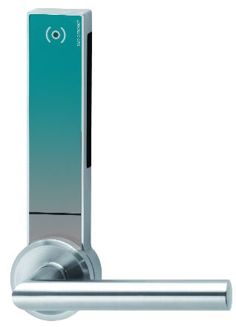
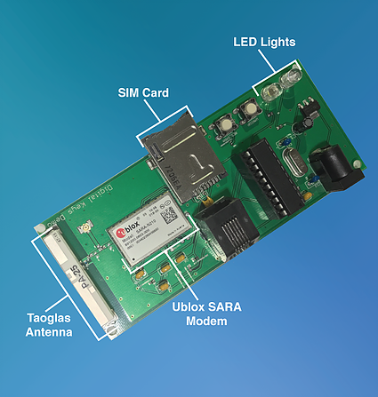
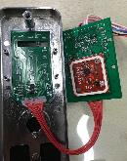
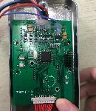
E2E NB IoT Smart Access Control Solution; PCB, Lock end NB IoT Smart Access Control System

Slide 11
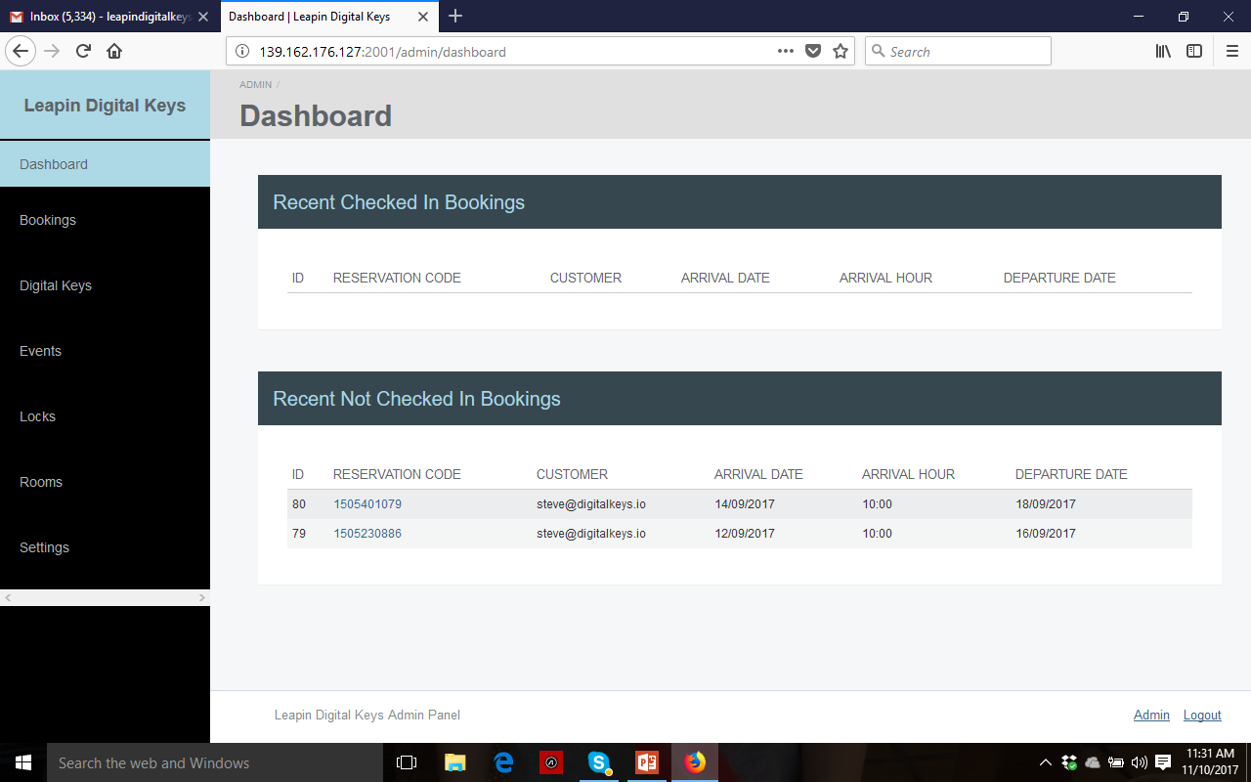
E2E NB IoT Smart Access Control Solution; Platform

Slide 12
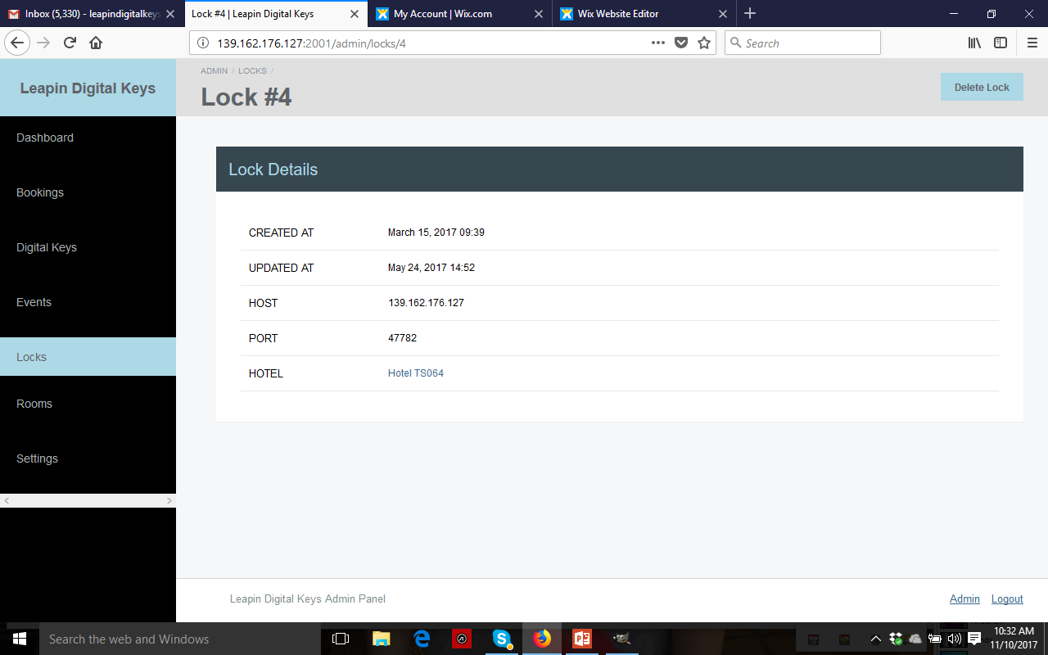
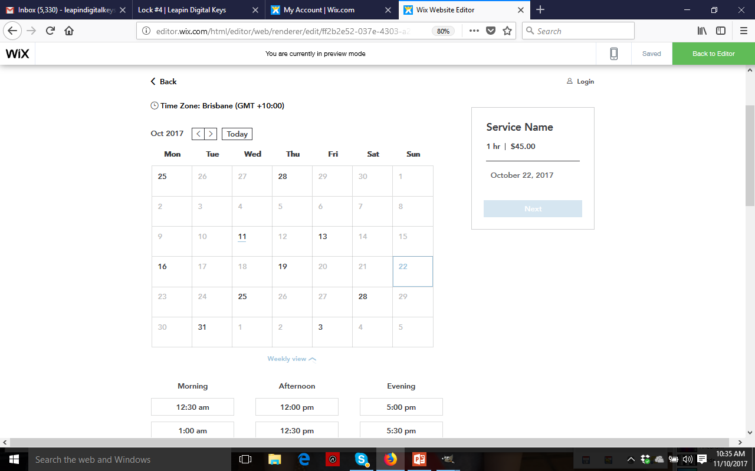
Generate/email time-sensitive digital keys and remote unlock
Remote Unlock

Slide 13
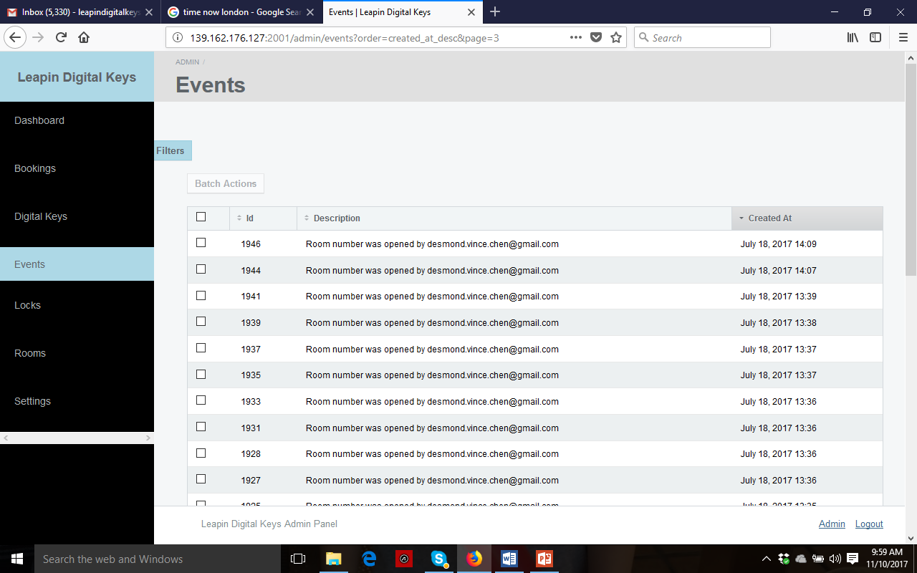

Live updates

Slide 14
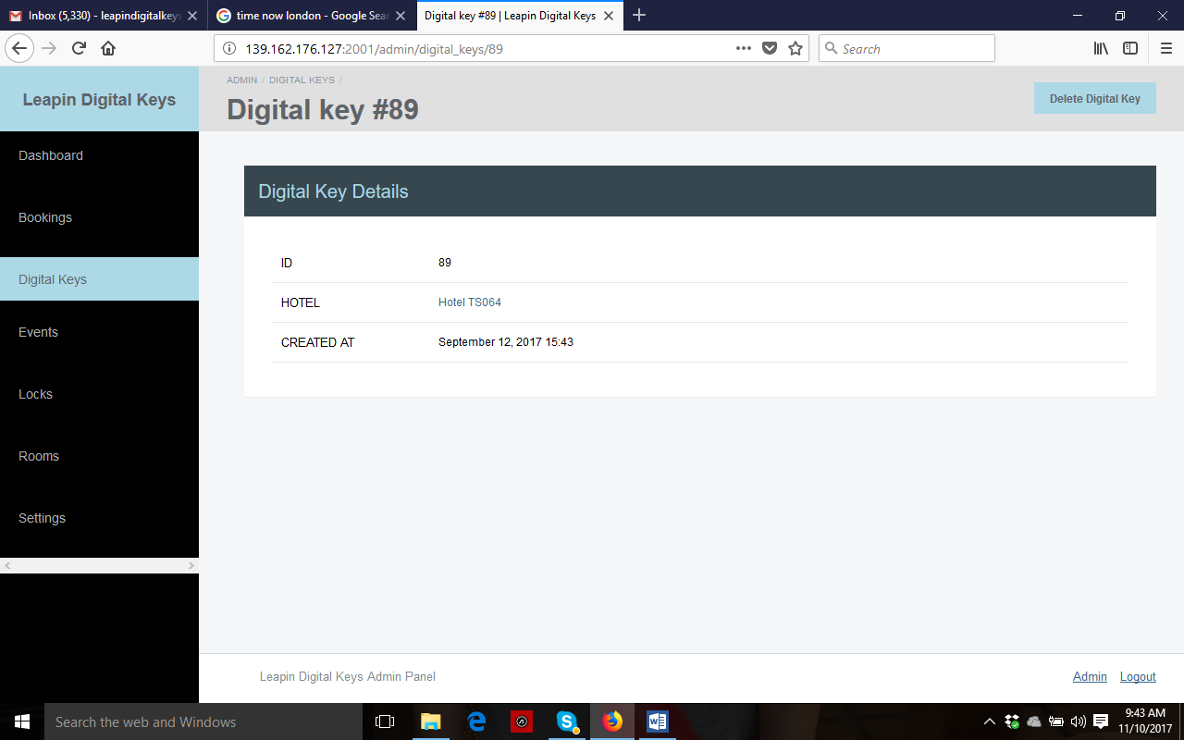
Cancel Digital Keys anytime

Slide 15
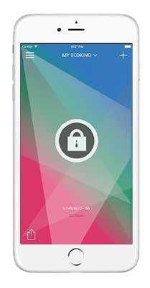
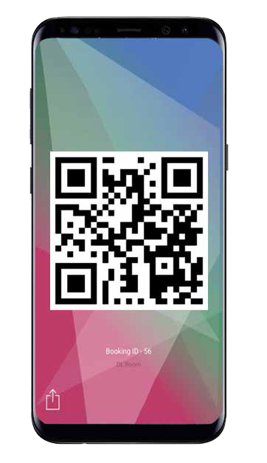


Digital Keys
Universal Digital Keys Apps FREE in the app stores
Customerised apps
Consultant quote on demand
Push one button
to unlock/share digital keys

Slide 16

Security features of NB-IoT powered Lock
3GPP & ETSI Global Security Standards
IP Network | Optional
Algorithm Negotiation
Critical Infrastructure Class | Access Classes 11-16
Reliable Delivery
Identity Protection | TMSI
Updatability (Device) | Possible
Updatability (Keys/Algorithms) | Optional (SIM OTA)
Network Authentication | LTE AKA
Data Confidentiality
Data Integrity | Optional (with DoNAS)
Network Monitoring and Filtering
Device/ Subscriber Authentication | UICC or eUICC
Control Integrity
Globally Unique Identifiers | IMSI
NB-IoT chipset Encryption | 2048 Bit RSA encryption
Military Grade Application Security
Network Level Security
Device & Application
Security

Slide 17
Security
1. The mobile network itself, of which NB-IoT is a part, is a fully managed network with mature and standardized security to guarantee the credential and integrity of all data running in it, comparing with unlicensed solutions.
​
2. NB-IoT as a mobile technology is applying 3GPP standardized security protocols at chipset level (3GPP is the organisation responsible for managing the mobile phone network). The NB-IoT chipset included in our NB Smart Locks also applies 2048 Bit RSA encryption.
​
3. Between the vertical applications, Digital Keys Management Platform, and Vodafone IoT platform, all communications are running on HTTPs military grade encryption to provide application layer securities.

Slide 18
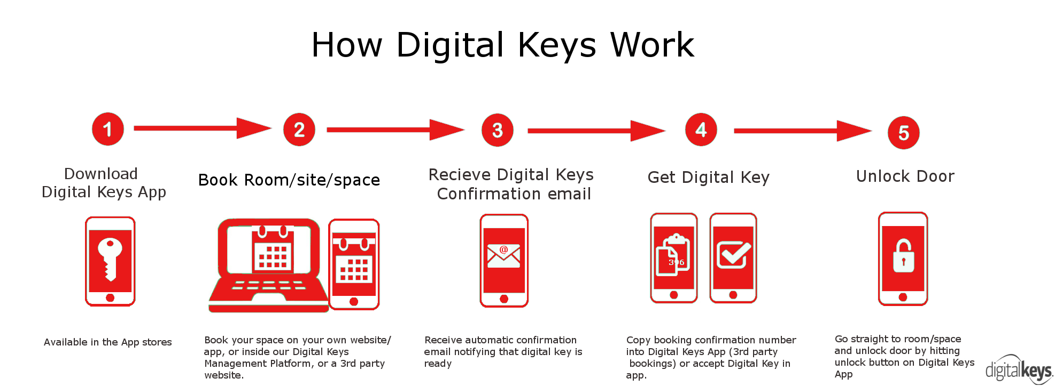
How it works

Slide 19
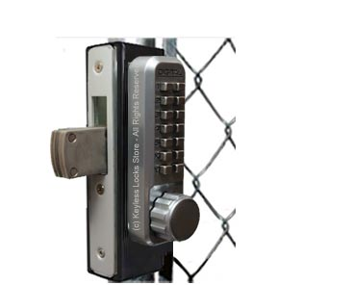
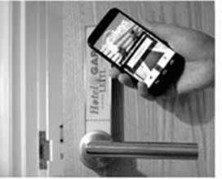
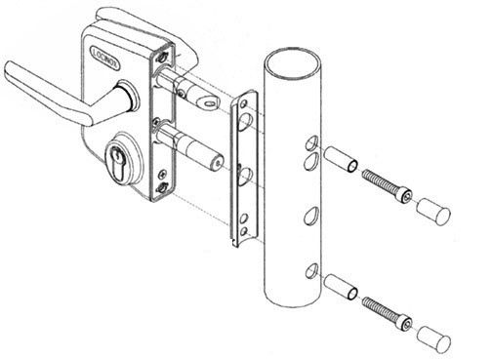
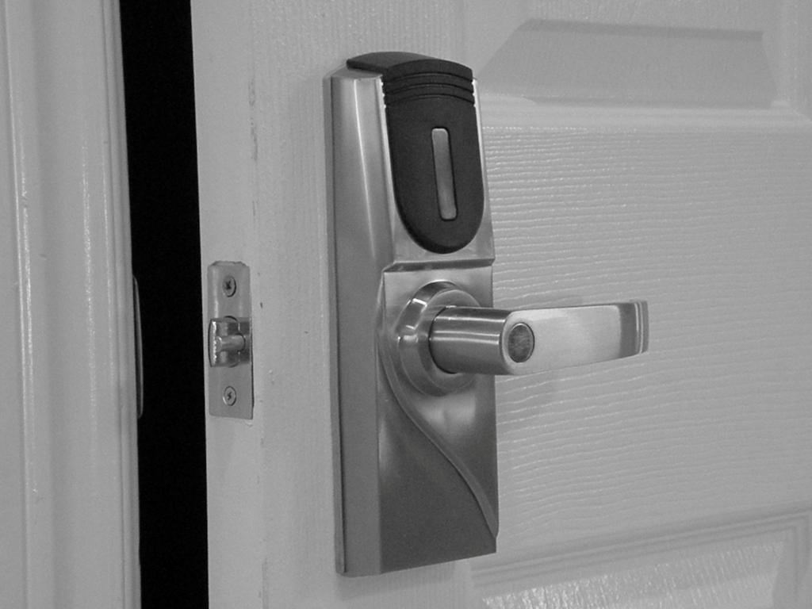
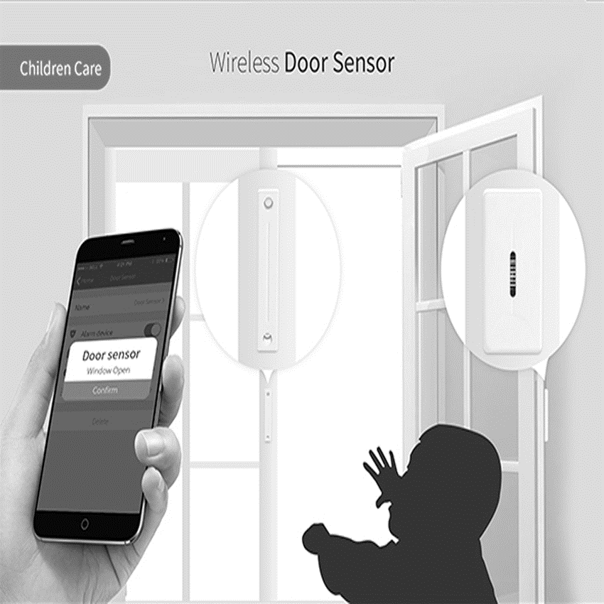
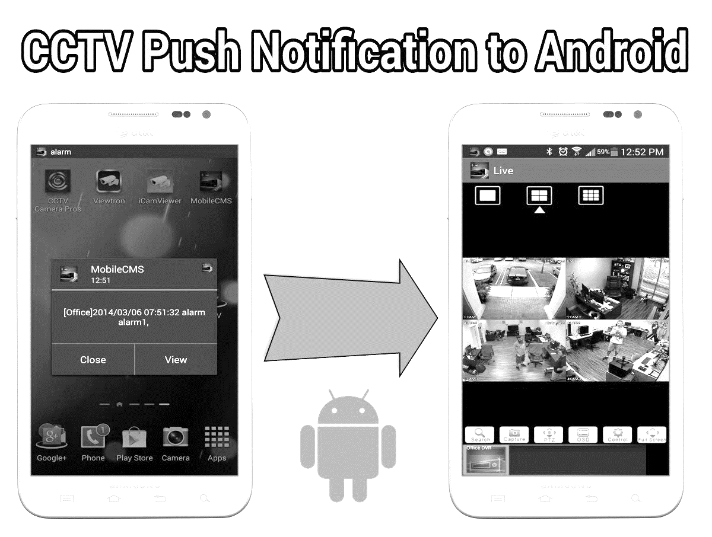
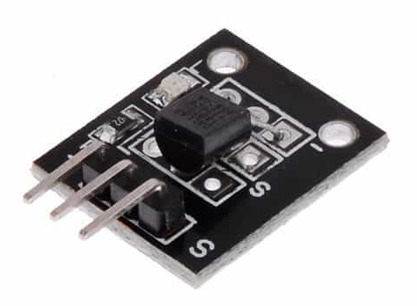
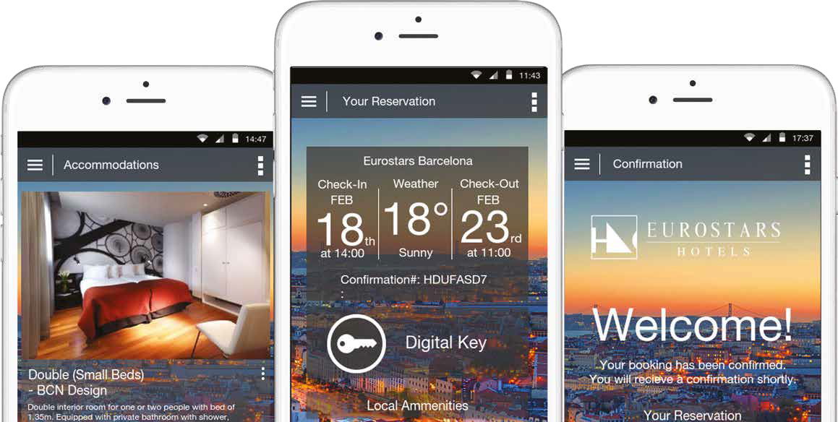
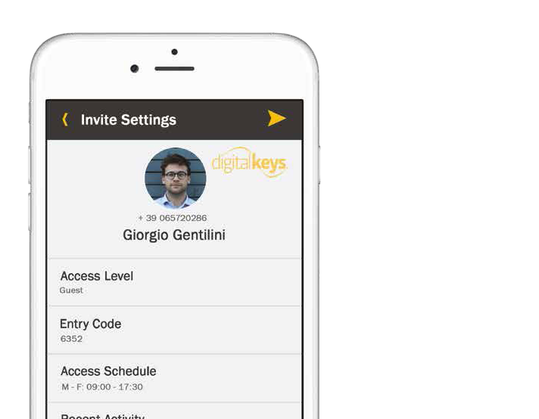
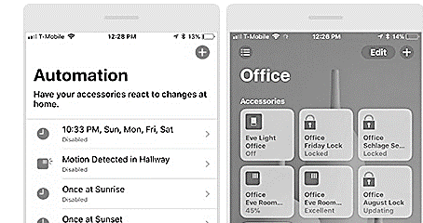
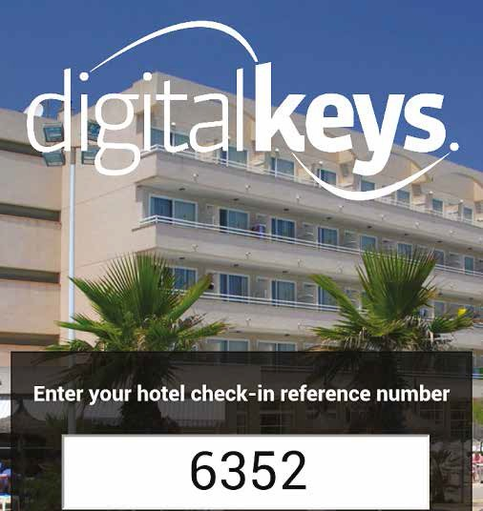
Customerisation
Any lock hardware design can be customerised
Add tampering sensors, alarms, notifications
Use API‘s to white label and customerise software, and apps

Slide 20
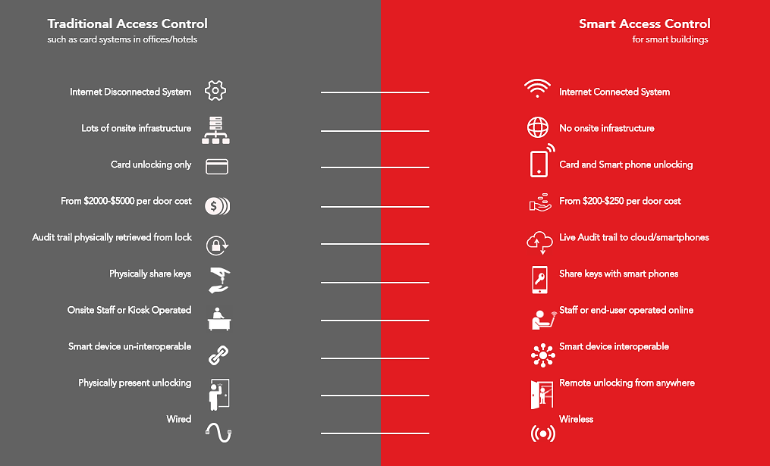
Differences between office keycard systems

Slide 21
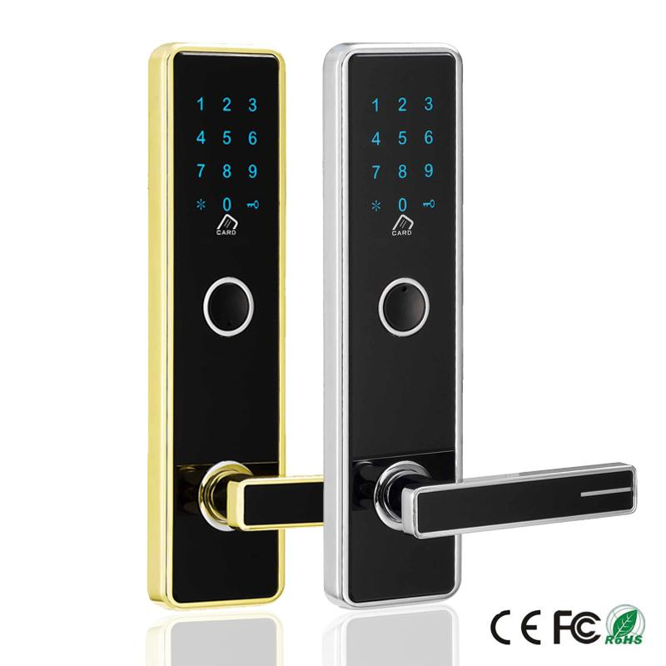

Costs
Item (non recurring fees) | Cost
NB IoT Smart locks | £250 per unit/door*
Installation time cost per lock (not including any travel related costs) | £30**
Item (recurring fees)
Digital Keys Management (DKM) Platform annual license fee | £1000 per year per 100 locks
API’s/server use fee for 3rd party white-labelling(if not using DKM Platform) | To be negotiated
Other costs
AA batteries, NFC cards/tokens, extended warranty | Provided on demand
*This is the price for the lock above - the NB IoT Smart lock LDK100, which is available now, as of June 2018.
For all new lock designs, a minimum order of 1000 is required(or a consult design fee to be negotiated), and cost per unit will be quoted separately.
All new locks include Vodafone SIM cards, and 2 years NB IoT connectivity.
** guide only, installation fees will vary depending on distributor quote, based on
volume and lock style

Slide 22
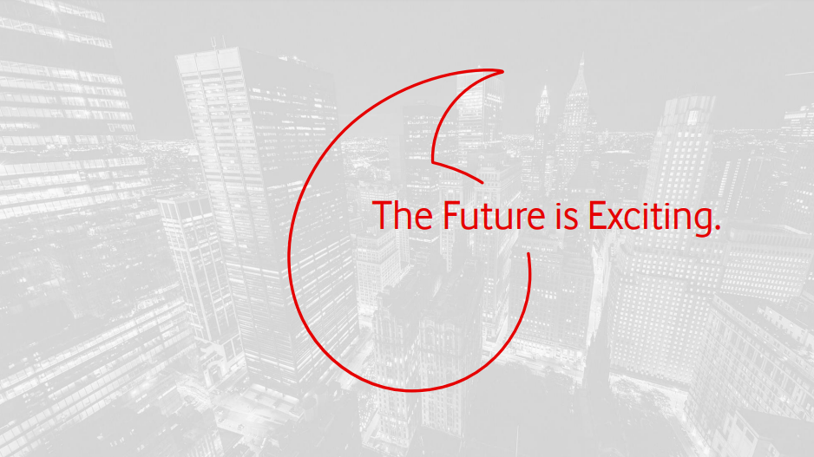

Slide 23
