Slide 1
OZONE Attainment in CT
10/28/2025
Jaimeson Sinclair, Director, Engineering
Bureau of Air Management

Slide 2

Attaining the NAAQs
NAAQS Attainment Status
Focus: Ozone

Slide 3




Connecticut’s ozone challenges
Connecticut has struggled to attain federal health-based standards for ground level ozone for 40 years
American Lung Association’s (ALA) State of the Air Report for 2023 gave failing grades for four CT counties due to the number of ozone exceedance days
Impacts of Climate Change Make it More Difficult to Attain Health-Based Air Quality Standards
Impacts of Air Pollution are Not Equitable People of Color are Almost 4x More Likely to Live in County that Fails to Meet Health-Based Standards

Slide 4
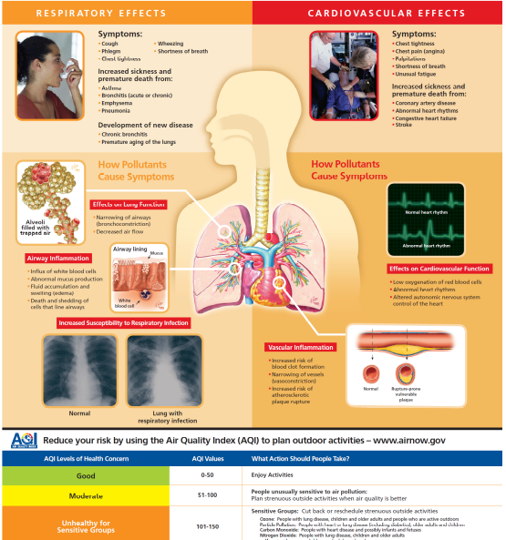
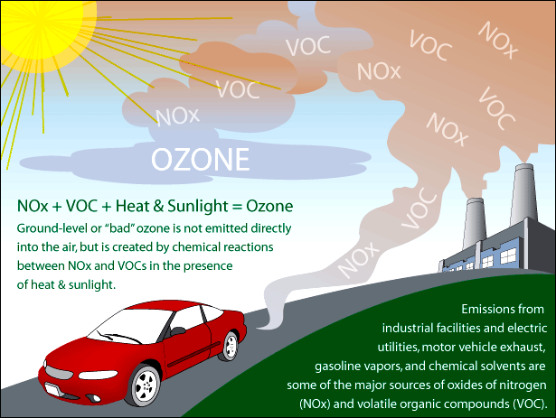
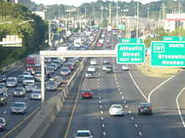
Ozone Pollution - Public Health and Equity
Ozone forms when NOx and VOC react during warm weather
Connecticut does not meet both the 2008 and 2015 8-hr ozone national ambient air quality standards
Breathing ozone triggers health problems; can reduce lung function and harm lung tissue. Ozone worsens bronchitis, emphysema, and asthma, leading to increased medical care costs and other economic impacts

Slide 5
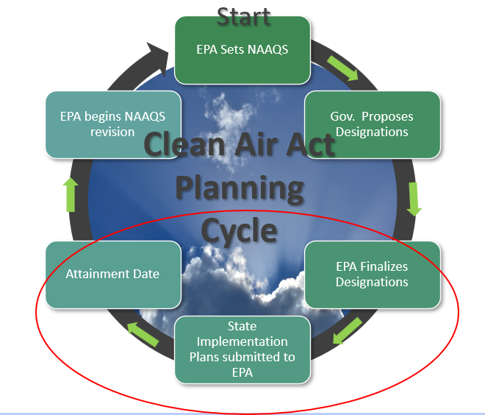

Air Quality planning cycle
EPA Sets and States Implement the NAAQs for six pollutants on a five-year schedule

Slide 6
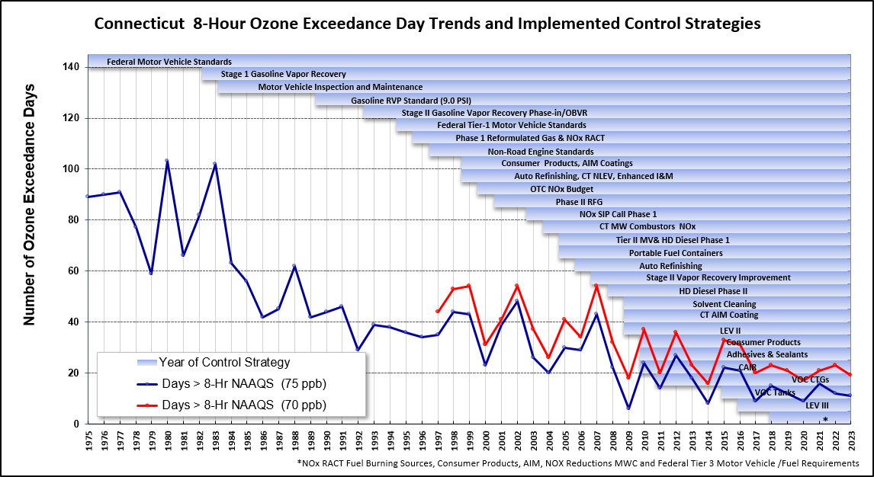
Connecticut’ progress in meeting the ozone NAaqs

Slide 7
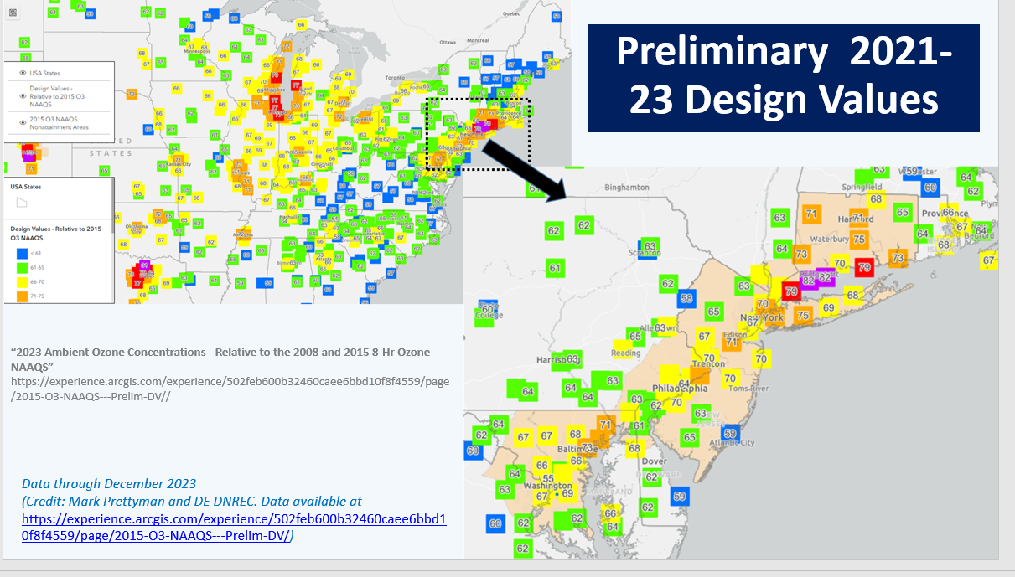
2023 ozone design values
2008 ozone standard is 75 ppb 2008
2015 ozone standard is 70 ppb
A design value is the average of the 4th highest monitored value from the previous three complete ozone seasons.

Slide 8
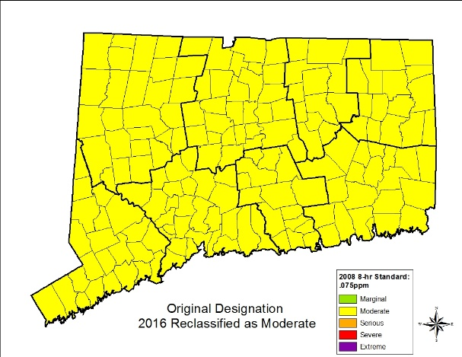
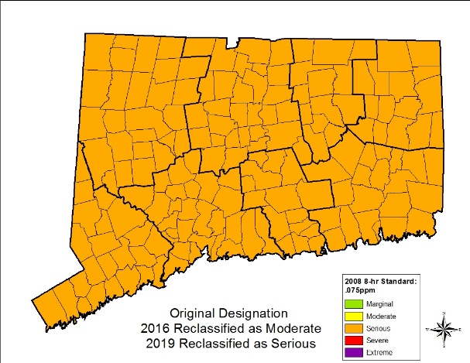
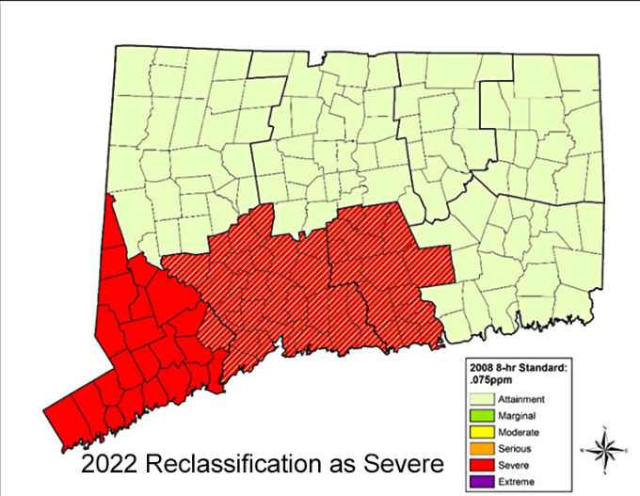
2008 Ozone naaqs: History of reclassification in Ct
SIP Revision Due Date
Jan. 1, 2017
Redesignation to Serious
September 23, 2019
Redesignation to Moderate
June 3, 2016
Attainment Date
July 20, 2018
Attainment Date
July 20, 2021
SIP Revision Due Date
August 3, 2020
Marginal nonattainment
Moderate nonattainment
Serious nonattainment
Severe Area Attainment Date July 20, 2027

Slide 9
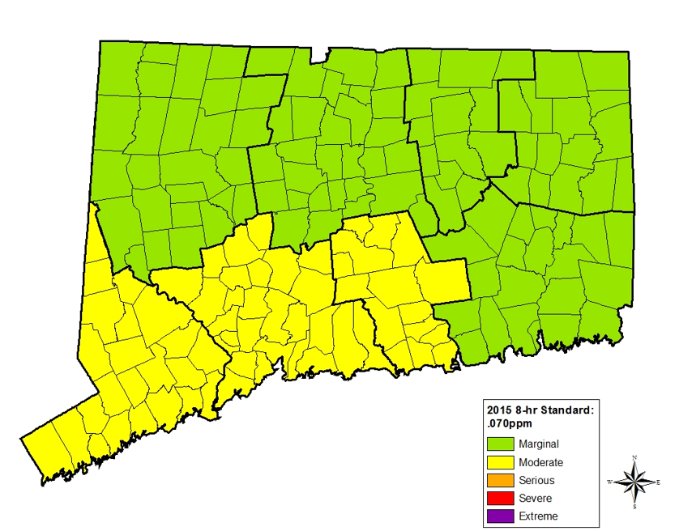
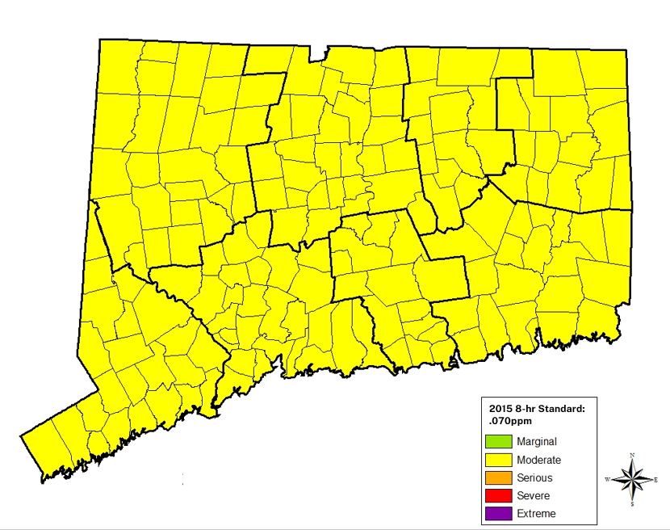

2015 Ozone naaqs: History of reclassification in Ct
Moderate SIP Revision Due Date
August 3, 2021
ReDesignation to Moderate
November 7, 2022
SIP Revision Due Date
January 1, 2023
Initial Designations
August 3, 2018
Marginal Attainment Date
August 3, 2021
Attainment Date
August 3, 2024
Marginal / Moderate nonattainment
Marginal / Moderate nonattainment
Moderate nonattainment
Serious nonattainment

Slide 10



Reclassification process: Update on permitting Activities
DEEP conducted extensive outreach focused on Middlesex and New Haven Counties given the new “severe” classification.
Few new regulated sources have been identified to date because of reclassification. Sources are seeking a mechanism to cap emissions for the Title V Program either under section 33a or 33b, requesting emission limits for NSR permits.
Timeline for submitting application for limits under section 33a or 33b – ASAP. Final deadline was 11/12/24.
VOC RACT and NOx RACT For VOC RACT, required to submit a compliance plan by 5/12/24

Slide 11

What will it take to reach ozone attainment in Connecticut?
EPA Letter to DEEP on Future Planning Efforts - November 27, 2023

Slide 12
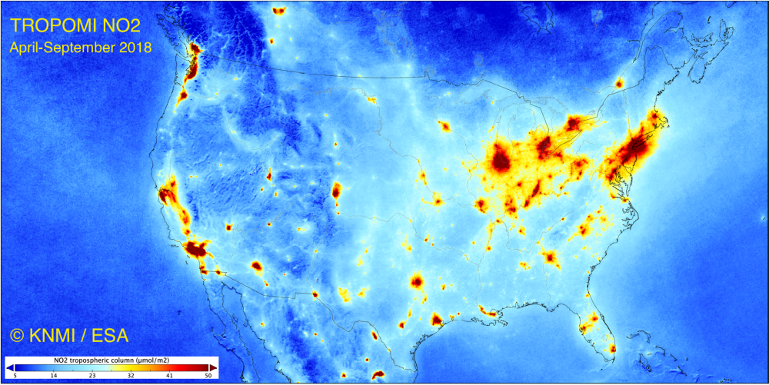
Substantial reductions of nitrogen oxides needed
in ct and the northeast

Slide 13
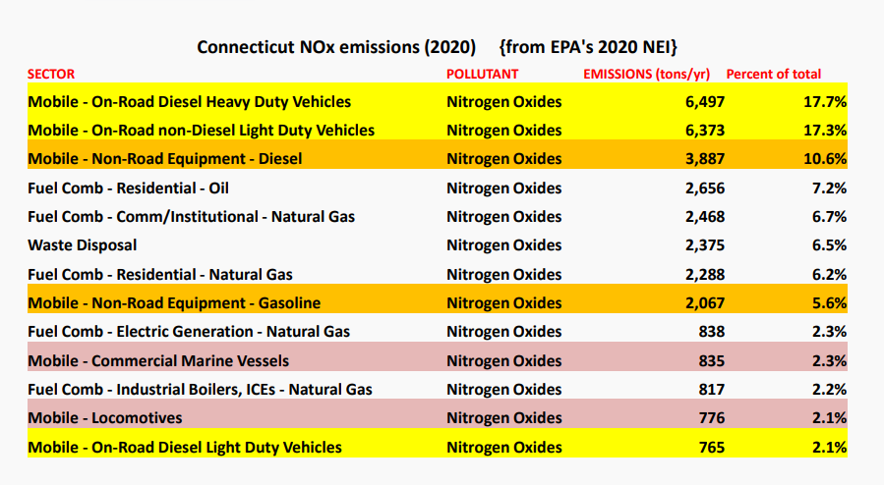
Highest emitting sectors OF noX eMISSIONS

Slide 14





What will it take to meet the Air quality standards in Connecticut?
EPA Must Continue to address the Interstate Transport of Air Pollution and Achieve Reductions through the “Good Neighbor Rule"
Reductions from the mobile source sector could have a significant impact in achieving the ozone standards.
Unfortunately EPA is rolling back limits for light, medium and heavy-duty vehicles so this sector is unlikely to deliver the level of reductions as quickly as needed.
Clean Air Act provisions require DEEP to consider adoption of local control measures to achieve reductions and avoid penalties and sanctions.

Slide 15
Progress towards ozone attainment
Connecticut has made significant progress to address ozone pollution in the state, but more reductions are needed.
Federal rules for cars, trucks, will provide some emission reduction benefits, but more reductions are needed.
Ongoing research will continue to provide scientific data to support state and federal pollution reduction efforts.
Section 182(j) of Clean Air Act requires states in multi-state nonattainment areas to work collaboratively in the development of plans to reach attainment. CT is working closely w NY and NJ to reduce elevated ozone pollution.

Slide 16

Questions

