Slide 1



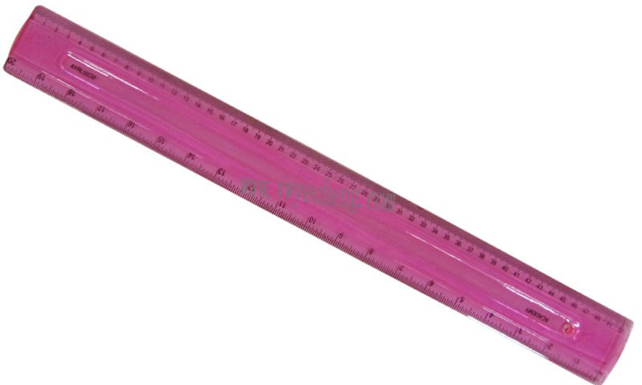
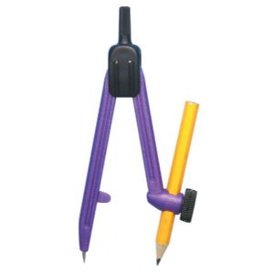
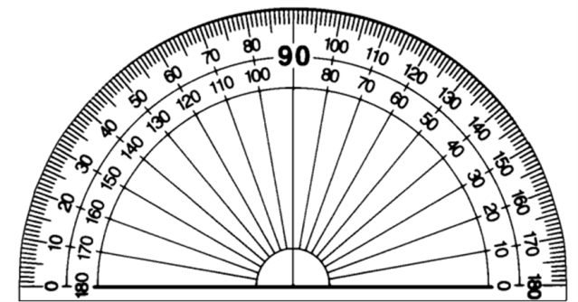
Maths Command Words
Estimate
Don’t work out exactly! Round the numbers to one significant figure first.
Simplify
Work out
Collect like terms together
Explain
A written or mental calculation is needed.
Simplify e + 7e
Answer: 8e
Estimate 4.7 x 6.2
Answer: 5 x 6 = 30
You must state why.
Work out 6²
Answer: 6 x 6 = 36
You must show your working
Give your answer in its simplest form
Calculate
Expand
You will need to do a sum either with or without your calculator.
Multiply out the brackets
If you don’t show your working you won’t get ALL the marks!
Cancelling of a fraction or ratio is needed.
Expand 4(3x – 2)
Answer: 12x – 8
12 : 15
simplified is 4 : 5
Solve
Describe fully
Factorise
Find the value of the variable in the question.
Usually with transformations:
Translation by a vector (2 marks)
Enlargement of a scale factor about a point (3 marks)
Reflection in a mirror line (2 marks)
Rotation through an angle about a point (3 marks)
To find factors and put brackets in.
Solve: 3x = 12
Answer: x = 4
Factorise 6x + 10x²
Answer: 2x(3 + 5x)
Measure
Use a ruler or protractor to accurately measure lines or angles.
Sketch
Construct, using ruler and compasses
An accurate drawing is not needed; freehand will do!
Diagram NOT accurately drawn
Use your ruler and pair of compasses to make an accurate drawing.
Don’t measure angles or sides.

