Slide 1
“Tech News”
Windows Server is a network operating system Microsoft, and can be deployed in medium to large scale industries in order to allow administrators to centrally manage the entire network setup right from a single location.
The network operating system (NOS) has some additional server specific features integrated in it. These additional features include:
Active Directory Domain Services (AD DS)
Dynamic Host Configuration Protocol (DHCP)
Domain Name System (DNS)
Active Directory Certificate Services (AD CS)
Active Directory Federation Services (AD FS)
Distributed File System (DFS), etc.
Requirements
The computer must meet the following minimum system requirements
1.4 GHz x86/x64 or Itanium 2 processor
512 MB RAM (2 GB recommended)
Super VGA or higher display
32 GB disk space (10 GB for Foundation Edition)
DVD drive
Keyboard and pointing device

Slide 2
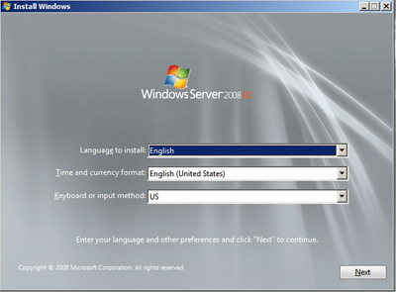
“Tech News”
Install Windows Server
Power on the computer on which Microsoft Windows Server 2008 R2 is to be installed.
Enter into the BIOS setup to make the computer boot from DVD.
Insert Microsoft Windows Server 2008 R2 bootable installation media.
Once inserted, reboot the computer.
On the Install Windows screen, click Next.
On the next page, click Install now.

Slide 3
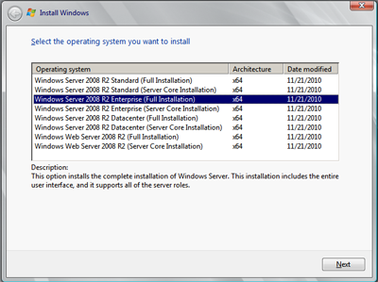
“Tech News”
On Select the Operating System you want to install page, from the displayed Windows Server 2008 R2 editions, select the appropriate edition that is to be installed.
On the next page, type the 25-character product key and click Next.
On Please read the License terms page, check I accept the license terms checkbox and click Next.

Slide 4
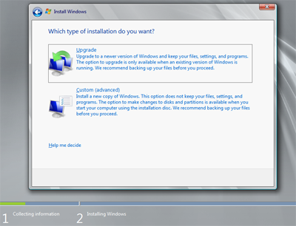
“Tech News”
On Which type of installation do you want page, click Custom (advanced).
Click Custom (Advance)

Slide 5
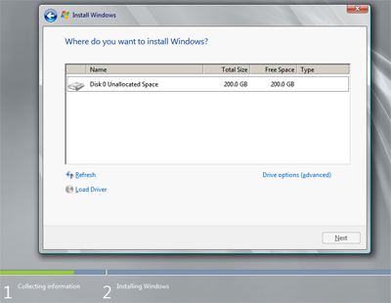
“Tech News”
On Where do you want to install Windows page, ensure that the hard disk drive on which Windows Server 2008 R2 is to be installed is selected.
Once selected, click Drive options (advanced).
Click Drive Options

Slide 6
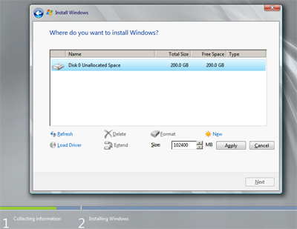
“Tech News”
From the enabled options, click New to create a new disk drive partition.
On the Size field, specify the size of the new volume in MB.
Specify Volume Size

Slide 7
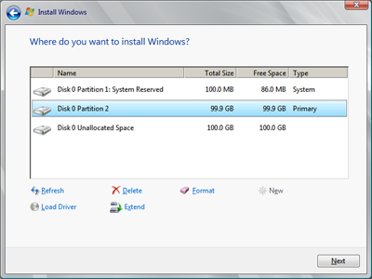
“Tech News”
On the displayed Install Windows message box, click OK.
Back on the same page, click to select the hard disk drive partition (E. g. Disk 0 Partition 2, in this demonstration) where Windows Server 2008 R2 is to be installed and click Next.
Select Disk Partition

Slide 8
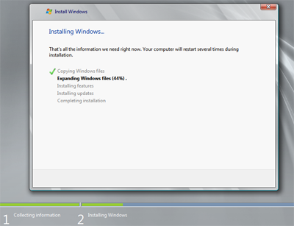
“Tech News”
On the Installing Windows page, wait till the Windows Server 2008 R2 installed and the computer get restarted.
Installing Windows
Note: Do not press any key if the screen displays the message, ‘Press any key to boot from CD or DVD’ while computer restarts for the first time, to resume the installation process.

Slide 9
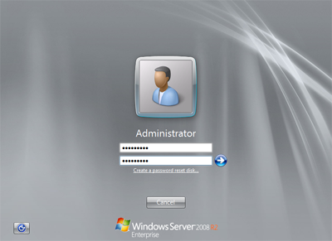
“Tech News”
After second restart, on the displayed screen, click OK to change the user password before logging on for the first time.
On the available fields, type and retype the new password and press Enter.
Change Password
On the next confirmation screen, click OK to log on to the Windows Server 2008 R2 computer.

