Slide 1
Configuring Server in a RACK
Where to Configure:
In the rack
On the bench
Precautions:
Anchor the Equipment Rack: The equipment rack must be anchored to an unmovable support to prevent it from falling over when one or more servers are extended in front of it on slide assemblies. The equipment rack must be installed according to the manufacturer's instructions.
Main AC Power Disconnect: It is responsible for installing an AC power disconnect for the entire rack unit. This main disconnect must be readily accessible, and it must be labeled as controlling power to the entire unit, not just to the server(s).
Grounding the Rack Installation: To avoid a potential electrical shock hazard, you must include a third wire safety grounding conductor with the rack installation.
Temperature: Extreme fluctuations in temperature can cause a variety of problems in your server.
Ventilation: The equipment rack must provide sufficient airflow to the front of the server to maintain proper cooling. It must also include ventilation sufficient to exhaust.

Slide 2
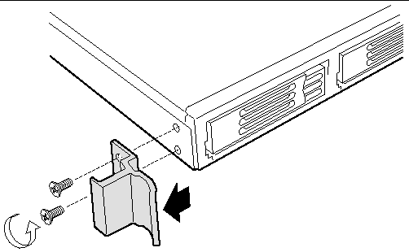
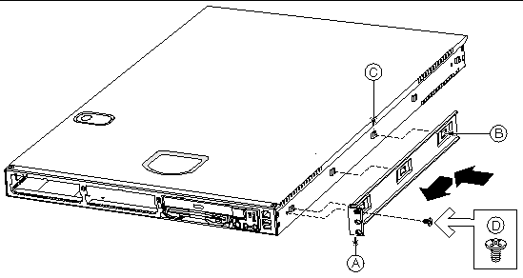
Configuring Server in a RACK
Mounting Methods
Bracket Kit : This mounting method is quick and easy, but makes it somewhat difficult to service the server.
Optional Slide Rail Kit : This mounting method is more complicated, but allows the server to be more easily serviced.
Installing the Server Using the Bracket Kit
Required Tools : Screwdriver
Mounting in a Four-Post Rack System
Attach Brackets to Chassis
Chassis bracket in front-mount position
Bracket holes
Chassis tabs
#6-32 x 3/16-inch screw

Slide 3
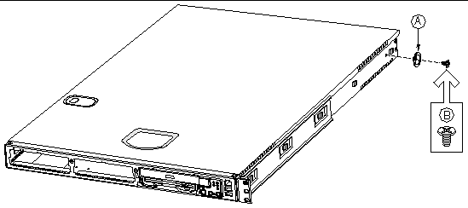
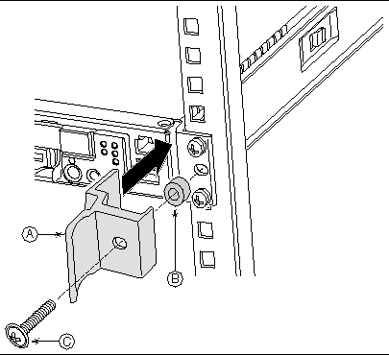
Configuring Server in a RACK
Attach Chassis Disks to Chassis: Place a chassis disk at the side of the chassis towards the rear
Install screw (B) and tighten.
In the same manner, attach a chassis disk to the opposite side of the chassis.
Install Chassis Handles : between the chassis and the chassis bracket.
Align the hole in the handle with the unused hole in the chassis bracket.
Install a spacer (B) between the handle and the chassis bracket.
Install and tighten screw (C) to secure the handle.
In the same manner, attach the other handle to the opposite side.
Replace the bezel :
Chassis handle
Spacer

Slide 4
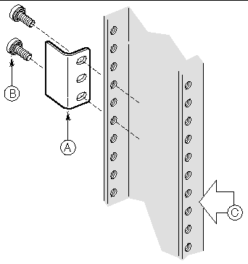
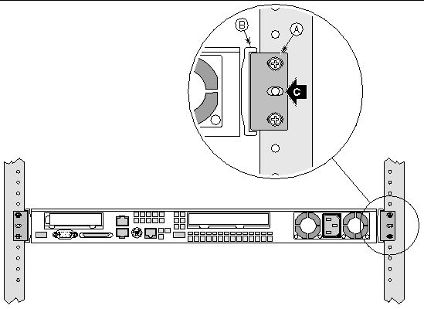
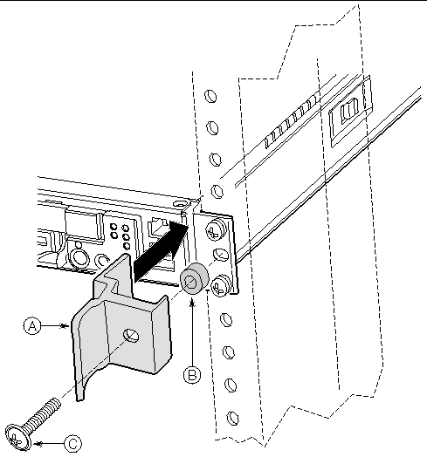
Configuring Server in a RACK
Attach L Brackets to Center Posts: Attach the L bracket to the center post using the screws (B) supplied with your rack. Do not fully tighten at this time.
In the same manner, attach an L bracket to the other center post.
Install Chassis in Rack:
Locate one person at the front of the rack and one at the rear.
Position the chassis so that the L brackets are inserted into the chassis mounting brackets .
While supporting the weight of the chassis, adjust the L brackets to fit tightly into the chassis brackets .

