Slide 1

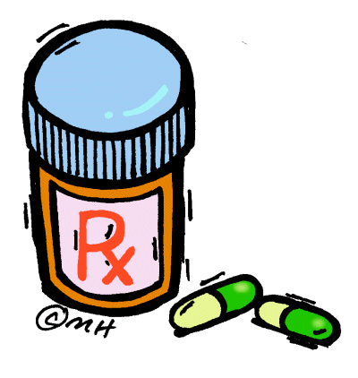
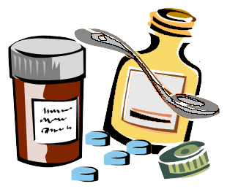
Future Pharmacists & Pharmaceutical Scientists
Romine Elementary School
Career Day
Henry North, Ph.D.
100 Black Men of Greater Little Rock
Harding University College of Pharmacy

Slide 2
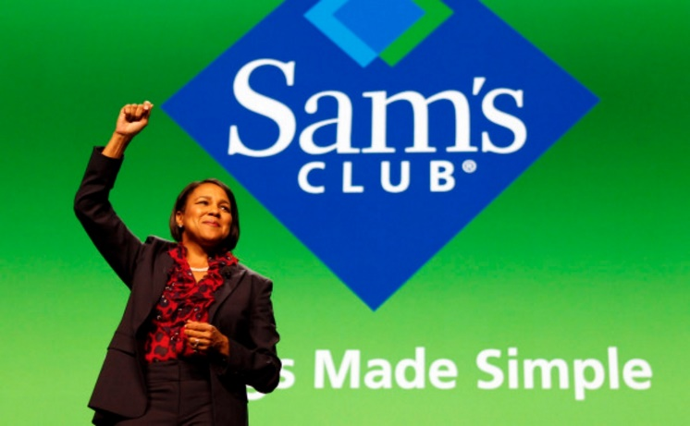

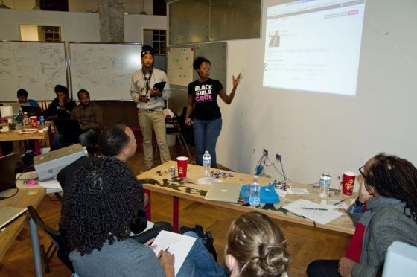


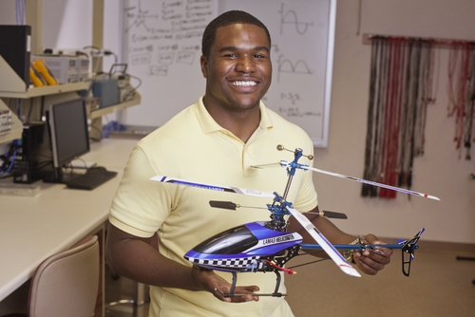
Lets Talk About Your Life!
What do you want to be when you grow up?
What does it take to get there?
Where are you now in the plans?
Four Volunteers Needed!!!

Slide 3
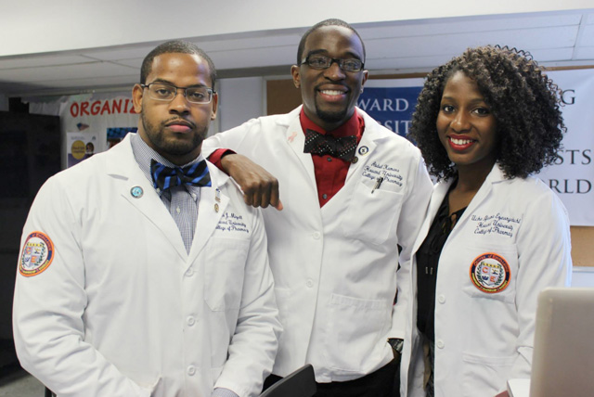
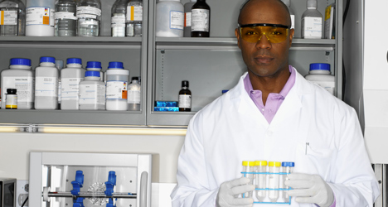
Do you know the difference between a Pharmacist and a Pharmaceutical Scientist?
Pharmacists work with existing drugs, patients, and other healthcare practitioners to optimize patient care and drug use.
Pharmaceutical scientists are typically involved in the development of new drugs. They spend most of their time doing research in a laboratory or office setting.
Notes:
While pharmacists are directly involved in patient care and work with existing drugs, it’s pharmaceutical scientists who create new drugs and therapies. The pharmaceutical sciences draw on a wide range of disciplines to discover, test, and manufacture new drugs and therapies, as well as evaluate their effectiveness and safety.
Pharmaceutical scientists can find employment at pharmaceutical and biotechnology companies, universities, regulatory agencies such as the Food and Drug Administration, and national laboratories such as the National Institutes of Health.
A career in pharmaceutical research requires strong interest in mathematics, biology, and the scientific process. Pharmaceutical scientists typically focus on a specific phase of the drug-development cycle — research, testing, or manufacturing. If you’re interested in a career in pharmaceutical research, you should pursue a degree in pharmaceutical sciences, pharmacy, biology, chemistry, medicine, engineering, or a related field.

Slide 4

What does it take to become a Pharmacist?
Be encouraged to take Math and Science courses.
Finish Elementary, Middle and High School.
Apply to college with a Pre-Pharmacy curriculum. If not at a college with a pharmacy school, look up the requirements for the Doctor of Pharmacy degree.
Get certified as a Pharmacy Technician
Have fun in college, GRADUATE!!!
Apply and get accepted to a Doctor of Pharmacy program.
After four years of study, Graduate!!!

Slide 5

What does it take to become a Pharmaceutical Scientist?
Be encouraged to take Math and Science courses.
Finish Elementary, Middle and High School.
Apply to college with a Science curriculum. Get a Bachelors degree in Chemistry, Biology, or Math. Some have Doctor of Pharmacy degree.
Have fun in college, GRADUATE!!!
Obtain research experience.
Apply and get accepted to a Doctor of Philosophy program with a Pharmaceutical Sciences program.
After completing the requirements, defend dissertation, Graduate!!!

Slide 6
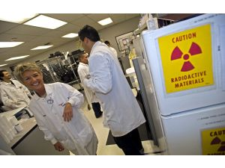
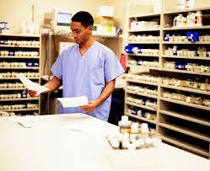
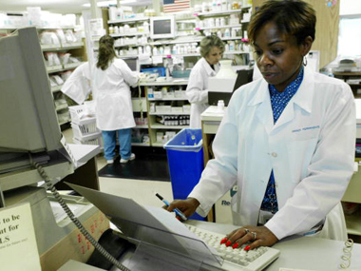
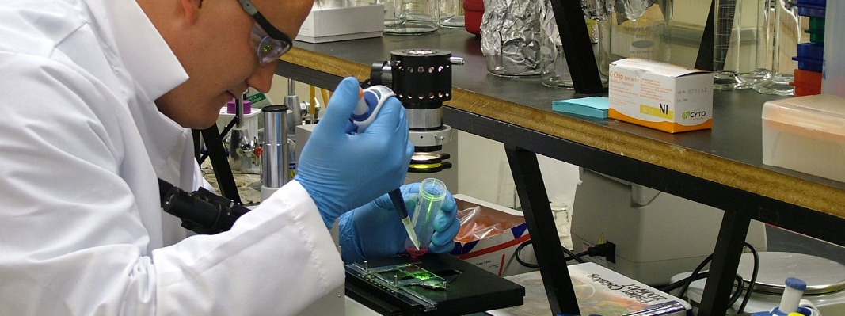
Roles of a Pharmacist
Nuclear Pharmacist
Retail Pharmacist
Hospital Pharmacist
Clinical Pharmacist

Slide 7
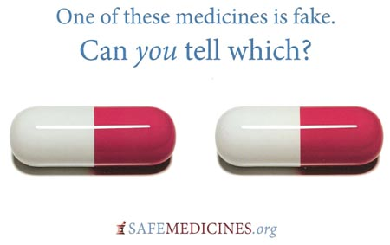

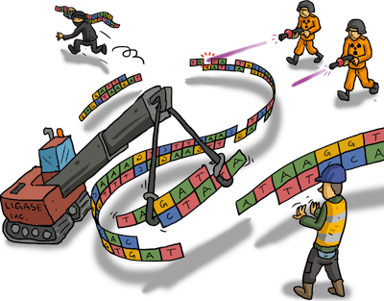
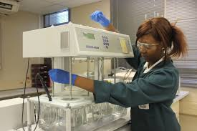

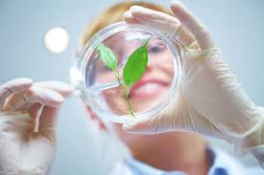
Disciplines of Pharmaceutical Science
Analysis and Pharmaceutical Quality—analytical techniques, quality control, and quality assurance.
Biotechnology—research, development, and commercialization of biotechnology-based pharmaceuticals, including genes and gene delivery.
Notes:
There are many difference disciplines that contribute to the discovery and development of new drugs and therapies. The following breakdown, which is how AAPS members choose to align themselves in our sections, loosely defines the categories of pharmaceutical science, with many specialties in each category.

Slide 8
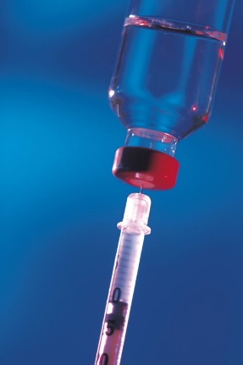
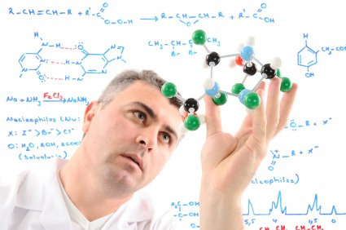
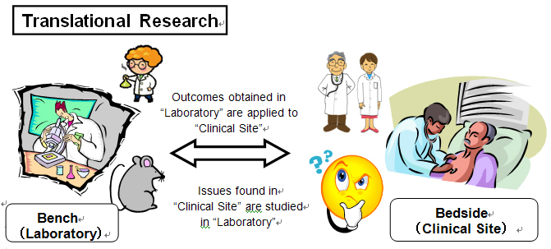
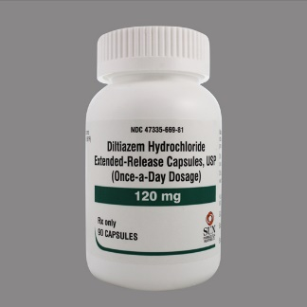
Disciplines of Pharmaceutical Science
Clinical Pharmacology and Translational Research—the clinical research dimension within the pharmaceutical sciences, focused on the therapeutic benefits and clinical assessment of drugs and biologicals.
Formulation Design and Development—formulation design, research and development; a multidisciplinary field drawing upon the physical, chemical, biological, and engineering sciences.

Slide 9
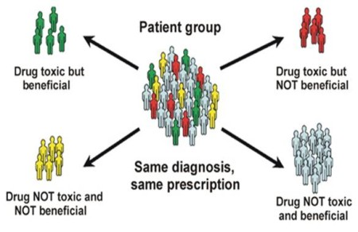
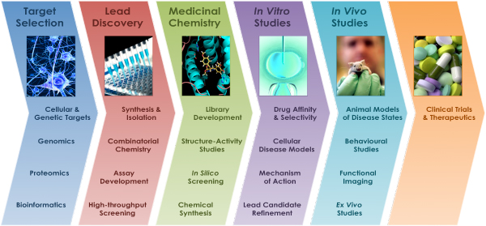
Disciplines of Pharmaceutical Science
Pharmacogenomics-the study of how genes affect a person's response to drugs. New field combines pharmacology (the science of drugs) and genomics (the study of genes and their functions) to develop effective, safe medications and doses that will be tailored to a person's genetic makeup.
Drug Discovery and Development Interface—medicinal, natural products, molecular and structural chemistry, and drug design and discovery.

Slide 10
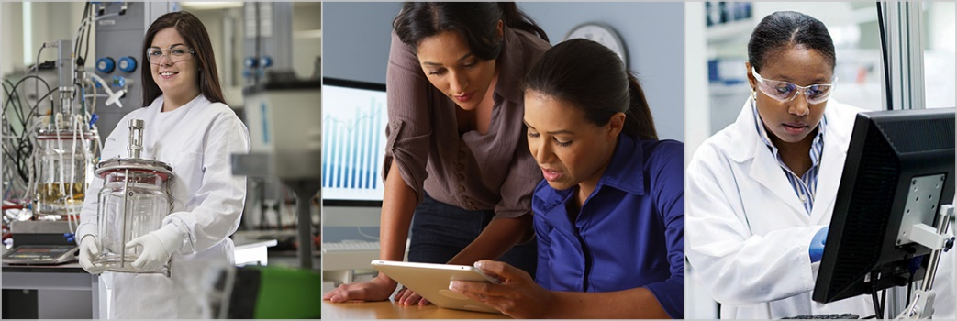

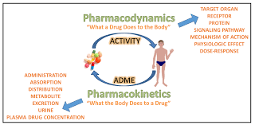
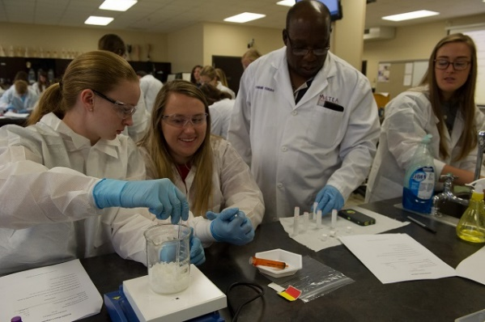
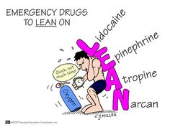
Disciplines of Pharmaceutical Science
Manufacturing Science and Engineering—the application and advancement of science and technology as it relates to process development and manufacture of pharmaceutical and pharmaceutically related products including medical devices and active pharmaceutical ingredients.
Pharmacokinetics, Pharmacodynamics, and Drug Metabolism—the effect of drugs and metabolites on the body and the effect of the body on drugs.

Slide 11
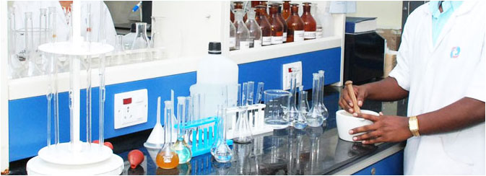

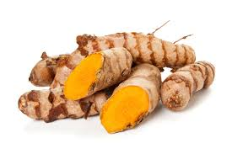
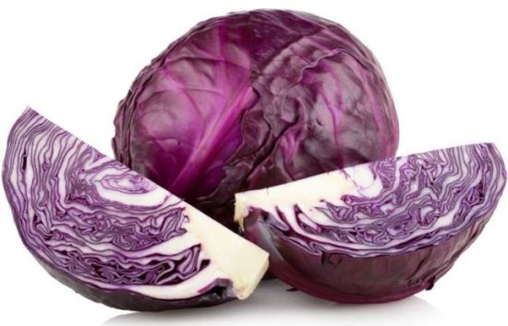
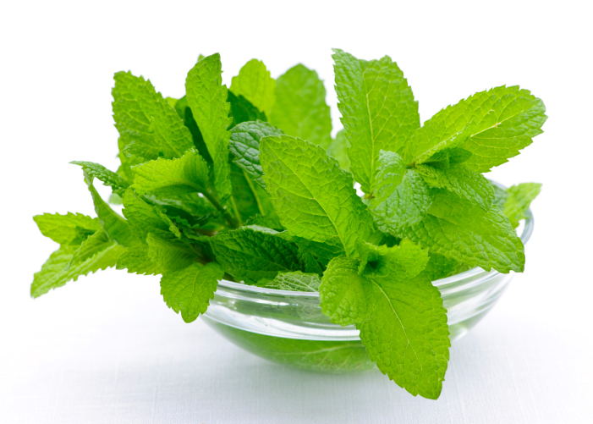
Laboratory Exercise
Can plants/vegetables be Medicinal Agents?
Hibiscus
Turmeric
Red Cabbage
Mint
Let’s Find Out!

Slide 12
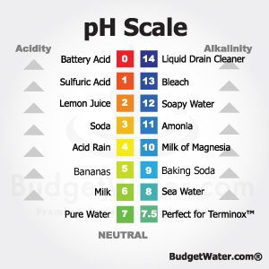
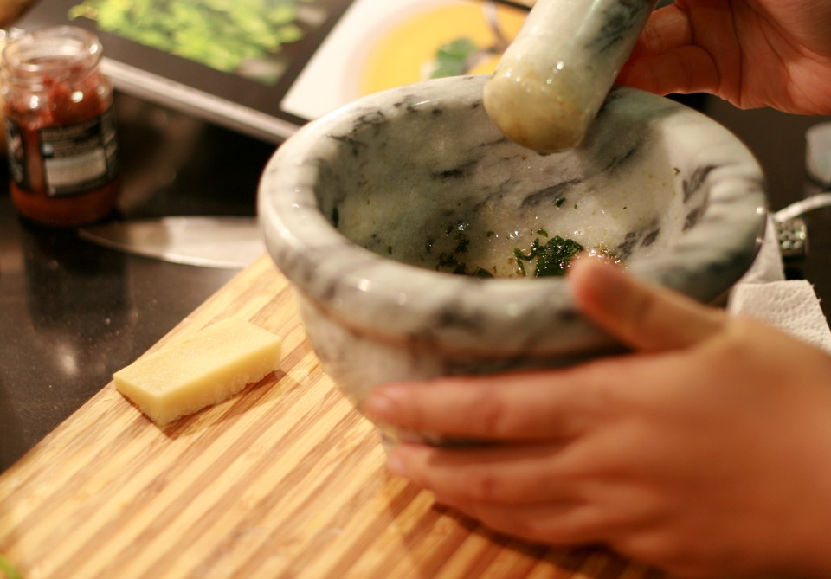
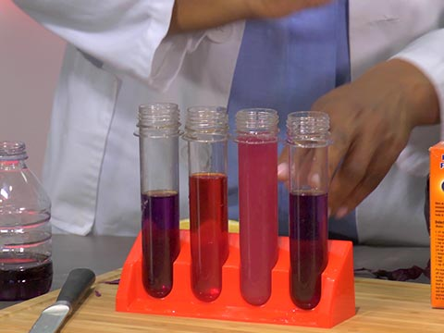
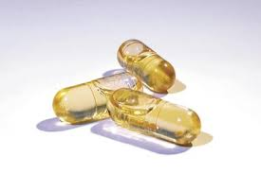
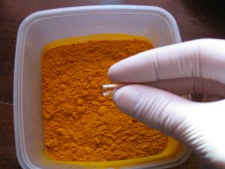
Laboratory Exercise
Why do we need a Mortar and Pestle?
Check the pH of our mixture.
Encapsulation of the mixture.
Make a solution.

Slide 13
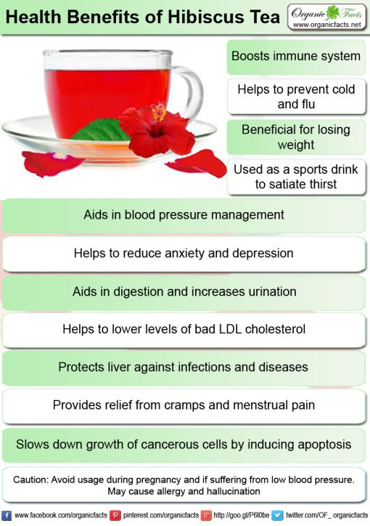
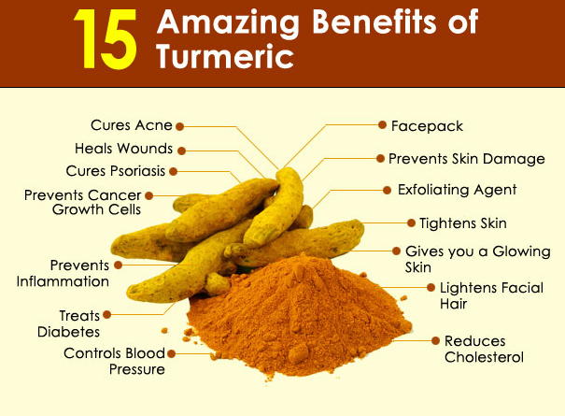
Health Benefits of Hibiscus, Turmeric, Red Cabbage & Mint

Slide 14
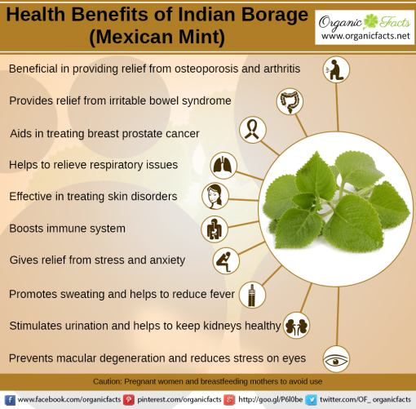
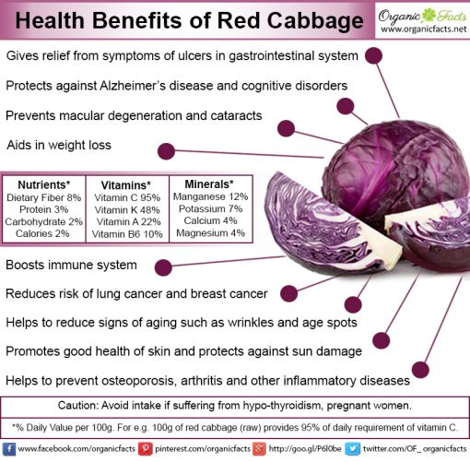
Health Benefits of Hibiscus, Turmeric, Red Cabbage & Mint

Slide 15
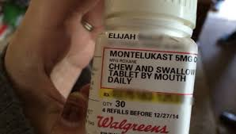


How has Pharmaceutical Science Research Changed Your Life?

Slide 16

Where can I get More Information about Pharmacy and the Pharmaceutical Sciences?
Visit these sites to learn more:
American Association of Pharmaceutical Scientists - www.aaps.org/ForStudents
http://careers.aaps.org/
American Pharmacists Association - http://www.pharmacist.com/
Arkansas Pharmacy Schools
Harding University College of Pharmacy - http://www.harding.edu/academics/colleges-departments/pharmacy
University of Arkansas for Medical Sciences - http://pharmcollege.uams.edu/

