Slide 1

Is Salutogenesis a universal construct? Developing a sensitive research tool for understanding sense of coherence among indigenous cultures
Hassan Ganayiem
Under The Supervision Of:
DR. Orna Braun-Lewensohn & DR. Ephrat Huss.
Notes:
My name is Hassan Ganayiem, an educational psychologist at Alkasom Regional council that gives service to Bedouins who live in unrecognized villages or in the process of recognition.
In my research I would like to check if salutogenesis…

Slide 2
AIMS
The aim of this study is to construct the foundation for understanding the core of salutogenesis- sense of coherence- in non-Western societies.
We aim to construct a new measure of SOC which will serve as a culturally sensitive research tool in non-Western indigenous cultures.

Slide 3
Salutogenesis
Saluto (health) + genesis (origins)
Salutogenesis examines the creation of wellbeing by looking at successful coping strategies and health.
Salutogenesis aims at finding and examining factors responsible for the formation and maintenance of health, as the healthy pole of a health-disease continuum.
Notes:
So what is salutogenesis?
This is a New concept of health that was created by Aaron Antonovsky.
What is important here is a basic change of perspective looking at illness.
We don't ask what could make person ill
But we ask what makes\ keeps person healthy.

Slide 4
Salutogenesis
A salutogenic orientation is in contrast to a pathogenic orientation, which focuses on a particular diagnosed disease. The salutogenic approach views the human system as basically unsound, continuously attacked by disturbing, unpreventable processes and elements.
According to this model, individuals have general resilience resources that help them conceptualize the world as organized and understandable.
Antonovsky’s findings were able to show that relatively unstressed people had much more resistance to illness than stressed ones.
Antonovsky argued that the experience of well-being constitutes a Sense of Coherence.
Notes:
Here we can see that pathogenesis is against disease and salutogenesis is for health.
We can also understand that the focus in pathogenesis is to prevent pain, and in salutogenesis the focus is to promote gains or growth. So it's about increasing health… not fighting illness.
General resilience resources can be: social supports, knowledge, self esteem, money.

Slide 5
Sense of Coherence (SOC)
A cognitive orientation views life as comprehensible, manageable and meaningful.
SOC is the result of the collective effect of resources and processes conducive to health.
Notes:
The core of salutogenesis which is

Slide 6
Sense of Coherence
In the salutogenic orientation, there is a direct relationship between the strength of the SOC and the person's ability to employ cognitive, affective –emotional- and instrumental strategies likely to improve coping, and thereby well-being.
Notes:
Antonovsky said: person who succeed, certainly has a high level of sense of coherence. That he defined as a feeling of trust, optimism that you can cope with all challenges in life… and it's a lasting feeling.

Slide 7
SOC increases throughout life span and it has strong positive correlations with perceived health, mental health, and quality of life.
The three components of sense of coherence:
Comprehensibility.
Manageability.
Meaningfulness.

Slide 8
Meaningfulness
It is the deep feeling that life makes sense emotionally; that life's demands are worthy of commitment.
It is essentially seeing coping as desirable.
Notes:
Does the challenge life situation ( being it internal or external) make sense in my life?
Does it make sense to go through all this ( e.g. learning something, getting clear)?

Slide 9
Manageability
It is the extent to which people feel they have the resources to meet the demands, or the feeling that they know where to go to get help.
Notes:
Can I handle the situation? Can I deal with it?
Can I cope using my resources?

Slide 10
Comprehensibility
It is the extent to which a person finds or structures their world to be understandable, meaningful, orderly and consistent instead of being chaotic, random and unpredictable.
Notes:
Is there an understandable pattern?
Is it all chaotic, disordered, accidental and random?
This means that whatever happens to a person, he/she is able to make sense of it and understand it.
The person believes that he or she is able to influence the course of events

Slide 11
“SOC is a construct that develops differently according to environmental characteristics and life experiences” (Sagy and Antonovsky 1999).
“The role of SOC in younger age groups fluctuates more” (Antonovsky 1987).
“Studies on adolescents have indicated that during adolescence SOC might have an important protective role as a coping resource, similar to the ‘mature’ adult SOC” (Antonovsky and Sagy 1986; Braun-Lewensohn et al. 2010b; Sagy 1998, 2002).

Slide 12
Antonovsky suggested that SOC is a universal construct.
SOC has primarily been tested with samples drawn from majority members of Western societies, and the few attempts to date at measuring this concept in non-Western cultures with standard measures have produced mixed results.
Notes:
These results raise the question if these salutogenesis concepts are universal and another question about the validity of Western tools in diverse cultures .

Slide 13
Maybe this is the tool?
Intercultural research shows there is a need to use both experimental tools and interviews to verify the cultural validity of Western tools (Samuda, 1998; Sue, 1999).
The question whether the structures assessed by means of Western tools retain their significance and functionality in non-Western cultures should be examined (Rogler, 1999).

Slide 14
The uniqueness of this study :
As we know, previous studies that dealt with salutogenesis used quantitative method.
This study will use different methods, like art tools of employing imagination to understand complicated concepts and to measure SOC in non-Western teenagers (like the Negev Bedouins).

Slide 15
This planned research will have important implications for coping and health promotion among diverse populations.

Slide 16
A mixed methods approach will be used to develop and validate a new measure of SOC that can be used with adolescents in non-Western cultures by employing imagery as a means of communicating complex concepts.

Slide 17
Study Questions
How is SOC perceived by Bedouin teenagers in Israel?
Does SOC contribute to psychological well-being in the Bedouin society as it does in the Western cultures?
How is it possible to characterize general resistance resources in Bedouin teenagers?
How is it possible to characterize the Bedouin’s central coping resources?

Slide 18
Participants
Approximately 500 teenagers from unrecognized villages in the Negev will participate in this study.
They will be requested to freely describe in words or drawings their everyday coping methods in different situations. In addition, they will be requested to fill in different questionnaires about demographic details, personal coherence, community coherence and a questionnaire about emotional responses to stress.

Slide 19
Pilot:
Forty teenagers from unrecognized villages in the Negev were requested to draw three drawings:
Drawing 1: to divide the page into two parts and to draw two places: one they like to be at and another where they do not like to be at.
Drawing 2: a good day in their lives and how it turned into a bad one.
Drawing 3: a stressful day in their lives and how it turned out to be a good one.
On the other side of the paper, they were requested to write a paragraph describing their drawings.
The drawings were analyzed quantitatively and qualitatively.

Slide 20
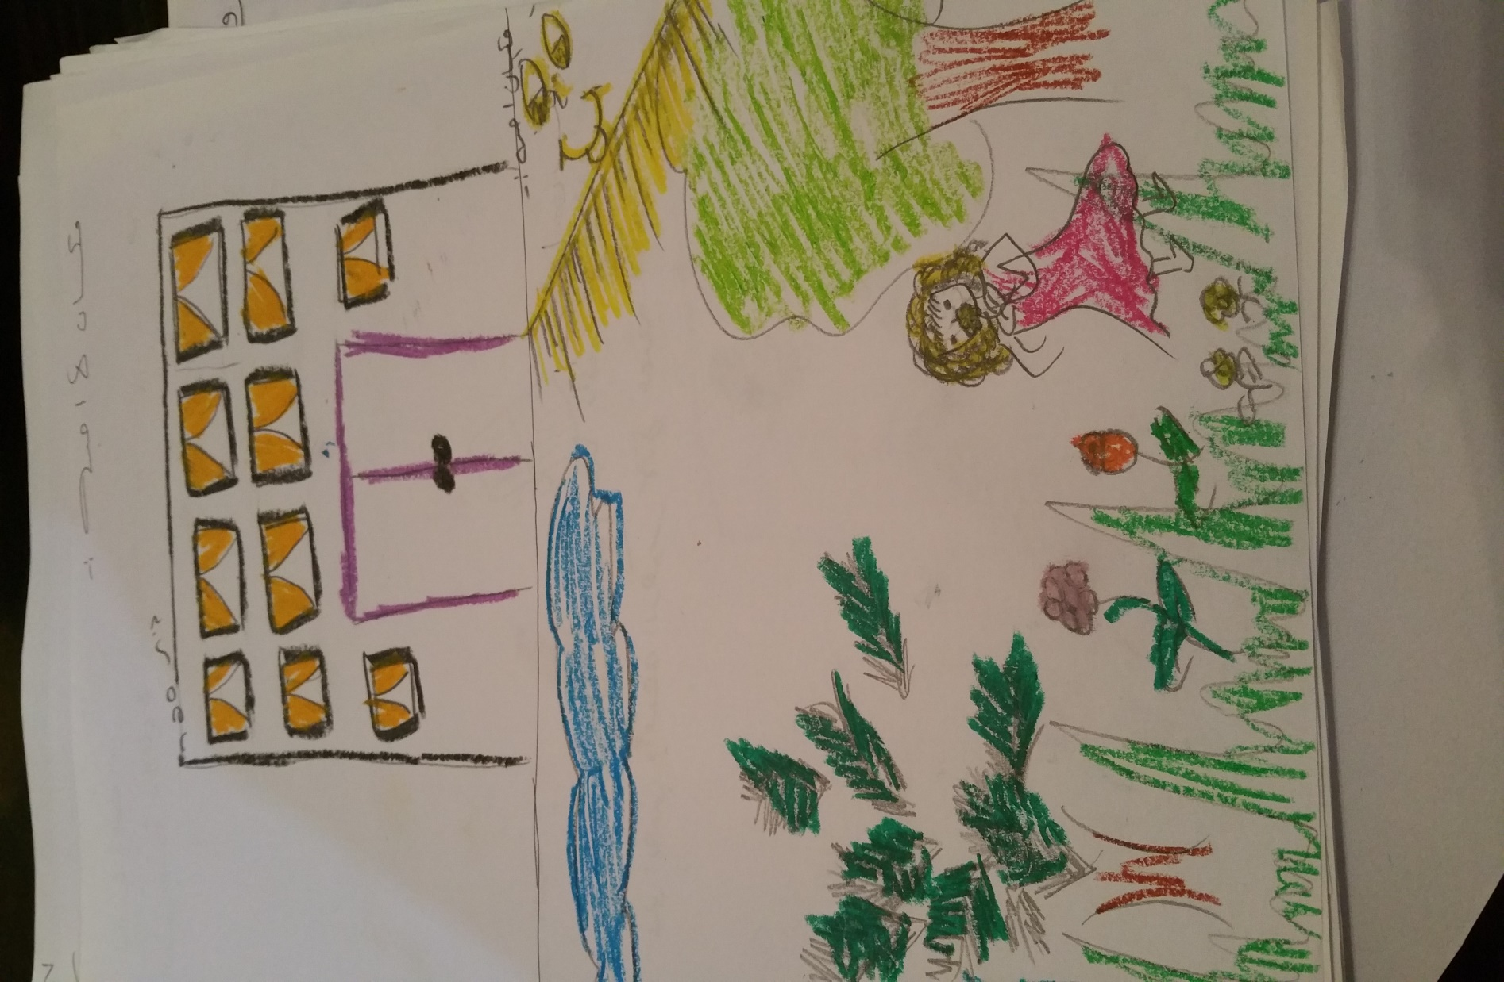
Notes:
In this picture we can see in the first part the teenager draw a school as a place that doesn't like to be at, and in the other part, a place he like to be at witch is as we can see a garden.

Slide 21
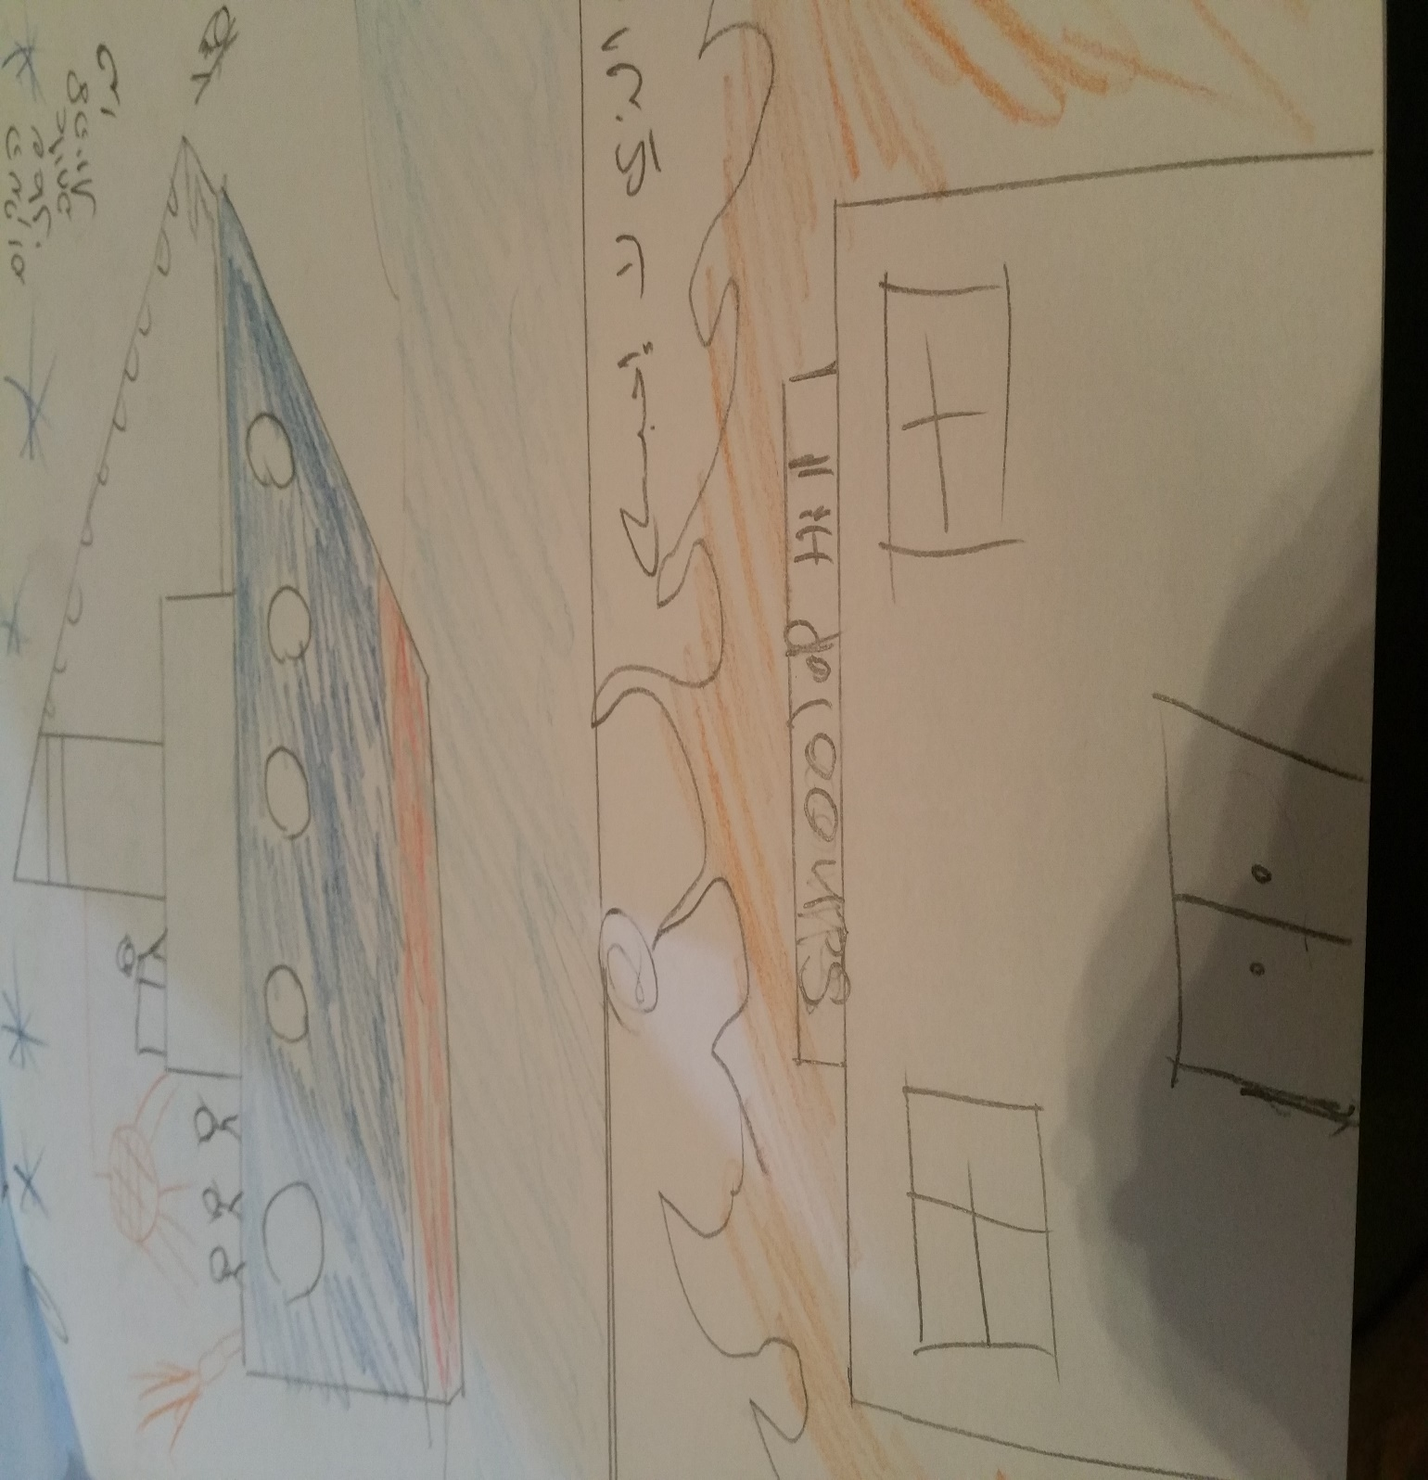

Slide 22
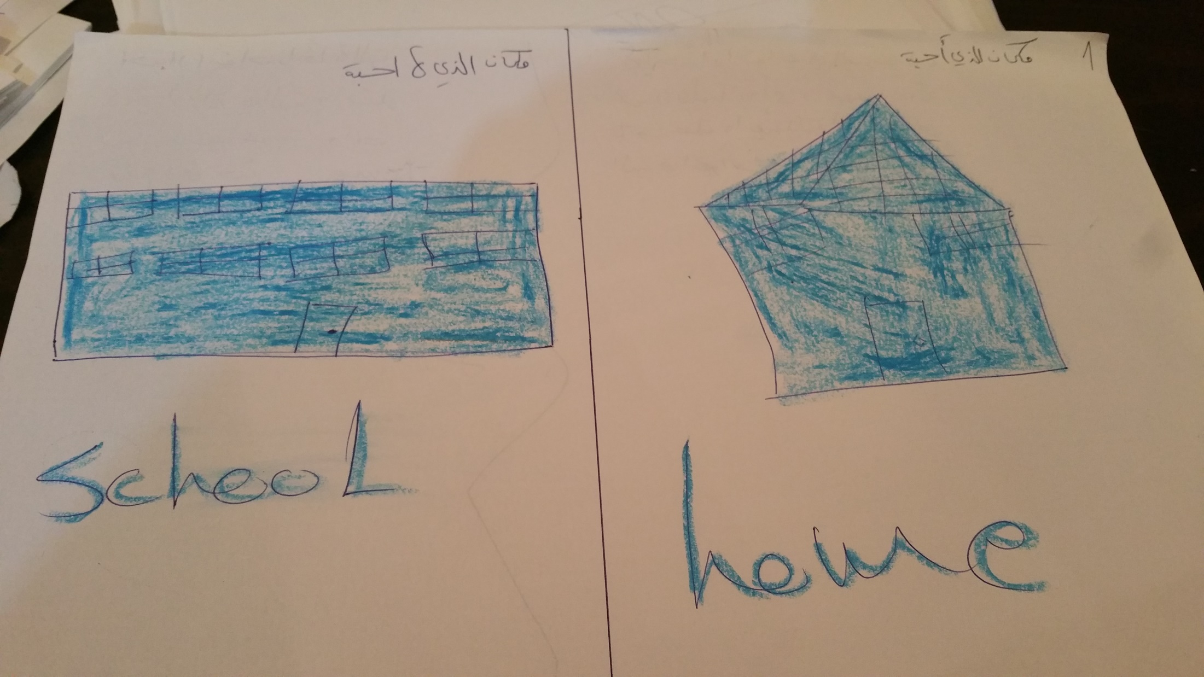

Slide 23
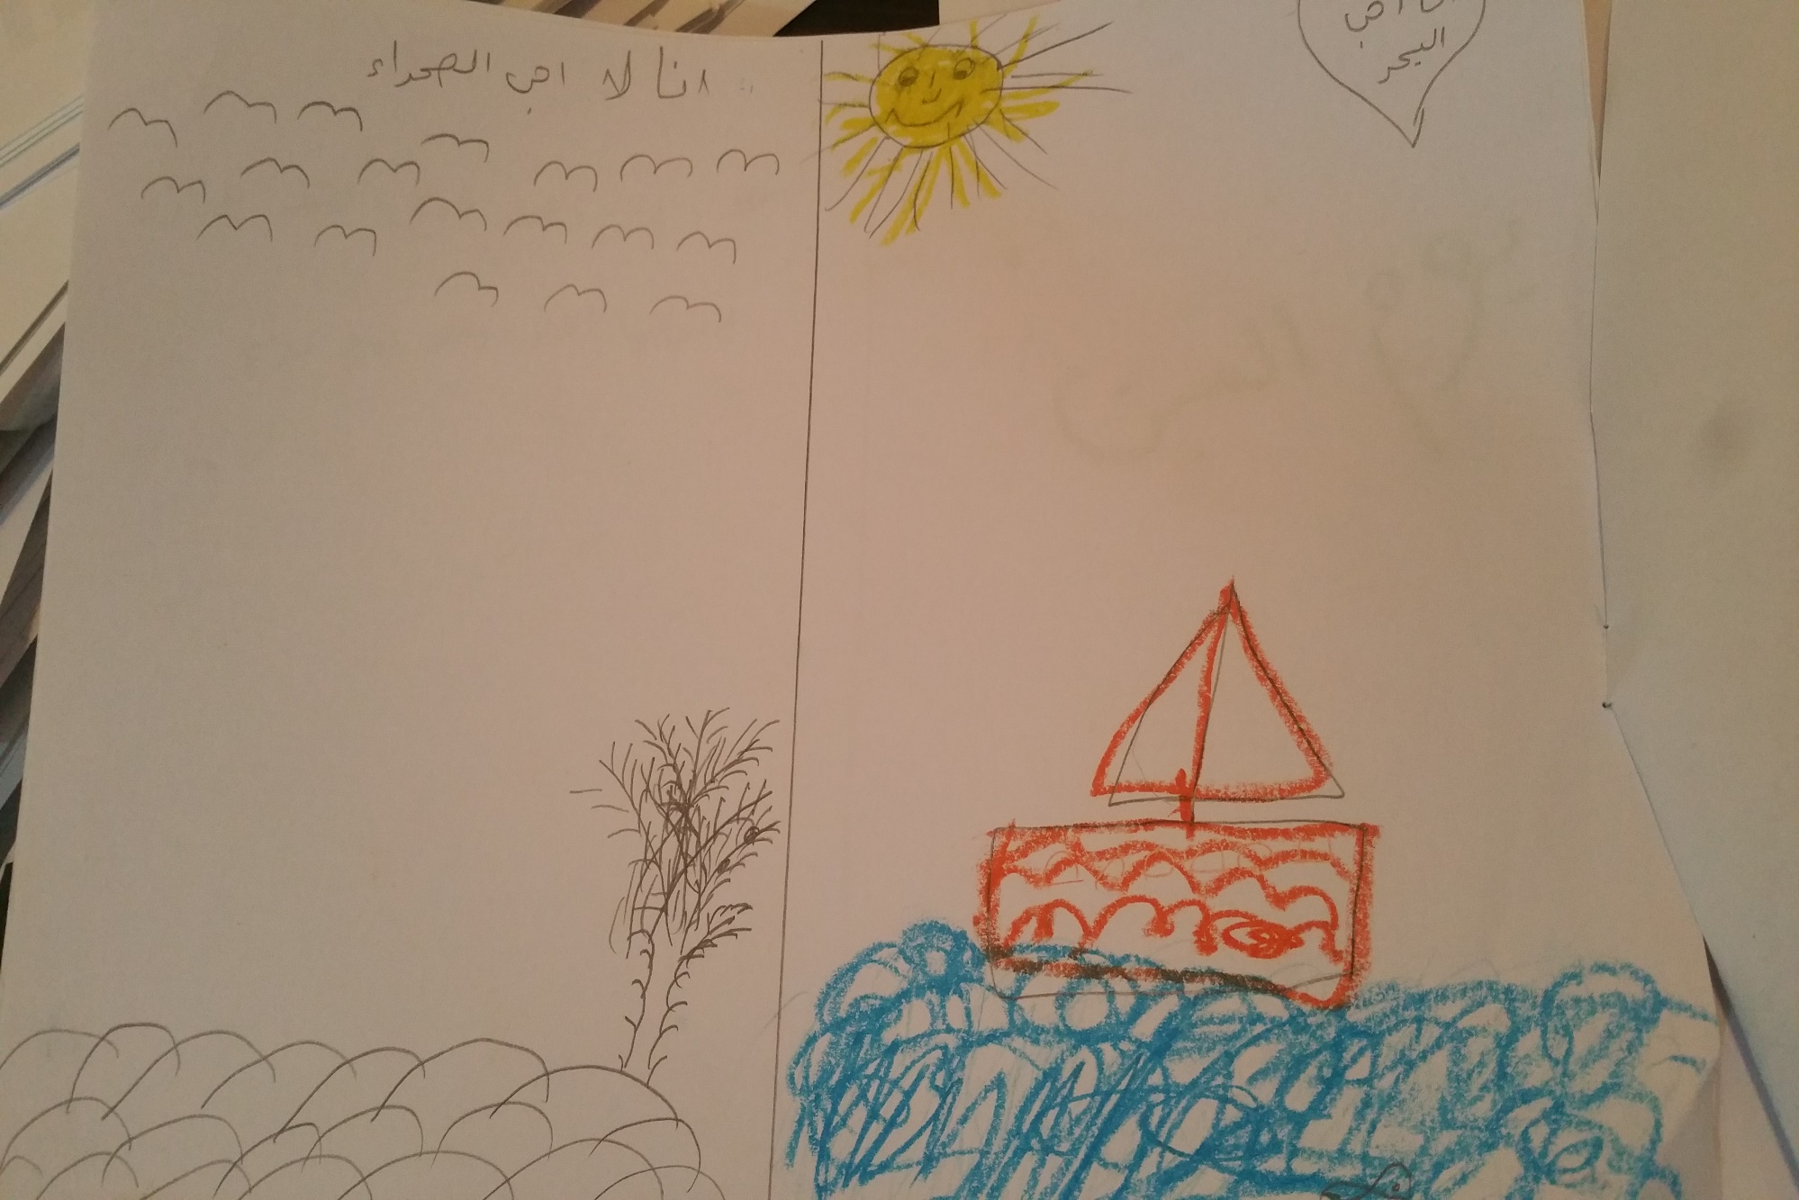

Slide 24
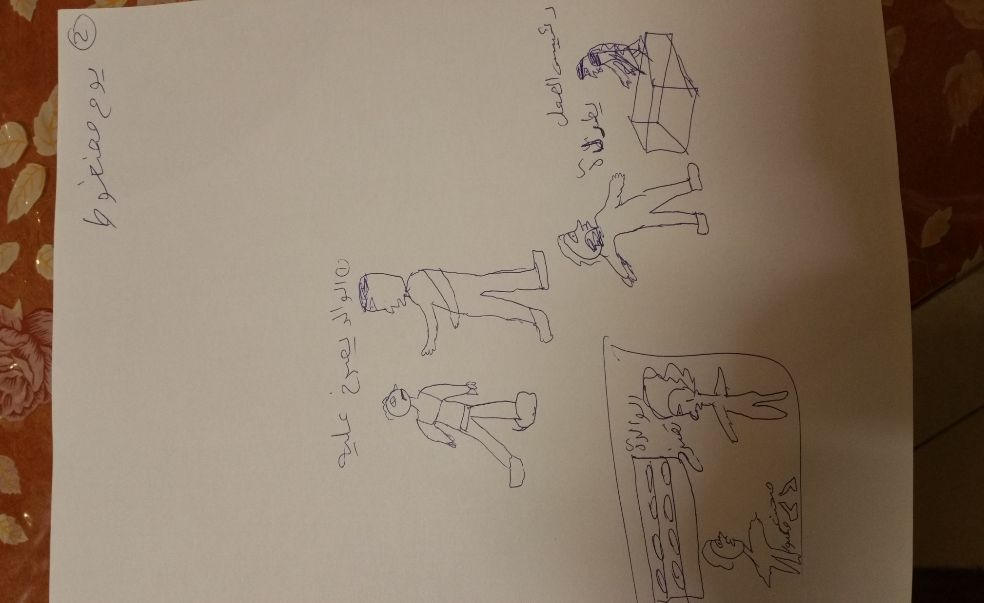
Notes:
The teenagers were asked to draw a stressful day in their life and how it turned out to be a good day.
We could see that he draw different situations were he felt stressful.
For example, mom that yelling at her daughter and as a result a glass was broken.
Dad also yelling at his son.
At work, was fired from his work.

Slide 25
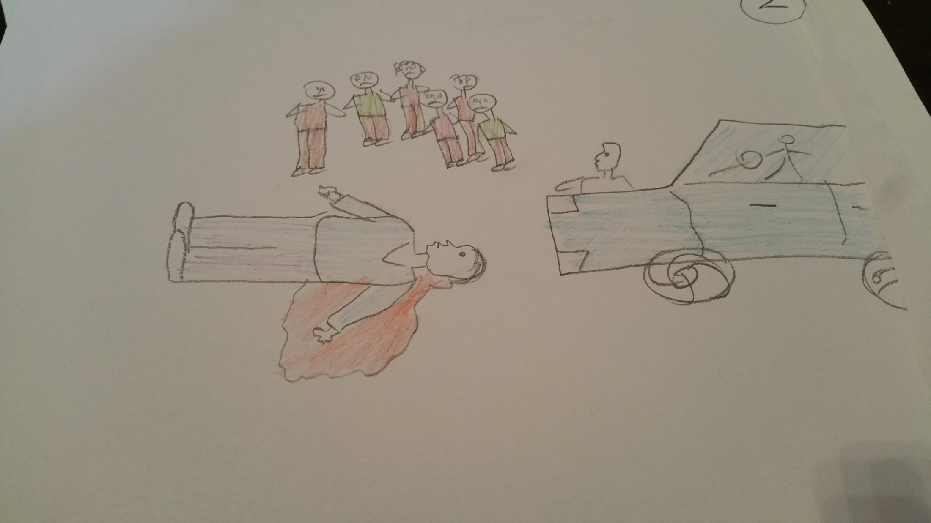
Notes:
The teenager were asked to draw a good day in their life and how it turned into a bad one.
We could see here people were at wedding and it turned into a bad day because of a car accident.

Slide 26
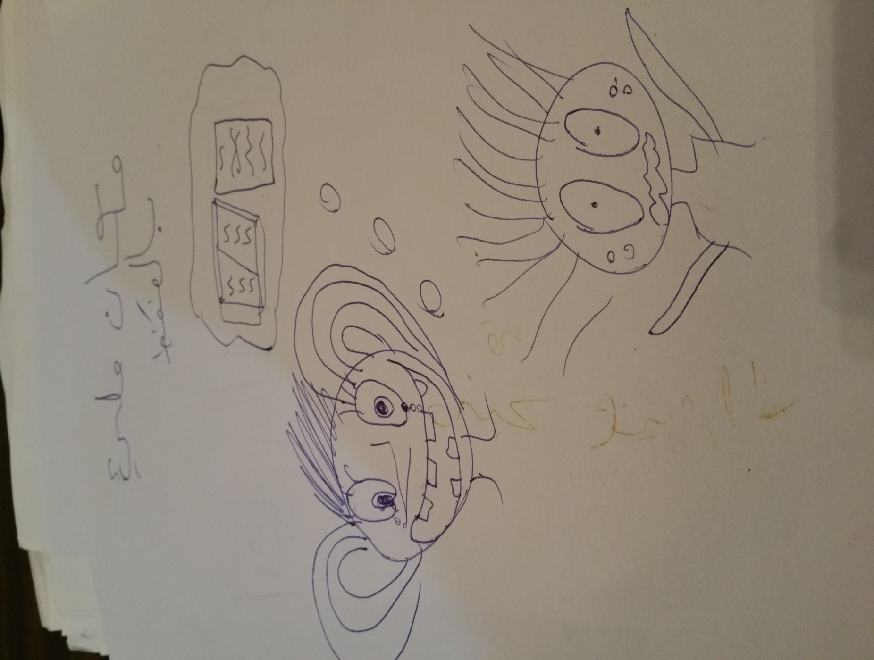
Notes:
Again a stressful day mainly stress of exams.
Place which is full of stress.

Slide 27
Qualitative analyses
The qualitative analyses consisted the following stages:
Stage 1: listing visual themes,( symbols, metonyms, and compositional elements such as color and shape) according to the strengths and according to the stressors that the teenagers experienced in their environment.
Stage 2: listing verbal themes ( words, concepts, narratives) according to the environmental strengths and stressors that they experienced in their environment.
Stage 3: analyzing these themes according to the three salutogenic concepts of meaning, manageability and comprehensibility.

Slide 28
This original analyses provided verification that the methods accesses the youth's experience of their environment according to their own concepts.
While some of the themes were universal teenage issues, such as constraints of parents' generation, wish to be alone or with peer group, and stress over studies, other elements in terms of stress are specific to their dessert environment, such as fear and lack of manageability of desert floods, wild animals, car accidents, boredom due to lack of external activities, and the major coping resources are family and nature.

Slide 29


Slide 30
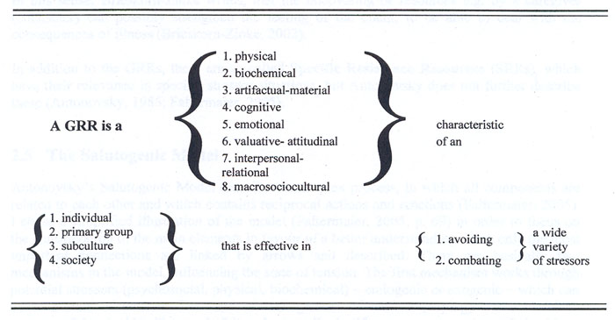

Slide 31
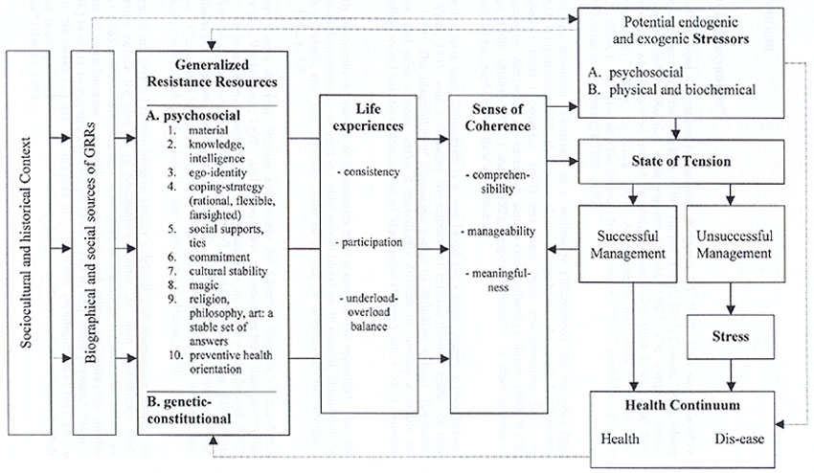

Slide 32
האם המושג סלוטוגניות הוא מושג אוניברסאלי?
הבנת המושג תחושת קוהרנטיות בקרב מתבגרים בדואים בנגב

Slide 33
AIMS
The aim of this study is to construct the foundation for understanding the core of salutogenesis- sense of coherence- in non-Western societies.
We aim to construct a new measure of SOC which will serve as a culturally sensitive research tool in non-Western indigenous cultures.

Slide 34
Salutogenesis
Saluto (health) + genesis (origins)
Salutogenesis examines the creation of wellbeing by looking at successful coping strategies and health.
Salutogenesis aims at finding and examining factors responsible for the formation and maintenance of health, as the healthy pole of a health-disease continuum.
Notes:
So what is salutogenesis?
This is a New concept of health that was created by Aaron Antonovsky.
What is important here is a basic change of perspective looking at illness.
We don't ask what could make person ill
But we ask what makes\ keeps person healthy.

Slide 35
Salutogenesis
A salutogenic orientation is in contrast to a pathogenic orientation, which focuses on a particular diagnosed disease. The salutogenic approach views the human system as basically unsound, continuously attacked by disturbing, unpreventable processes and elements.
According to this model, individuals have general resilience resources that help them conceptualize the world as organized and understandable.
Antonovsky’s findings were able to show that relatively unstressed people had much more resistance to illness than stressed ones.
Antonovsky argued that the experience of well-being constitutes a Sense of Coherence.
Notes:
Here we can see that pathogenesis is against disease and salutogenesis is for health.
We can also understand that the focus in pathogenesis is to prevent pain, and in salutogenesis the focus is to promote gains or growth. So it's about increasing health… not fighting illness.
General resilience resources can be: social supports, knowledge, self esteem, money.

Slide 36
המודל הסלוטוגני
המסגרת התיאורטית בעבודה תתבסס על המודל הסלוטוגני (Antonovsky, 1979).
לפי אנטונובסקי (1996) גורם לחץ מהווה גירוי חיצוני או פנימי היוצר מתח. שימוש במשאבי התנגדות פנימיים או חיצוניים אשר מצויים ברשות האדם עשוי להפחית מתח זה. המאפיינים הסלוטוגניים אם כן הם אותם גורמים המאפשרים לפרט לשמור על בריאותו, תוך כדי אינטראקציה עם מצב החיים בו הוא נתון ( ( Antonovsky, 1996 .

Slide 37
לפי מודל זה, לאנשים יש משאבי חוסן המייצגים את המוטיבציות ומשאבים פנימיים וחיצוניים שהפרט יכול לעשות בהם שימוש כשהוא נתקל במצב לחץ או במצב קונפליקטואלי. (87 ( Antonovsky, 19.

Slide 38
המונח המרכזי בתיאוריה הסלוטוגנית הוא "תחושת קוהרנטיות" שהיא ביטוי של אוריינטציה גלובאלית מתמשכת, המשקפת את תפיסתו של האדם את העולם ואת מקומו בתוכו באופן מוכלל, ולא כתגובה לסיטואציות ספציפיות.
אנטונבסקי (1987) טען שאנשים בעלי תחושת קוהרנטיות גבוהה שנתקלים במצב לחץ יתמודדו טוב יותר וידווחו על פחות תסמינים פסיכולוגיים ופסיכוסומאטיים.

Slide 39
Sense of Coherence (SOC)
A cognitive orientation views life as comprehensible, manageable and meaningful.
SOC is the result of the collective effect of resources and processes conducive to health.
Notes:
The core of salutogenesis which is

Slide 40
Sense of Coherence
In the salutogenic orientation, there is a direct relationship between the strength of the SOC and the person's ability to employ cognitive, affective –emotional- and instrumental strategies likely to improve coping, and thereby well-being.
Notes:
Antonovsky said: person who succeed, certainly has a high level of sense of coherence. That he defined as a feeling of trust, optimism that you can cope with all challenges in life… and it's a lasting feeling.

Slide 41
SOC increases throughout life span and it has strong positive correlations with perceived health, mental health, and quality of life.
The three components of sense of coherence:
Comprehensibility.
Manageability.
Meaningfulness.

Slide 42
מחקרים מהמערב הצביעו על הקשר הזה, לעומת זאת,
המחקרים המעטים שכללו משתתפים מחברות לא מערביות מעלים שאלה לגבי האוניברסליות של מושגי התאוריה הסלוטוגנית, ואם אכן הם אוניברסאליים, האם הם עדיין מועילים לאנשים מתרבות שונה להתמודד עם גורמי לחץ באותו אופן שבו הם מועילים לאנשים בחברות מערביות? (Braun-(Lewensohn & Sagy, 2011; Bull, Mittelmark & Kanyeka, 2013).

Slide 43
אולי זה הכלי?
המחקר הבינתרבותי מצביע על הצורך להשתמש בכלים ניסיוניים ובראיונות ניסיוניים כאחד כדי לאשש את התוקף התרבותי של הכלים המערביים (Samuda, 1998; Sue, 1999).
יש לבחון הן האם המבנים שהוערכו באמצעות כלים מערביים שומרים על משמעותם בחתך תרבותי והן אם הם שומרים על אותה תפקודיות בתרבויות שונות זו מזו (Rogler, 1999).

Slide 44
הייחודיות של המחקר הנוכחי:
כפי שידוע לנו, מחקרים קודמים אשר עסקו בסלוטוגניות פעלו בשיטת מחקר כמותית.
במחקר נשתמש בדרכים שונות על מנת למדוד "תחושת קוהרנטיות" בקרב מתבגרים בתרבות לא מערבית (כדוגמת הבדואים בנגב): שאלונים, הפעלת הדמיון להבנת מושגים מורכבים.
שלב חשוב במחקר הנוכחי יתמקד בניתוח איכותני לציורים אשר יקוטלגו לתמות שמסבירות איך הנבדקים תופסים את משמעות המושג קוהרנטיות.

Slide 45
שאלות המחקר:
איך נתפסת תחושת קוהרנטיות בקרב בדואים ישראלים בגיל ההתבגרות?
האם תחושת קוהרנטיות מסייעת לבריאות הנפשית בחברה הבדואית כפי שהיא מסייעת בעולם המערבי?
איך אפשר לאפיין את משאבי החוסן המוכללים (GRR- General Resistance Resources). בקרב מתבגרים בדואים?
איך אפשר לאפיין את משאבי ההתמודדות (Coping Resources) המרכזיים בחייהם של הבדואים?

Slide 46
מערך המחקר:
במחקר ישתתפו כ 500 תלמידי בית ספר הגרים בכפרים לא מוכרים בנגב.
התלמידים יתבקשו לתאר בצורה חופשית במילים או בציור את דרכי ההתמודדות שלהם בחיי היומיום במצבים שונים. בנוסף, התלמידים ימלאו מספר שאלונים: פרטים דמוגרפיים, קוהרנטיות אישית, קוהרנטיות קהילתית ושאלון תגובות רגשיות ללחץ.

Slide 47
פיילוט- ניתוח איכותני:
המתבגרים התבקשו לצייר שלושה ציורים:
ציור 1: לחלק את הדף לשני חלקים ולצייר מקום שאוהבים להיות בו ומקום שלא אוהבים להיות בו.
ציור 2: יום טוב בחיי ומה יכול להפוך אותו לרע?
ציור 3: יום לחוץ בחיי ומה יכול להפוך אותו ליותר טוב?
על גבי כל ציור המתבגרים התבקשו לכתוב פסקה שמתארת מה שציירו.
הציורים והמלל נותחו הן כמותית והן איכותנית.

Slide 48


Slide 49


Slide 52


Slide 53
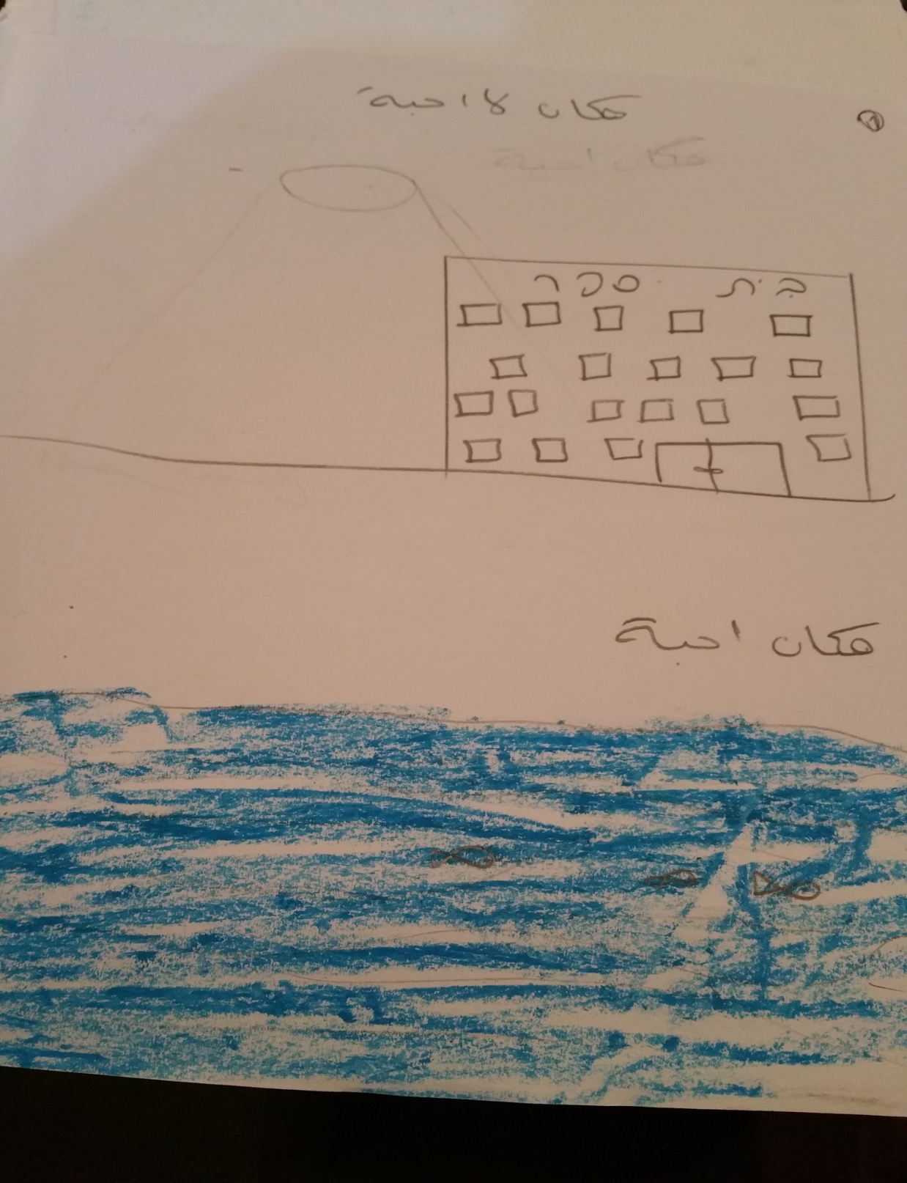

Slide 54
שלבי הניתוח האיכותני:
ספירת\רישום תמות חזותיות שהתלמיד הזכיר כגורמי חוזק או סיכון.
ספירת\רישום תמות מילוליות שהתלמיד הזכיר כגורמי חוזק או סיכון.
ניתוח התמות לפי שלושת מרכיבי המושג "תחושת קוהרנטיות".

Slide 55
This original analyses provided verification that the methods accesses the youth's experience of their environment according to their own concepts.
While some of the themes were universal teenage issues, such as constraints of parents' generation, wish to be alone or with peer group, and stress over studies, other elements in terms of stress are specific to their dessert environment, such as fear and lack of manageability of desert floods, wild animals, car accidents, boredom due to lack of external activities, and the major coping resources are family and nature.

