Slide 1
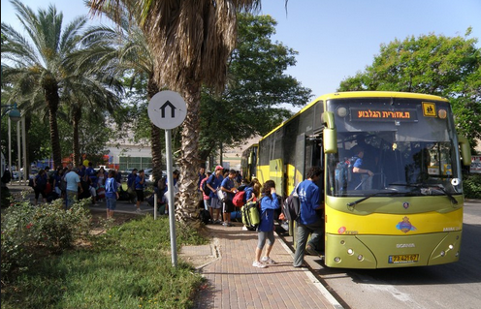
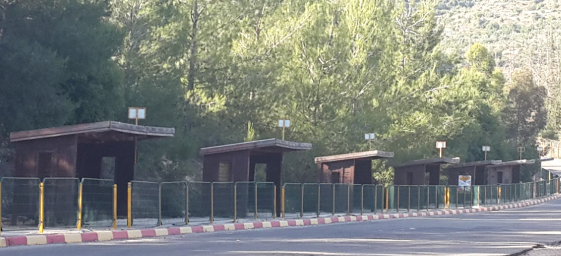
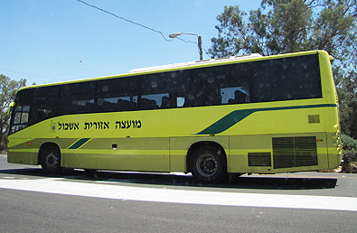
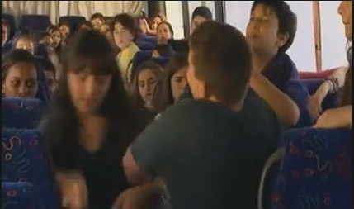
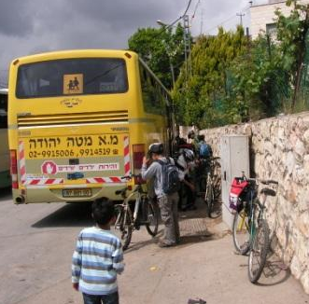
The Relationship between the Characteristics of the Individual, Family and Community, and Bullying Victimization on the School Bus from an Ecological Perspective
Ariel Caduri
30.6.15

Slide 2
Bullying on the School Bus Central Findings
Introduction
In Israel, many students live in rural communities served by regional councils and learn in regional schools which are generally located far from their homes. For these students, organized school buses are the main option for transportation to and from school.
Lack of structure and lack of appropriate authority and supervision
Heterogeneous environment with regard to ages and grades
school or regional councils Who Belongs the school busses?
?
What is surprising is that in spite of the high rate of school bus use and the large amount of time that students spend in these buses during their school years, the phenomena on of violence in school bus rides has received little research attention in contrast to the amount of research devoted to the experience of violence within school walls.

Slide 3
In this study we will examine a model based on the ecological approach. The ecological approach is a theoretical framework that explains what resources in the individual’s environment (family, community) are likely to help them cope best with situations of stress and conflict, and in our case, how to reduce the level of violence on school bus rides.
What is Ecological Theory? (Bronfenbrenner, 1979, 1994)
Mesosystem
Microsystem
Individual
Macrosystem
Exosystem

Slide 4
(Ecological Systems Framework, 1979, 1994)
According to the ecological approach, bullies and victims of bullying are all part of the system, connected and interconnected with one another, and influencing the individual’s behavior. This claim goes hand in hand with research systematically finding that young people involved in bullying in schools, experience difficulties in a range of other areas, such as in their families, their peer groups, their schools, their neighborhoods, and their communities.
Many studies have dealt with violence in school in the ecological context, but we have not found any studies which have comprehensively and systematically dealt with student violence during school bus rides within the ecological context.
Accordingly, in this study, we will attempt to examine the model based on the ecological approach, explaining which resources in the individual’s environment (family, community) are likely to optimally assist them in coping with stressful situations and conflict, and to reduce the level of violence during school bus rides.

Slide 5
The causes of bullying according to the ecological theory
Factors at the individual level
Sense of Coherence (SOC) is the central variable in the salutogenic theory, and this variable describes how people perceive the world and the events that happen to them, and the way they respond to a variety of events that are stressful. A person’s SOC eases their management of stress and contributes to the person’s sense of well-being.
The three components of SOC are :
comprehensibility
manageability
meaningfulness
There is a negative correlation between SOC and being victims of violence
) García-Moya, Suominen & Moreno, 2014; Braun-Lewensohn, Alziadana & Eisha, in press.(

Slide 6
Factors at the Family Level
Parental Autonomy-Support
Autonomy-support relates to learning in which the individual speaks and acts in order to improve the self-perception of another person, focusing on that person’s wants and on receiving freedom of choice to act (Reeve, Nix, & Hamm, 2003), and active support of the child’s ability to initiate action independently and autonomously (Ryan, Deci, Grolnick, & La Guardia, 2006).
This support includes advancing choice and limited use of control methods, by giving options for actions, positive feedback on progress, listening to emotions and thoughts and giving rational explanations for the actions (Deci & Ryan, 2000).
When people feel that their level of autonomy is decreasing, they often respond with less polite and more anti-social behavior.

Slide 7
Factors at the Community Level
Sense of Community Coherence: comprehensibility/ manageability/ meaningfulness
community coherence is positively associated with personal coherence and a negative associated with victims of violence (Elfassy and colleagues, in press).
The Climate of the School Bus Rides
A positive school climate is likely to have a positive impact on coping with violence in school and the creation of an environment in which victimhood is lower.
School Policy
Teacher support
Students participant
Studies have found that there is a negative correlation between students' perception of the school climate and the extent of their involvement in bullying behaviors as a bully or a victim
) Giovazolias, Kourkoutas, Mitsopoulou, & Georgiadi, 2010; Khoury-Kassabri et al., 2004;
Meyer-Adams & Conner 2008).

Slide 8
Demographic Characteristics
Gender: boys tend to be victims of violence and also to act with both direct physical and emotional violence to a greater extent than girls
(Khoury-Kassabri, 2011; Khoury-Kassabri et al., 2009.(
Parents' educational level: As parents' educational level increased, students witnessed fewer violent situations and their perception of insecurity was lower (Janosz et al., 2008; Na et al., 2014).
the goal of the current study is to examine what individual, family and community resources from the students’ perspectives, and in the framework of the ecological contextual approach, can contribute to prevention of bullying victimization during school bus rides.

Slide 9
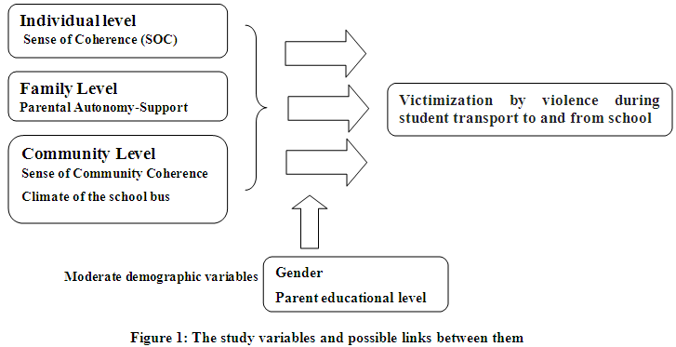
The research model
we have administered the questionnaires to students in grades 7-9 in three regional councils. Five hundred students completed questionnaires. The questionnaires are anonymous.
We hope to be able to present analyzed results very soon.

Slide 10

Thank you for listening !!!

