Slide 1

2.5 hrs (3 hours with Practice time)
Presents
The FRC Robot Project
LabVIEW2014

Slide 2
The FRC Robot Project
(Students using this primer should already have a basic understanding of LabVIEW architecture.)
Goals
  Overview of the various VI’s in the FRC Robot Project.
  Create a program that uses a joystick to control 2 drive motors and an additional actuator motor.
  Upload code and run in debug mode.
  Create an autonomous routine.
  Run a practice match.

Slide 3
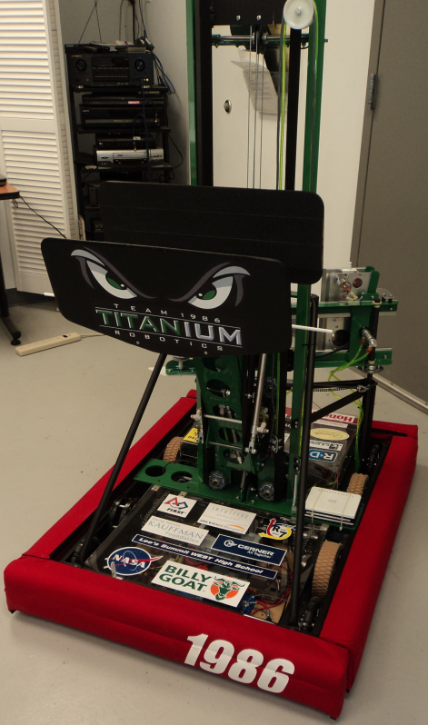
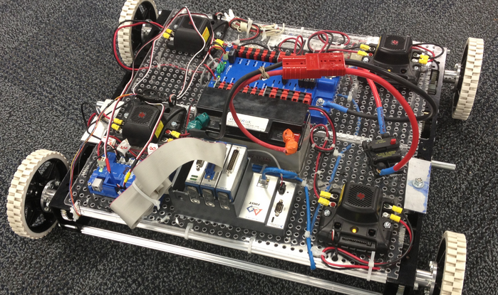
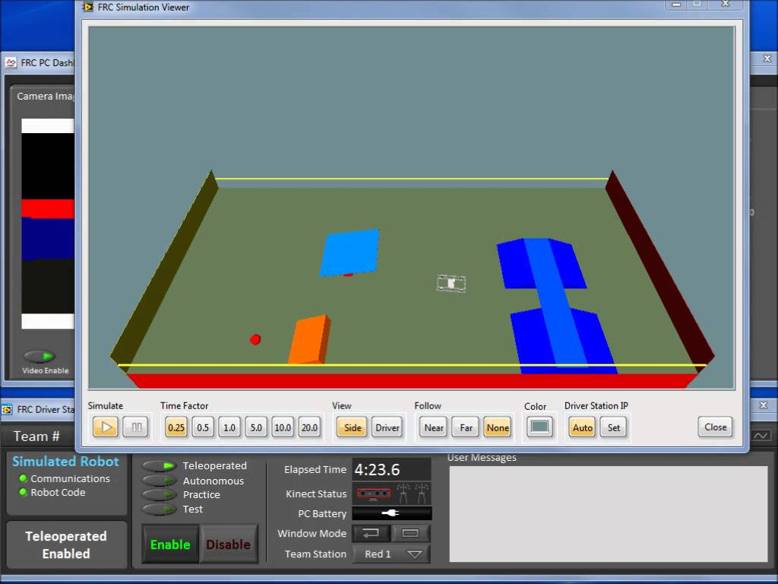
Your Robot
Hopefully you’ve brought an FRC robot with you or a test bed with all the essential components.
The bulk of this presentation can be run without an actual robot, but the payoff at the end is seeing the code work on the real deal.
  Even without an actual robot LabVIEW provides a simulator that can be used to test some functionality.

Slide 4
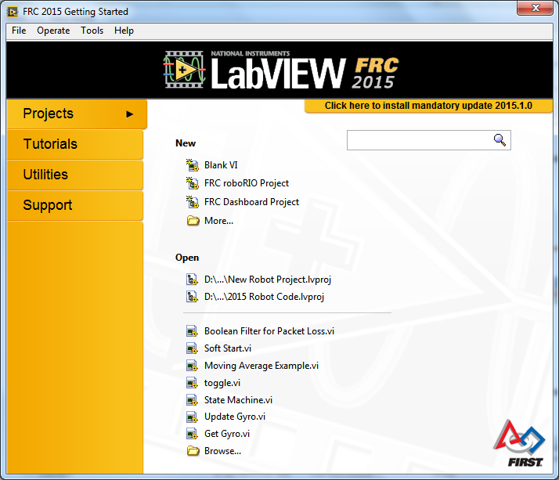
Opening a New Robot Project
If LabVIEW is already open, the getting started window can be found under VIEW.
This will not be an option if you have not downloaded the FRC specific updates.
Click on
“FRC roboRIO Project”

Slide 5
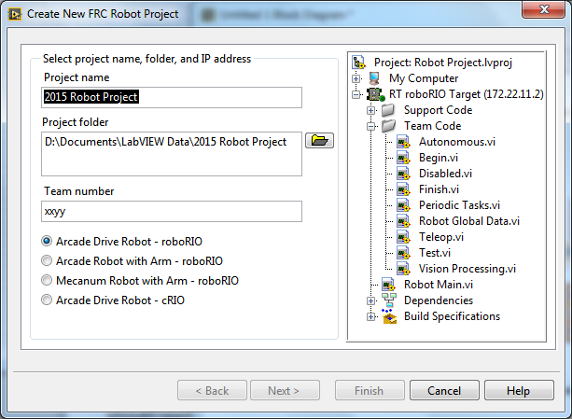
Create New Setup Window
Give the project a name and a folder location that you can find again later.
Under Team Number replace xxyy with your team number. For example Titanium members would use 1986.
Select “Arcade Drive Robot - roboRIO” and hit the Finish button.
Give the project some time to configure and then the Project Explorer window should open automatically.

Slide 6
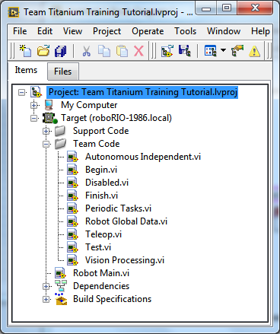
Project Explorer
The Project Explorer Window shows what files are part of the code project we are creating
  Robot Main contains the top level architecture.
  Under “Team Code” there are several supporting files, many of which we will be modifying as we program our robot.
Double click on Robot Main to open it.

Slide 7
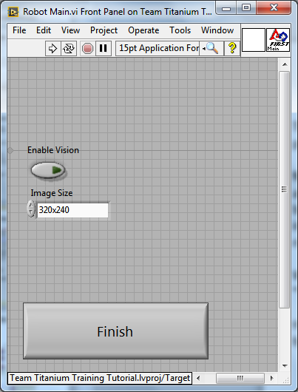
Robot Main Front Panel
This is where we will RUN and STOP our program when testing in debug mode.
Notice the big “Finish” button. We once accidently saved the program with the button pressed as default. The program instantly finished every time we tried to run it until we sorted out that issue.
We will not be working with the “Vision” information in this tutorial.
Hit control-E to go to the Block Diagram for Robot Main

Slide 8
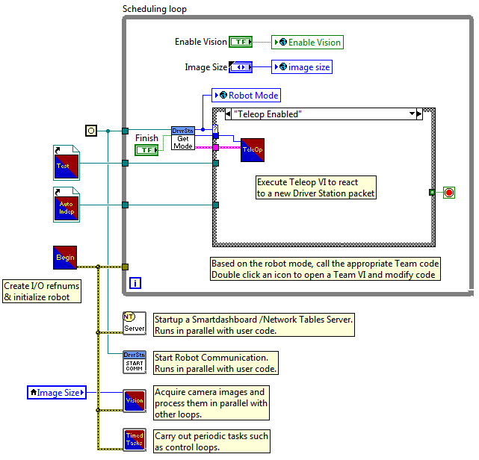
Robot Main Block Diagram
In general there is no need to modify robot main.
This is the architecture that allows the Field Management System to control the robot, and schedule when each part of the project should run.
Double click on the icon for the “Begin” VI. This is the first part of the project that we want to modify.

Slide 9
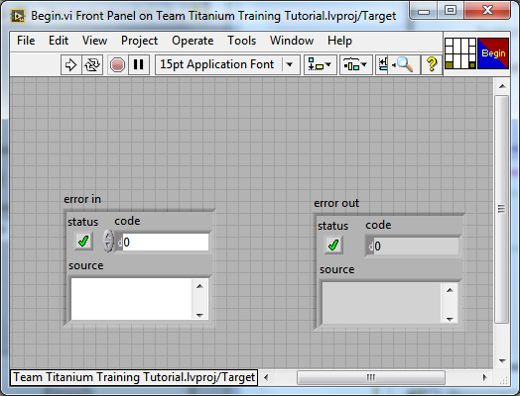
Begin Front Panel
In Robot Main “Begin” was located outside of any looping structure.
  Begin is only called once when the project is run.
This is the VI where we will tell the program how our robot is wired.
  Every actuator (motor etc.) and sensor will be opened and given a reference here.
There is nothing to change on the Front Panel. Hit control-E to open the Block Diagram.

Slide 10


Begin Block Diagram
There are two things we must keep in Begin.
  Writing Autonomous Disabled to the Robot Mode Global Variable is a safety feature
  The “error out” cluster at the end of the “joystick” code is an output of Begin, and an expected input for a couple other VI’s. Robot Main would get an error if we deleted this. The error cluster is read as “error in” in Vision and Periodic Tasks, but it is not used for anything besides forcing those VI’s to wait for Begin to finish before starting.
Two things are begun in the default program.
  The Drive Motors: Defaults to 2 motors, but most teams prefer 4 or more.
  The Joystick: Not very complicated.

Slide 11


Begin Drive VI’s
The OPEN 2 MOTORS VI does 3 things.
  Identifies which PWM channels on the digital sidecar we are using to communicate with the motor controllers.
  Allows us to invert the motors (if they get wired backwards).
  Specifies what type of motor controller we are using (Jag, Victor, or Talon).
FYI: There is an Open 4 Motors Drive option for teams running 4 motors in their drivetrain.
Trace the wiring of your robot to make sure the PWM channels correspond with a motor controller from the right and left sides of your robot. Also double check which motor controller type you are using.
The Drive Set VI lets us assign a name to the drive motors we opened so we can refer to them later by that name.
  Names should be chosen that are informative and free of spelling errors.

Slide 12

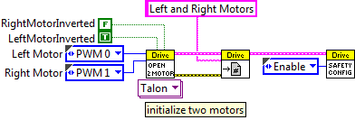
Safety Config VI
The Safety Config VI is there to protect the robot incase
it looses communication with the field.
  The field attempts to communicates with the robot every 20 ms.
  If the Drive Motors do not receive an instruction within 100 ms they will shut off until they receive a new instruction.
  This keeps the robot from running away when it looses communications.
  This function can be disabled, but that is not recommended.
In the overall code the pink and yellow connections show clusters of string and error information that is shared between the VI’s.

Slide 13

Begin Joystick VI’s
The Open Joystick indicates which USB port the Joystick is plugged into on the Driver Station computer. This can be forced to match within the driver station in the USB Order tab.
The Joystick Set VI assigns a name to the joystick we opened so we can refer to it later by that name.
The Brown connecting wire contains a cluster of information about the joystick.

Slide 14
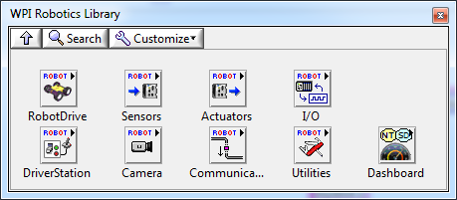
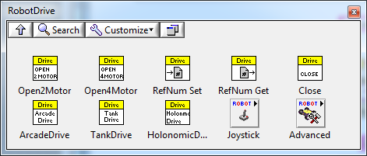
WPI Library
Writing our code from scratch would be a daunting task. Fortunately the underlying code to open and communicate with a device has already been written in the WPI Library.
On the block diagram open the functions palette, and scroll to the bottom to find the WPI Robotics Library. Pin it to the screen.
Inside RobotDrive you’ll find all the vi’s we used to begin the drive motors and several other options for working with them later.
Inside RobotDrive you’ll find a sub-menu for Joystick. Other parts of the WPI library include sensors and actuators (like motors, servos and solenoids).

Slide 15
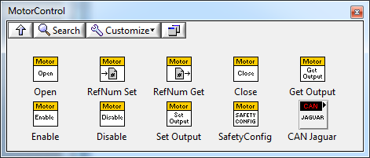

Adding a Motor
From the functions palette > WPI Robotics Library sub-palette > actuators > motors place a copy of the motor Open and RefNum Set vi’s on the Begin Block Diagram.
Find an independent motor in your robot not in the drive system. Note the type of speed controller and PWM channel for that motor. If running the motor past a mechanical limit could damage the robot, consider disconnecting the power to it for this training.
Create a constant for the PWM channel and set it to the channel for the motor you choose.
On the Open Motor vi set the speed controller to the appropriate Jaguar, Victor or Talon.

Slide 16

Adding a Motor Continued
Place the RefNum set vi to the right of the Open vi and wire over the DevRef string cluster and the error cluster
Create a string constant for the refnum name of the motor RefNum set vi and give the motor and name that you will remember later.

Slide 17
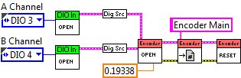


Begin Possibilities
We’re done with Begin, but for a more complex project we would have a lot more items in here from the WPI library. Hear are some examples

Slide 18
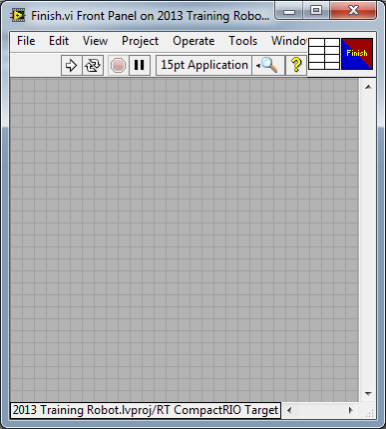
Finish Front Panel
Find “Finish” in the Project Explorer Menu. (You can also find it in the Robot Main architecture buried in the case structure.)
  Open the Finish VI.
This is the VI where we close everything we opened in the Begin VI.
There is nothing on the Front Panel. Hit control-E to open the Block Diagram.

Slide 19
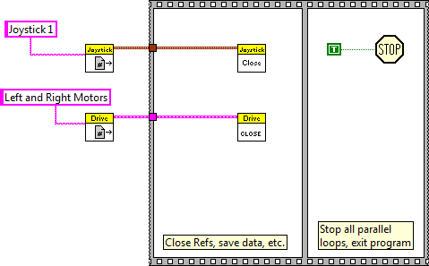


Finish Block Diagram
The Finish Block Diagram consists of a sequence structure
The Get.vi is used to link to the RefNum we setup in Begin.
The Close.vi is used to close the reference opened in Begin.
The sequence structure cab be extended down to make room to close the motor we opened in Begin if there is not enough space already.

Slide 20
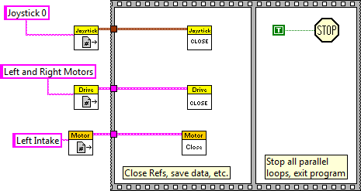
Modifying the Finish Block Diagram
In the MotorControl sub-palette select the RefNum Get.vi and Close.vi and place them in the space created in the sequence structure.
Create a string constant and make sure the RefNum name is the same as what you created in Begin.

Slide 21
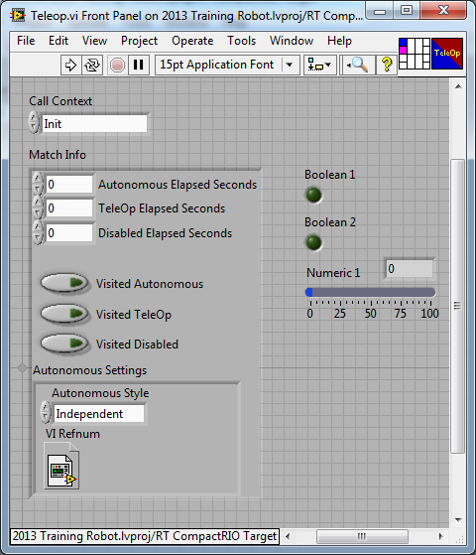
Teleop Front Panel
From the Project Explorer Menu open the Teleop VI. (It can also be found in the case structure in Robot Main).
This is the VI where we will read all the driver input controls.
This VI is called every 20 ms by the Field Management System (FMS) and teams should avoid adding any code that would cause the loop to process slower than that.
There is nothing on the Front Panel that we need to modify. Hit control-E to open the Block Diagram.

Slide 22
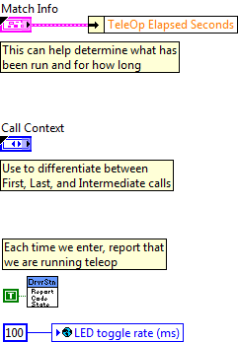
Teleop Block Diagram
There are a few items on the left side of the Teleop stock program that we want to leave unchanged
Match Info and Call Context are expected inputs to the Teleop VI and deleting them would require us to modify Robot Main.
The Report Code State helps communicate to the field observers that the robot is in the correct mode.

Slide 23

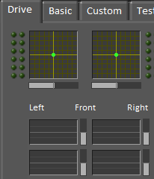

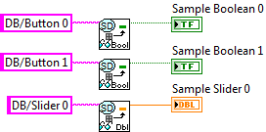
Network Tables
There are several VI’s in the default code with an SD circle on them. They are designed to pass information between the robot and the driver’s station computer.
Some of them are set to read parts of the driver’s station screen that the user can interact with. Others read the robot and display updated information on the driver’s station screen.

Slide 24
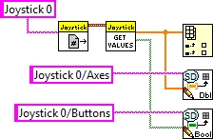

Teleop Block Diagram Continued
Teleop is the perfect place to read driver inputs like the joystick.
It is our opinion that there are other places in the code that are better for processing those inputs. We will want to cut out the following piece of code and save it to paste in a later VI where the functionality could also be available for the autonomous.

Slide 25
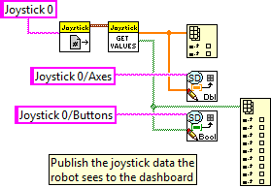
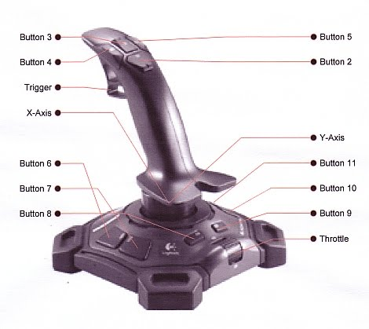
Reading the Joystick
The joystick already has the x and y axis placed in an indexed array. We also want to index an array for the buttons so we can interact with them too.
On the functions palette > array sub-palette > select index array and place it on the block diagram.
Splice the green array wire from the Get Values.vi into the index function.
Pull down the bottom of the index array symbol to see enough indices to account for the number of buttons on your joystick. (Usually 12.)

Slide 26
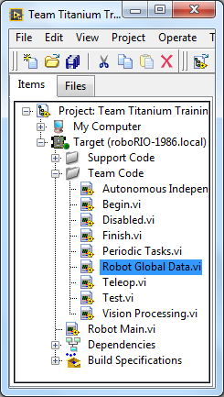
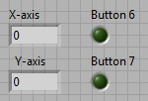
Global Variables
When we read the axis and buttons from the joystick we want to make those values available to other VI’s for processing. Global Variables are a great way to communicate between separate VI’s within a project.
There is already a front panel dedicated to global variables called Robot Global Data.vi. Open that VI from the Project Explorer.
There are 3 Global Variables currently in our project, and their data is stored here. (Enable Vision, Image Size, and Robot Mode). We want to add 4 more for our simple project.
  Numeric Indicator labeled X-axis
  Numeric Indicator labeled Y-axis
  Boolean Indicator labeled button 6
  Boolean Indicator Labeled button 7

Slide 27
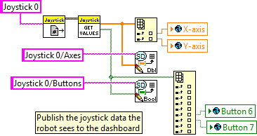
Global Variables Continued
It is possible to have more than one Front Panel of global variables. This is usually not desirable.
In Teleop… Right click on the block diagram to access the functions palette and choose “select a vi”. Navigate to where you have saved this project and select Robot Global Data.vi. This should bring in a global variable
Make 3 more copies of this global variable.
Right click on each of the copies and set them to write to the 4 global indicators we set up previously.
Then wire them to the appropriate array indices.

Slide 28
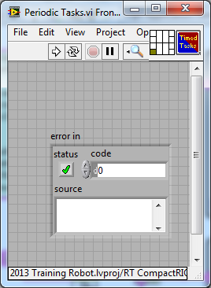
Periodic Tasks Front Panel
In Robot Main “Periodic Tasks” is called Timed Tasks on the icon and is located outside of any looping structure at the bottom of the Block Diagram.
  Double click to open Periodic Tasks.
This is the VI where we will develop all of our functionality!
This loop runs during autonomous and teleop, so functions developed here can be used in both parts of the game.
There is nothing to change on the Front Panel. Hit control-E to open the Block Diagram.

Slide 29

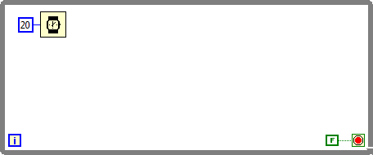
Periodic Tasks Block Diagram
There is some sample code to help teams get started. We want to erase all of it except for the error in. Error in is an expected input wired in Robot Main.
Because Periodic Tasks is not in a loop, all of the code we write must be placed in while loops if we expect it to run repeatedly during a match. (This is different than teleop.)
Create a new while loop with a 20 ms wait, and a false constant wired to the stop condition.

Slide 30
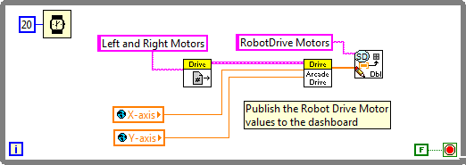
Modifying Periodic Tasks
Place the drive code we cut out of Teleop into the loop. (Recreate it if necessary)
Use the select vi function to create 2 copies of a global variable and set them to read the X-axis and Y-axis variables. Wire those variables into the x and y inputs on the arcade drive vi.
Why 20 ms wait? Remember teleop is not updating our X and Y joystick values any faster than that. In Begin we also have a safety config that needs to be updated at least every 100 ms before it shuts down the motors.

Slide 31
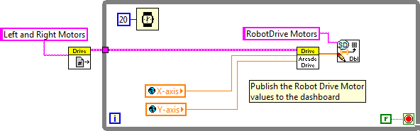
In or Out?
In the interest of efficiency (the code will run either way) drag the Drive get.vi along with it’s string constant outside of the while loop and reconnect it.
This is not a value that changes, so it can be processed once when the VI starts instead of every 20 ms!
We want every function in a separate while loop so that errors in one function will not affect the rest of the code.
Create another while loop, this time with a 100 ms wait and a false constant.

Slide 32
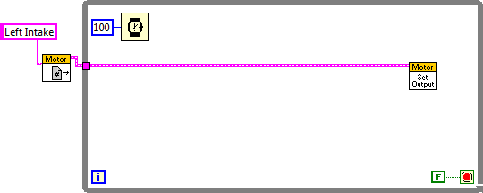
Designing a Function
We began a 3rd motor earlier, and we want to program it to use buttons 6 and 7 to turn clockwise or counterclockwise.
Use the WPI library to get a Motor Get and a Motor Set Output VI. Put the Get just outside the loop and make a string constant with the name of the motor
  It is vital that we remember exactly what we named the motor in Begin and spell it the same way here.
  Wire the Motor Get to the Motor Set Output.

Slide 33
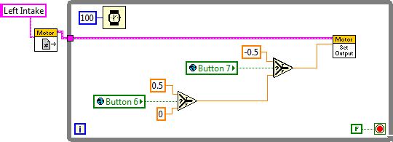
Button Logic
Put in two Global Variables set to read button 6 and 7.
Use a couple of selects to have the motor Set Output go forward when button 6 is pressed (at 50% power) and backwards when button 7 is pressed.
Logic question… If both buttons are pressed what will the motor do?
If both buttons are pressed button 7 will win and the indicator lights on the speed controller should indicate backwards movement.

Slide 34
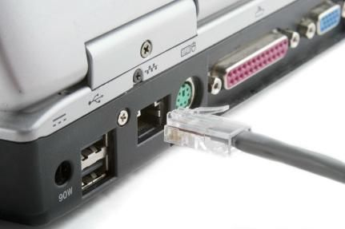
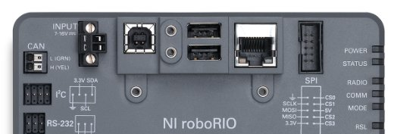
Tethering the Robot
We’ve completed everything in the program except for the autonomous. Let’s run it on the actual robot and see it come to life.
Connect an Ethernet cable or USB from your laptop to the roboRIO. This is called tethering the robot. In the competition we would run off of a wireless signal, and FIRST provides excellent documentation on how to do that.
We need to set your laptop up to communicate directly to the roboRIO.
  Open your “Network and Sharing Center”
  Select “Change Adaptor Settings”
  Disable the wireless and Enable the Local Area Connection
  The robot should automatically connect. (If it’s turned on.)

Slide 35

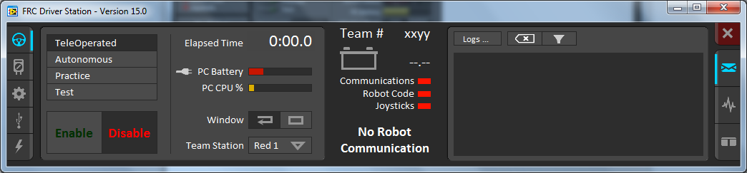

Driver’s Station
Open the Driver’s Station from your list of programs.
Hit OK to allow it to make changes to the computer and then the following should pop up. Make sure the joystick/gamepad is plugged into a USB port.
Hit the Settings tab on the left and type in your team number then hit enter.
Your Team number should show up at the top of the Driver Station in place of xxyy and the communications light should turn green after a few moments. (mDNS)
If they do not turn green, close and restart the drivers station.

Slide 36

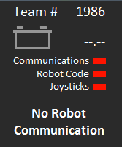
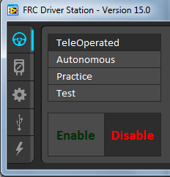
Running in Debug
We are going to run the code from the Laptop. Sometimes this is called running in debug. For competition we would have to build (compile) the code and deploy it to the roboRIO.
Go to the Robot Main Front Panel and hit the run arrow. Code will be temporarily built and sent to the roboRIO, but won’t start to run yet.
Sometimes this process takes a while and we may have some Conflict Resolution. Hitting “OK” usually takes care of this.
When your robot is ready to run battery should have a voltage number and all 3 status lights should go from red to green.
Make sure we are in “Teleoperated” and hit “Enable”.
“Enter” on the keyboard is a hot key to disable the robot if needed.

Slide 37
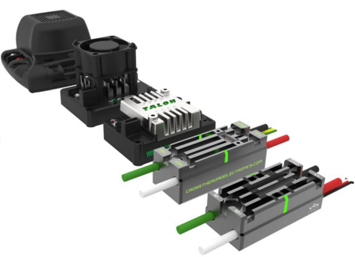
Driver Control
Now that the code is running try moving the joystick. (You may want to put the robot on blocks) The wheels should respond to forward, back, and turning joystick commands.
Holding buttons 6 and/or 7 should trigger some status lights on the motor controller we assigned. (The motor may move unless it has been unplugged.)
Status lights for all controllers should be:
  Solid green if 100% forward power
  Blinking green if less that 100% forward power
  Solid Orange if signal is within deadband (neutral)
  Blinking Orange if disabled or PWM signal is lost.
  Solid red if 100% reverse power
  Blinking red if less than 100% reverse power

Slide 38

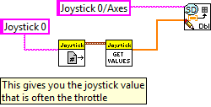
Autonomous Control
Hit Finish on the Robot Main Front Panel to stop running the code.
If all the functions that the driver controls are in Periodic Tasks, then we can utilize those same functions during the autonomous. Instead of letting the joystick determine the state of each variable, we will control them directly.
During Autonomous the initial state of the driver station is read, and then locked, so they will not be causing a race condition for us. When teleop starts the driver station will again start writing to those variables.
In Robot Main open up the Autonomous Independent VI.
Hit control-E to open up the Block Diagram and erase both disable structures and the joystick block. That should clear everything off of the front panel as well.

Slide 39
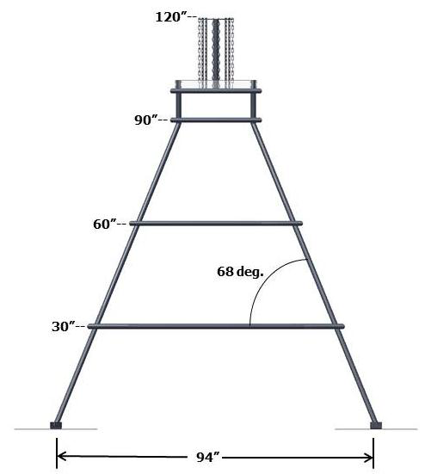
Model the Autonomous
Find a way to model the autonomous and work out the timing, angles, and distances.
25 degrees

Slide 40
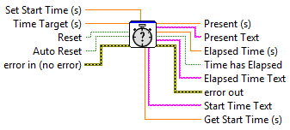
Autonomous Script
Autonomous can be thought of like a story board where every scene is a while loop. Let’s create an autonomous that does the following:
  Drive Forward while turning our intake motor clockwise
  Stop intake, but keep driving forward.
  Stop driving forward and run intake in reverse.
  Stop intake and wait for autonomous to finish.
That is going to require 4 while loops, and since we do not have sensors programmed to track how far the drive train has traveled we will have to rely on timing.
Reminder that the timing VI we want is elapsed time, and we are interested in the Time Target (s) input and Time has Elapsed output.
It normally comes in as a large image, make sure and reduce it to an icon.

Slide 41
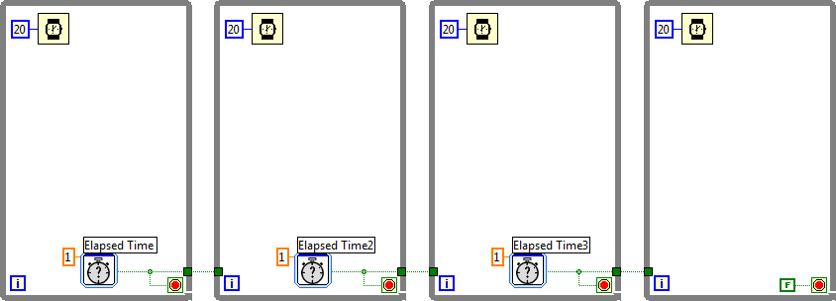
Autonomous Script Continued
Put 4 while loops in sequence (Use the Boolean wire to force the sequence by tying it to the next loop.) and place a 20 ms wait in each. Wire an Elapsed Time vi to the first 3 stop terminals and wire the last stop terminal to a constant false.
Now we will plan out the logic.

Slide 42
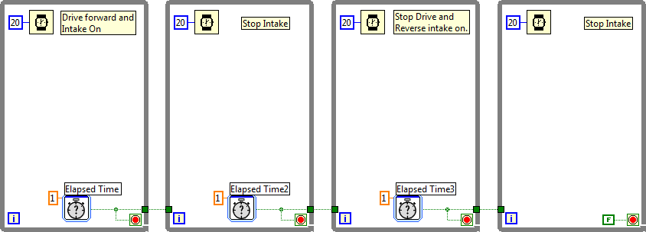
Spelling it Out
Put comments in each loop to spell out what is going to happen.
Now all we need to do is pretend the driver is operating the robot and mimic his actions with the variables they would trigger.

Slide 43
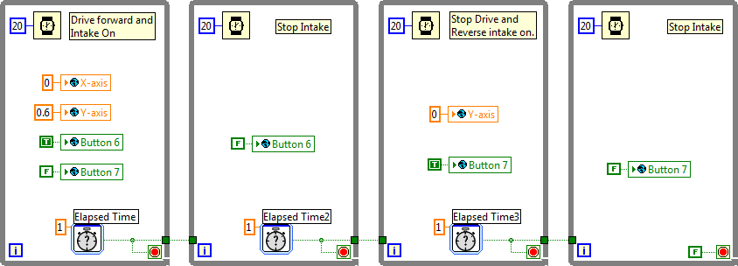
Coding it up
Use global variables to mimic the driver inputs needed to run the autonomous.
Our last step is to get the timing right for each loop.

Slide 44

Adjusting the Timing
Adjust the time each loop will run before moving on
  4 seconds for the first loop
  3 seconds for the second loop
  5 seconds for the third loop
The last loop will continue to run until autonomous ends.
  Note: There is some antidotal evidence that suggests allowing the autonomous sequence to end before the FMS officially ends the autonomous period may cause an error.

Slide 45
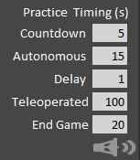
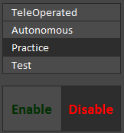
Run a Practice Match
In the settings tab on the driver’s station make sure Autonomous is set for 15 seconds.
Go to the operations tab and select Practice.
Hit the run arrow on Robot Main to load the code in Debug mode
When the robot is ready (maybe on blocks?) press Enable on the Operations tab on the Driver Station.
Did the autonomous do what we expected?
Did the robot enter into Teleop after autonomous ended?

Slide 46
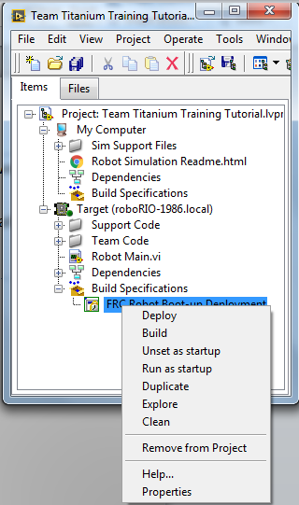
Build and Run as Startup
In order for us to compete (and for the drivers to practice without the programmers) we want to transfer the code permanently to the roboRIO.
Go to the Project Explorer Window and under Build Specifications right-click on FRC Robot Boot-up Deployment.
We need to Build the code first. The programming computer does not need to be connected to the robot for this.
Once the code is built (and this may take some time) select Run as startup. This should deploy the code to the roboRIO. We do need to be connected to the robot for this step.
Note: This last step does overwrite whatever code was on the roboRIO previously.

Slide 47
On Your Own
Find an additional feature on your old robot and develop code to get it to operate.
  Read a sensor like a gyro or encoder.
  Get the compressor to work if you have one installed.
  Get a pneumatic solenoid to fire on a button press.
  Other mentor approved component.
Warning: Some mechanisms may involve motors which can move parts of a robot through a hard limit (Like running an elevator through a mechanical stop.) Have a plan for testing your code without destroying your robot!

Slide 48
Congratulations!
You’ve Completed
The FRC Robot Project Tutorial

Slide 49
FRC Robot Project Structure Recap
  Robot Main (Organizational Structure for the Code. Do Not Modify!)
  Begin (Tell the program where everything is located on the robot and what you will refer to it as in the code)
  Finish (Close everything you opened in Begin)
  Teleop (Read driver inputs)
  Robot Global Data (Store variables that can be written to and read from any vi in the project)
  Periodic Tasks (Robot Functions!)
  Autonomous Independent (10 or 15 seconds of scripted robot actions)

