Slide 1
EQS_Backtesting & Comparing GSMF Portfolio.
University of Massachusetts Boston
MBA AF 632 Asset Mgmt Practicum
Fall 2017

Slide 2

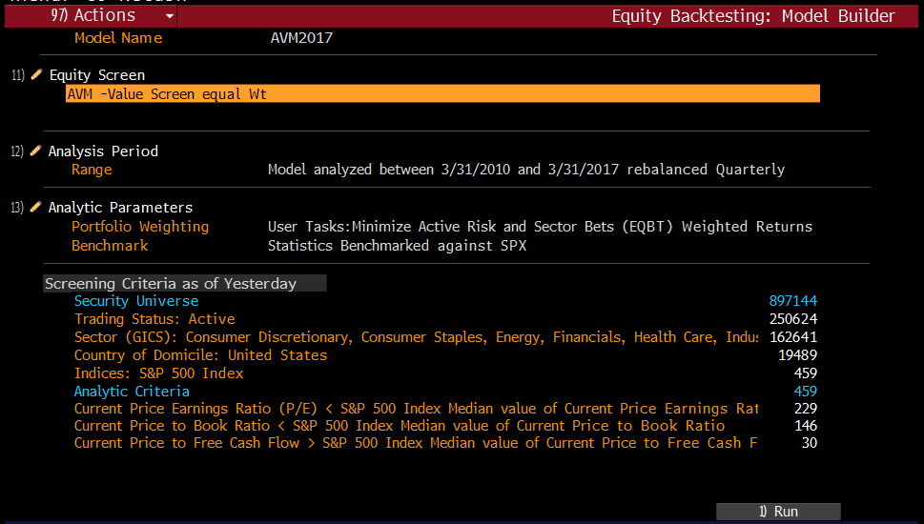
EQS Backtesting: Model Builder

Slide 3
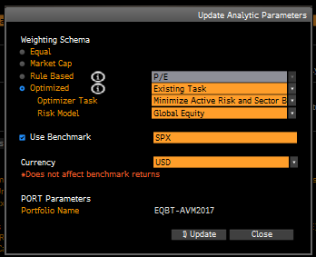
EQS Backtesting: Model Builder

Slide 4
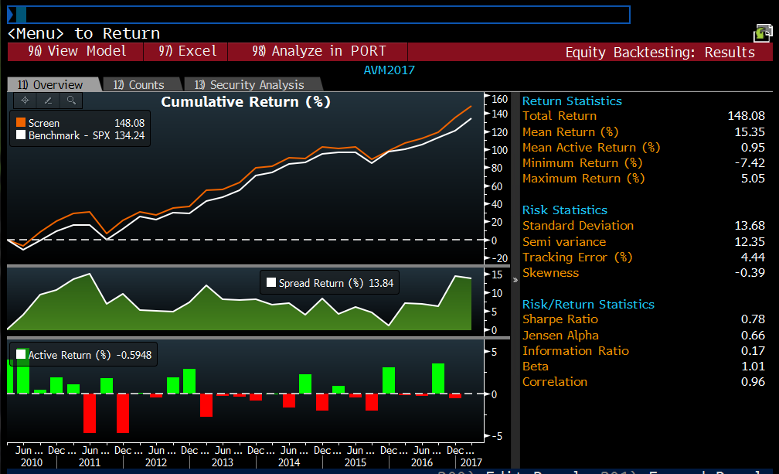
EQS: Backtesting Results
Active
Risk
Low tracking error means a portfolio is closely following its benchmark. High tracking errors indicates the opposite.

Slide 5
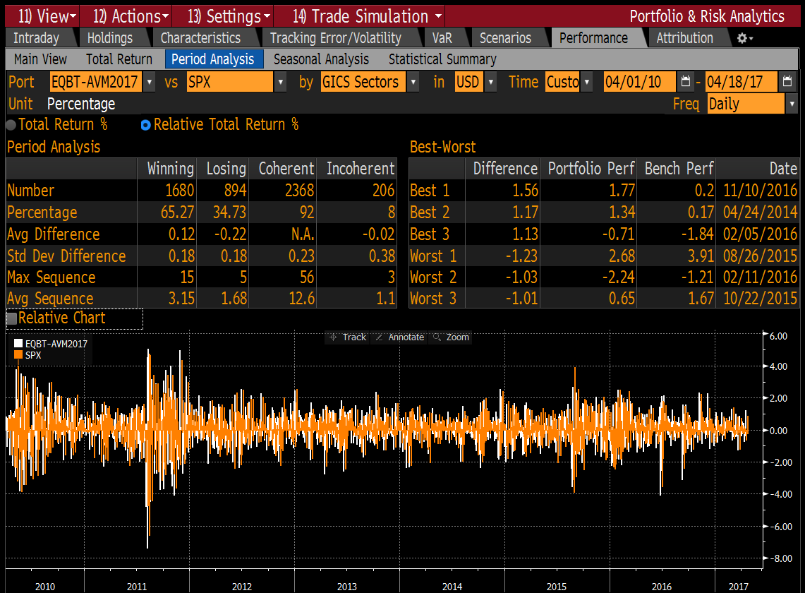
Portfolio & Risk Analytics
Period Analysis

Slide 6
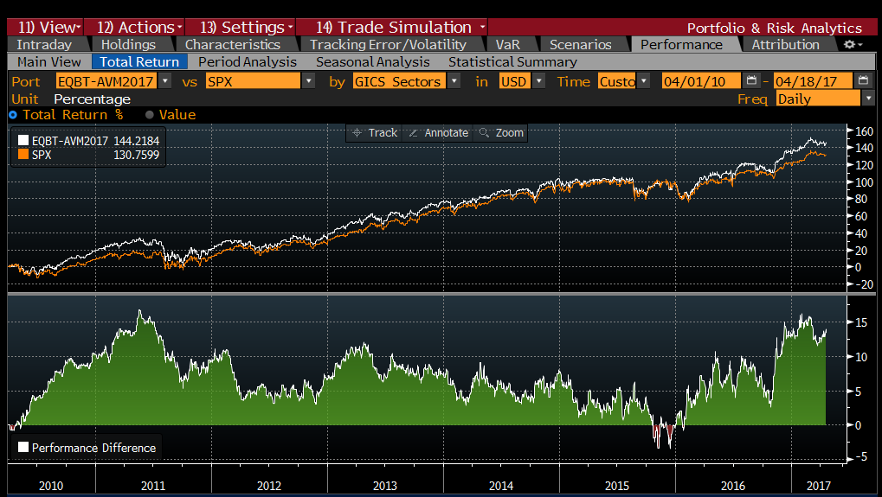
Value Screener v/s SP500
Performance - Total Return

Slide 7
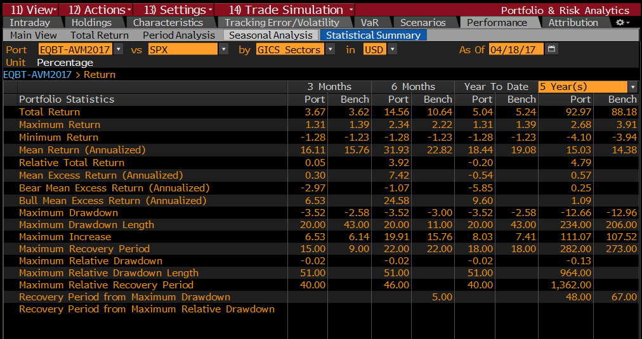
Value Screener v/s SPX
Performance - Statistical Summary

Slide 8
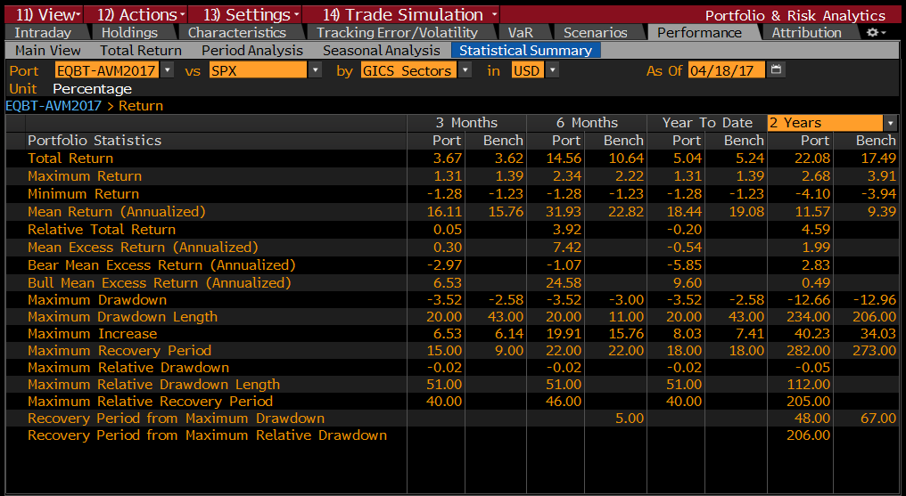
Return - Analysis
Statistical Summary (continue)

Slide 9
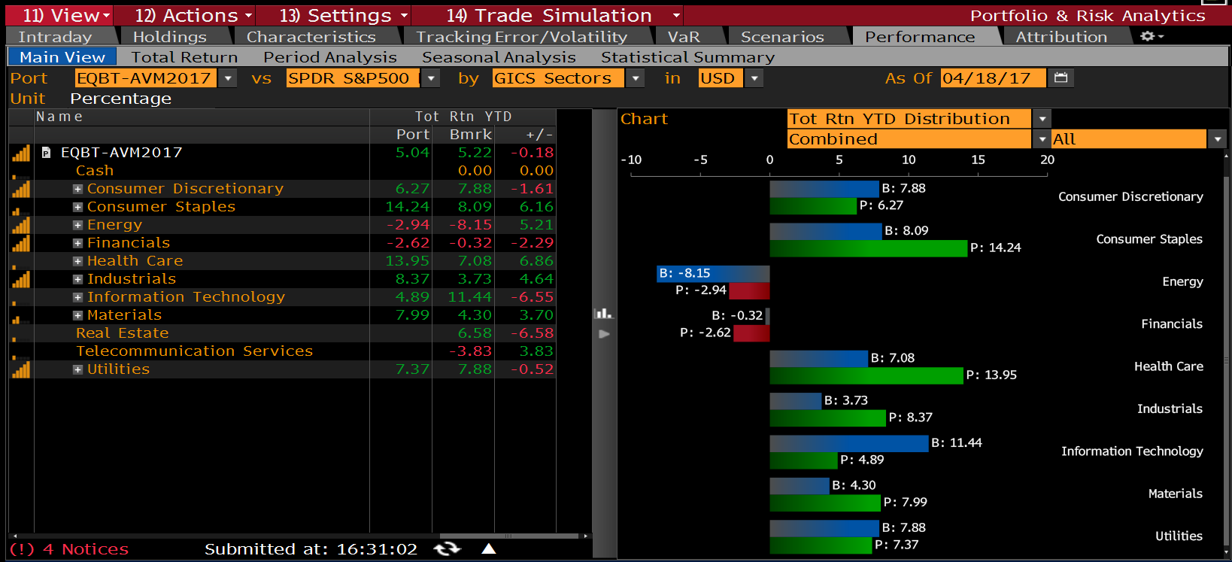
Portfolio & Risk Analytics
AVM screener v/s SPX

Slide 10
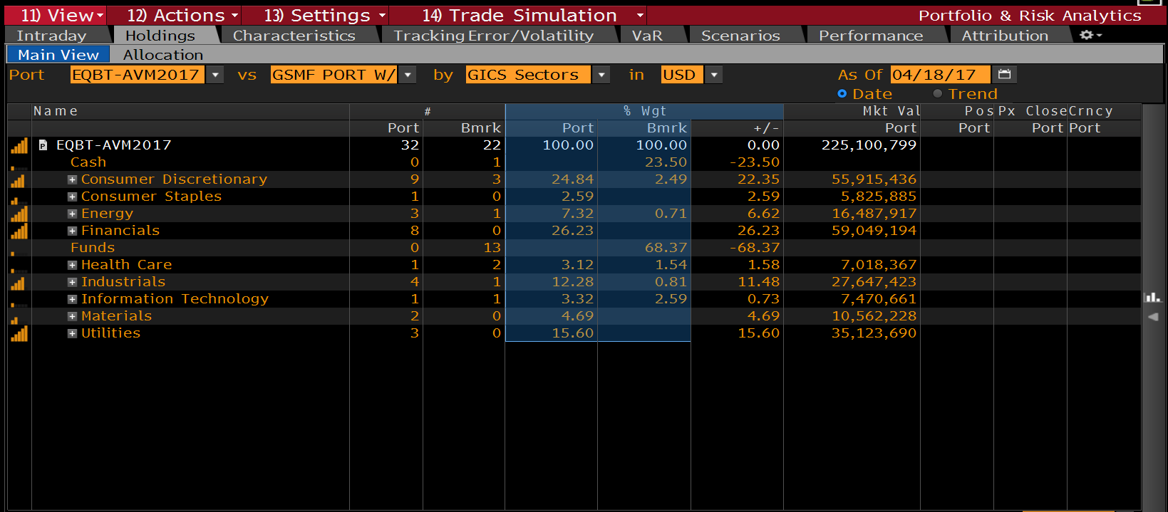
Portfolio & Risk Analytics
AVM screener v/s GSMF Portfolio

Slide 11
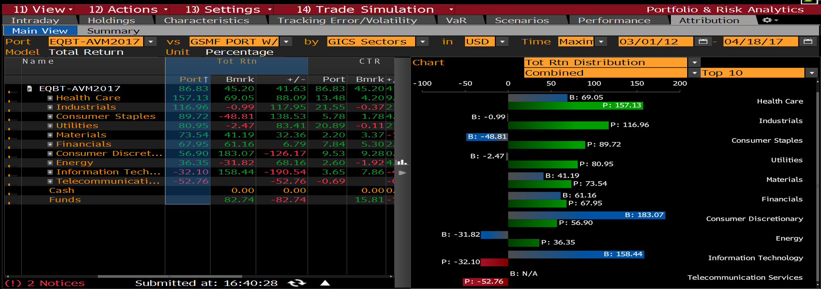
Portfolio & Risk Analytics
AVM screener v/s GSMF Portfolio

Slide 12
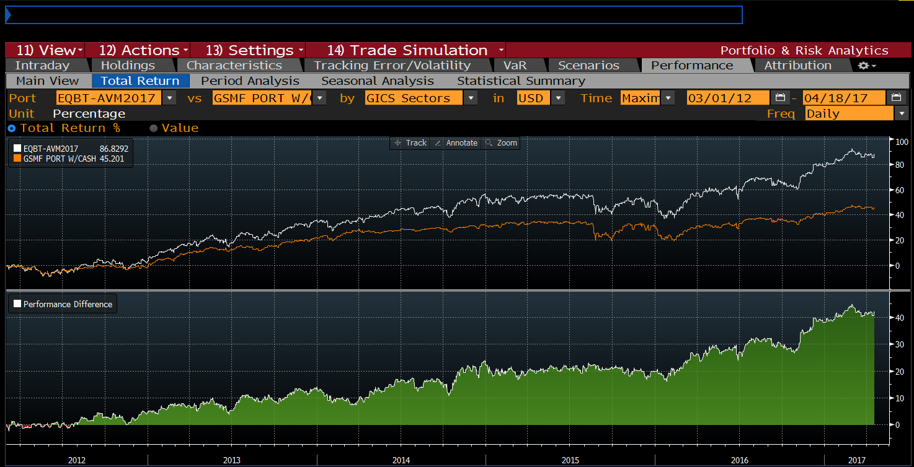
Portfolio & Risk Analytics
Total Return – Graphical Representation.
Value Screen
GSMF

Slide 13
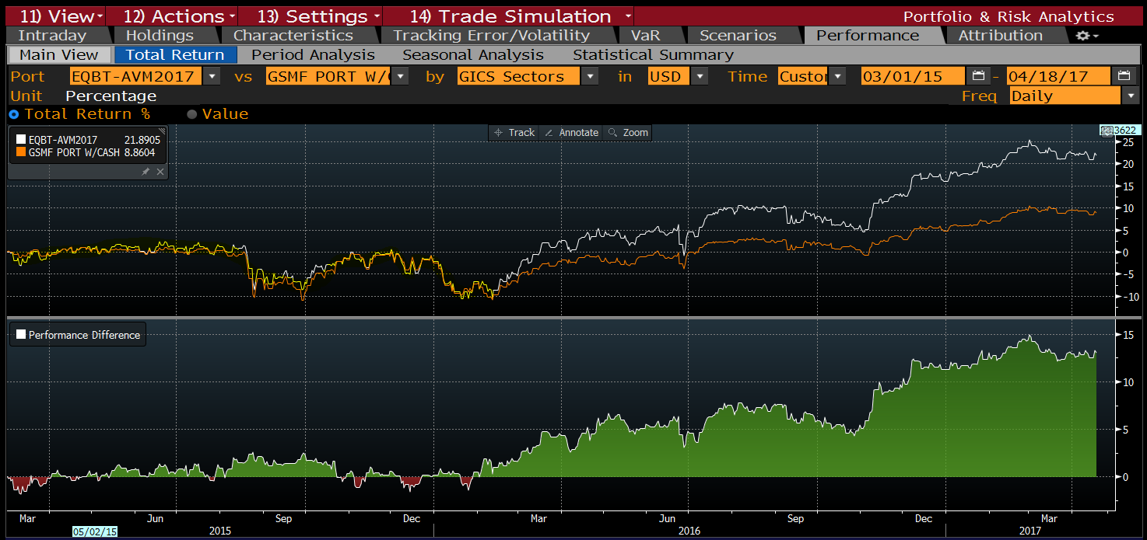
Portfolio & Risk Analytics
Value strategy (AVM screener) vs individual stock picking (GSMF)
Value Investing Strategy
Value Investing
Mixed Strategy
Opportunity to Improve

