Slide 1


be Simple present Être
I am
you are
he, she,it is
we are
you are
they are

Slide 2
be Present progressive être
I am being
you are being
he/she/it is being
we are being
you are being
they are being
Now

Slide 3

be (Simple past) être
I was
you were
he, she,it was
we were
you were
they were
X

Slide 4
X
be (Simple future) être
I will be
you will be
he, she,it will be
we will be
you will be
they will be

Slide 5
have Simple present Avoir
I have
you have
he, she,it has
we have
you have
they have

Slide 6
have Present progressive Avoir
I am having
you are having
he/she/it is having
we are having
you are having
they are having
Now

Slide 7
X
have (Simple past) Avoir
I had
you had
he/she/it had
we had
you had
they had

Slide 8
have (Simple future) Avoir
I will have
you will have
he/she/it will have
we will have
you will have
they will have
X

Slide 9
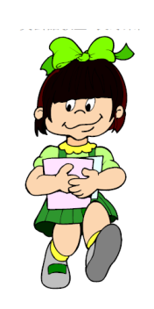
Walk (Simple present) marcher
I walk
you walk
he/she/it walks
we walk
you walk
they walk

Slide 10
walk (Present progressive) marcher
I am walking
you are walking
he/she/it is walking
we are walking
you are walking
they are walking
Now

Slide 11
Walk (Simple past) marcher
I walked
you walked
he/she/it walked
we walked
you walked
they walked
X

Slide 12
Walk (Simple future) marcher
I will walk
you will walk
he/she/it will walk
we will walk
you will walk
they will walk
X

Slide 13

run (Simple present) courir
I run
you run
he/she/it runs
we run
you run
they run

Slide 14
run (Present progressive) courir
I am running
you are running
he/she/it is running
we are running
you are running
they are running
Now

Slide 15
X
run (Simple past) courir
I ran
you ran
he/she/it ran
we ran
you ran
they ran

Slide 16
run (Simple future) courir
I will run
you will run
he/she/it will run
we will run
you will run
they will run
X

Slide 17
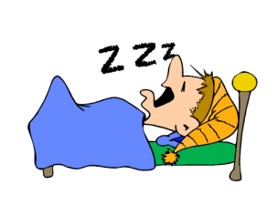
sleep (Simple present) dormir
I sleep
you sleep
he/she/it sleeps
we sleep
you sleep
they sleep

Slide 18
sleep (Present progressive) dormir
I am sleeping
you are sleeping
he/she/it is sleeping
we are sleeping
you are sleeping
they are sleeping
Now

Slide 19
X
sleep (Simple past) dormir
I slept
you slept
he/she/it slept
we slept
you slept
they slept

Slide 20
sleep (Simple future) dormir
I will sleep
you will sleep
he/she/it will sleep
we will sleep
you will sleep
they will sleep
X

Slide 21
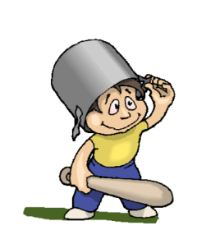
play (Simple present) jouer
I play
you play
he/she/it plays
we play
you play
they play

Slide 22
Now
Play (Present progressive) jouer
I am playing
you are playing
he/she/it is playing
we are playing
you are playing
they are playing

Slide 23
X
play (Simple past) jouer
I played
you played
he/she/it played
we played
you played
they played

Slide 24
X
Play (Simple future) jouer
I will play
you will play
he/she/it will play
we will play
you will play
they will play

Slide 25

read (Simple present) lire
I read
you read
he/she/it reads
we read
you read
they read

Slide 26
Now
read (Present progressive) lire
I am reading
you are reading
he/she/it is reading
we are reading
you are reading
they are reading

Slide 27
read (Simple past) lire
I read
you read
he/she/it read
we read
you read
they read
X

Slide 28
read (Simple future) lire
I will read
you will read
he/she/it will read
we will read
you will read
they will read
X

Slide 29

write (Simple present) écrire
I write
you write
he/she/it writes
we write
you write
they write

Slide 30
Now
Write (Present progressive) écrire
I am writing
you are writing
he/she/it is writing
we are writing
you are writing
they are writing

Slide 31
write (Simple past) écrire
I wrote
you wrote
he/she/it wrote
we wrote
you wrote
they wrote
X

Slide 32
write (Simple future) écrire
I will write
you will write
he/she/it will write
we will write
you will write
they will write
X

Slide 33

talk (Simple present) parler
I talk
you talk
he/she/it talks
we talk
you talk
they talk

Slide 34
Now
Talk (Present progressive) parler
I am talking
you are talking
he/she/it is talking
we are talking
you are talking
they are talking

Slide 35
talk (Simple past) parler
I talked
you talked
he/she/it talked
we talked
you talked
they talked
X

Slide 36
X
Talk (Simple future) parler
I will talk
you will talk
he/she/it will talk
we will talk
you will talk
they will talk

Slide 37
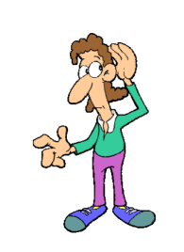
listen (Simple present) écouter
I listen
you listen
he/she/it listens
we listen
you listen
they listen

Slide 38
listen (Present progressive) écouter
I am listening
you are listening
he/she/it is listening
we are listening
you are listening
they are listening
Now

Slide 39
listen (Simple past) écouter
I listened
you listened
he/she/it listened
we listened
you listened
they listened
X

Slide 40
listen (Simple future) écouter
I will listen
you will listen
he/she/it will listen
we will listen
you will listen
they will listen
X

Slide 41

jump (Simple present) sauter
I jump
you jump
he/she/it jumps
we jump
you jump
they jump

Slide 42
jump (Present progressive) sauter
I am jumping
you are jumping
he/she/it is jumping
we are jumping
you are jumping
they are jumping
Now

Slide 43
jump (Simple past) sauter
I jumped
you jumped
he/she/it jumped
we jumped
you jumped
they jumped
X

Slide 44
jump (Simple future) sauter
I will jump
you will jump
he/she/it will jump
we will jump
you will jump
they will jump
X

Slide 45
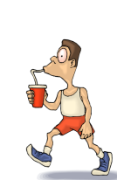
drink (Simple present) boire
I drink
you drink
he/she/it drinks
we drink
you drink
they drink

Slide 46
drink (Present progressive) boire
I am drinking
you are drinking
he/she/it is drinking
we are drinking
you are drinking
they are drinking
Now

Slide 47
drink (Simple past) boire
I drank
you drank
he/she/it drank
we drank
you drank
they drank
X

Slide 48
drink (Simple future) boire
I will drink
you will drink
he/she/it will drink
we will drink
you will drink
they will drink
X

Slide 49
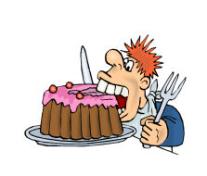
eat (Simple present) manger
I eat
you eat
he/she/it eats
we eat
you eat
they eat

Slide 50
eat (Present progressive) manger
I eating
you eating
he/she/it eating
we eating
you eating
they eating
Now

Slide 51
eat (Simple past ) manger
I ate
you ate
he/she/it ate
we ate
you ate
they ate
X

Slide 52
eat (Simple future) manger
I will eat
you will eat
he/she/it will eat
we will eat
you will eat
they will eat
X

Slide 53
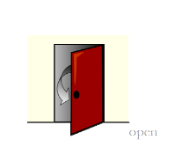
open (Simple present) ouvrir
I open
you open
he/she/it opens
we open
you open
they open

Slide 54
open (Present progressive) ouvrir
I opening
you opening
he/she/it opening
we opening
you opening
they opening
Now

Slide 55
open (Simple past ) ouvrir
I opened
you opened
he/she/it opened
we opened
you opened
they opened
X

Slide 56
open (Simple future) ouvrir
I will open
you will open
he/she/it will open
we will open
you will open
they will open
X

Slide 57

close (Simple present) fermer
I close
you close
he/she/it closes
we close
you close
they close

Slide 58
close (Present progressive) fermer
I closing
you closing
he/she/it closing
we closing
you closing
they closing
Now

Slide 59
close (Simple past ) fermer
I closed
you closed
he/she/it closed
we closed
you closed
they closed
X

Slide 60
close (Simple future) fermer
I will close
you will close
he/she/it will close
we will close
you will close
they will close
X

