Slide 1


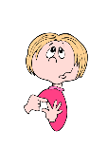
count Simple present compter
I count
you count
he, she,it counts
we count
you count
they count

Slide 2
Now
count (Present progressive) compter
I am counting
you are counting
he/she/it is counting
we are counting
you are counting
they are count ing

Slide 3

count (Simple past) compter
I counted
you counted
he, she,it counted
we counted
you counted
they counted
X

Slide 4
X
count (Simple futur) compter
I will count
you will count
he, she,it will count
we will count
you will count
they will count

Slide 5
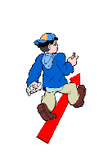
go Simple present aller
I go
you goes
he, she,it go
we go
you go
they go

Slide 6
go (Present progressive) aller
I am going
you are going
he/she/it is going
we are going
you are going
they are going
Now

Slide 7
go (Simple past) aller
I went
you went
he/she/it went
we went
you went
they went
X

Slide 8
X
go (Simple futur) aller
I will go
you will go
he/she/it will go
we will go
you will go
they will go

Slide 9
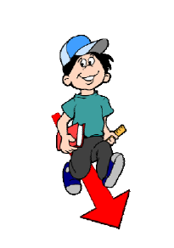
come (Simple present) venir
I come
you come
he/she/it comes
we come
you come
they come

Slide 10
come (Present progressive) venir
I am coming
you are coming
he/she/it is coming
we are coming
you are coming
they are coming
Now

Slide 11
come (Simple past) venir
I came
you came
he/she/it came
we came
you came
they came
X

Slide 12
X
come (Simple futur) venir
I will come
you will come
he/she/it will come
we will come
you will come
they will come

Slide 13
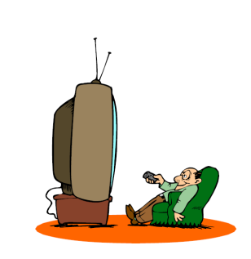
watch (Simple present) regarde
I watch
you watch
he/she/it watches
we watch
you watch
they watch

Slide 14
watch (Present progressive) regarder
I am watching
you are watching
he/she/it is watching
we are watching
you are watching
they are watching
Now

Slide 15
X
watch (Simple past) regarder
I watched
you watched
he/she/it watched
we watched
you watched
they watched

Slide 16
X
watch (Simple futur) regarder
I will watch
you will watch
he/she/it will watch
we will watch
you will watch
they will watch

Slide 17
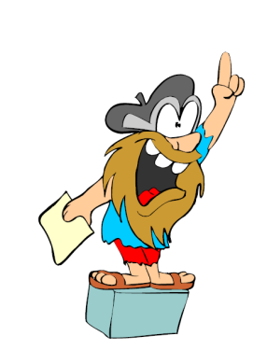
speak (Simple present) prendre la parole
I speak
you speak
he/she/it speaks
we speak
you speak
they speak

Slide 18
speak (Present progressive) prendre la parole
I am speaking
you are speaking
he/she/it is speaking
we are speaking
you are speaking
they are speaking
Now

Slide 19
X
speak (Simple past) prendre la parole
I spoke
you spoke
he/she/it spoke
we spoke
you spoke
they spoke

Slide 20
X
speak (Simple futur) prendre la parole
I will speak
you will speak
he/she/it will speak
we will speak
you will speak
they will speak

Slide 21
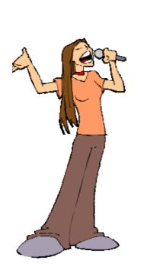
sing (Simple present) chanter
I sing
you sing
he/she/it sings
we sing
you sing
they sing

Slide 22
Now
sing (Present progressive) chanter
I am singing
you are singing
he/she/it is singing
we are singing
you are singing
they are singing

Slide 23
X
sing (Simple past) chanter
I sang
you sang
he/she/it sang
we sang
you sang
they sang

Slide 24
X
sing (Simple futur) chanter
I will sing
you will sing
he/she/it will sing
we will sing
you will sing
they will sing

Slide 25
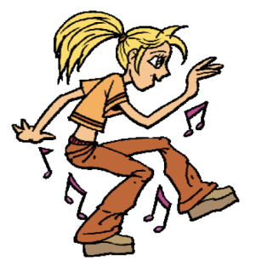
dance (Simple present) danser
I dance
you dance
he/she/it dances
we dance
you dance
they dance

Slide 26
Now
dance (Present progressive) danser
I am dancing
you are dancing
he/she/it is dancing
we are dancing
you are dancing
they are dancing

Slide 27
dance (Simple past) danser
I danced
you danced
he/she/it danced
we danced
you danced
they danced
X

Slide 28
X
dance (Simple futur) danser
I will dance
you will dance
he/she/it will dance
we will dance
you will dance
they will dance

Slide 29
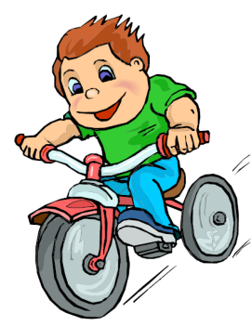
ride (Simple present) aller à (vélo, moto, cheval, etc.)
I ride
you ride
he/she/it rides
we ride
you ride
they ride

Slide 30
Now
ride (Present progressive) aller à (vélo, moto, cheval, etc.)
I am riding
you are riding
he/she/it is riding
we are riding
you are riding
they are riding

Slide 31
ride (Simple past) aller à (vélo, moto, cheval, etc.)
I rode
you rode
he/she/it rode
we rode
you rode
they rode
X

Slide 32
X
ride (Simple futur) aller à (vélo, moto, cheval, etc.)
I will ride
you will ride
he/she/it will ride
we will ride
you will ride
they will ride

Slide 33
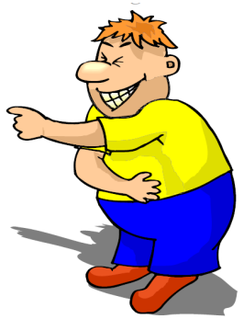
laugh (Simple present) rire
I laugh
you laugh
he/she/it laughs
we laugh
you laugh
they laugh

Slide 34
Now
laugh (Present progressive) rire
I am laughing
you are laughing
he/she/it is laughing
we are laughing
you are laughing
they are laughing

Slide 35
laugh (Simple past) rire
I laughed
you laughed
he/she/it laughed
we laughed
you laughed
they laughed
X

Slide 36
X
laugh (Simple futur) rire
I will laugh
you will laugh
he/she/it will laugh
we will laugh
you will laugh
they will laugh

Slide 37
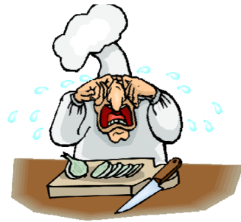
cry (Simple present) pleurer
I cry
you cry
he/she/it cries
we cry
you cry
they cry

Slide 38
cry (Present progressive) pleurer
I am crying
you are crying
he/she/it is crying
we are crying
you are crying
they are crying
Now

Slide 39
cry (Simple past) pleurer
I cried
you cried
he/she/it cried
we cried
you cried
they cried
X

Slide 40
X
cry (Simple futur) pleurer
I will cry
you will cry he/she/it will cry
we will cry
you will cry
they will cry

Slide 41
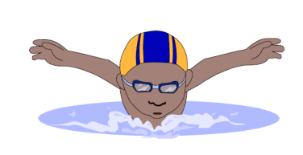
swim (Simple present) nager
I swim
you swim
he/she/it swims
we swim
you swim
they swim

Slide 42
swim (Present progressive) nager
I am swimming
you are swimming
he/she/it is swimming
we are swimming
you are swimming
they are swimming
Now

Slide 43
swim (Simple past) nager
I swam
you swam
he/she/it swam
we swam
you swam
they swam
X

Slide 44
X
swim (Simple futur) nager
I will swim
you will swim
he/she/it will swim
we will swim
you will swim
they will swim

